Slide 1
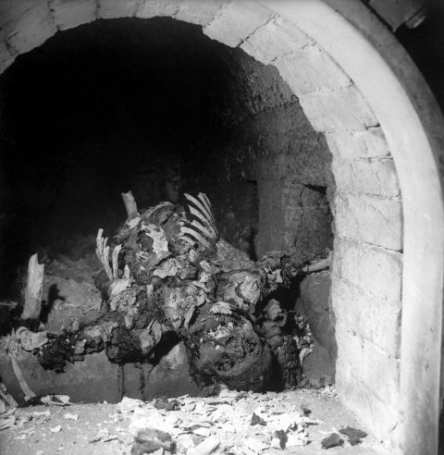
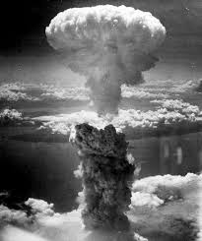
The Outcomes of WWII

Slide 2
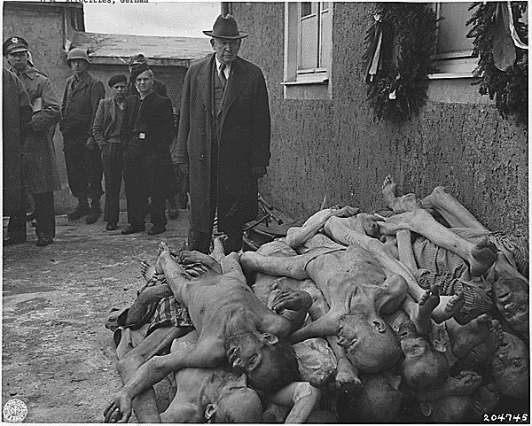
GENOCIDE
The systematic and purposeful destruction of a racial, political, religious or ethnic group
The FINAL SOLUTION targeted Jews, Gypsies, the Handicapped, and other groups the Nazis considered “inferior”

Slide 3
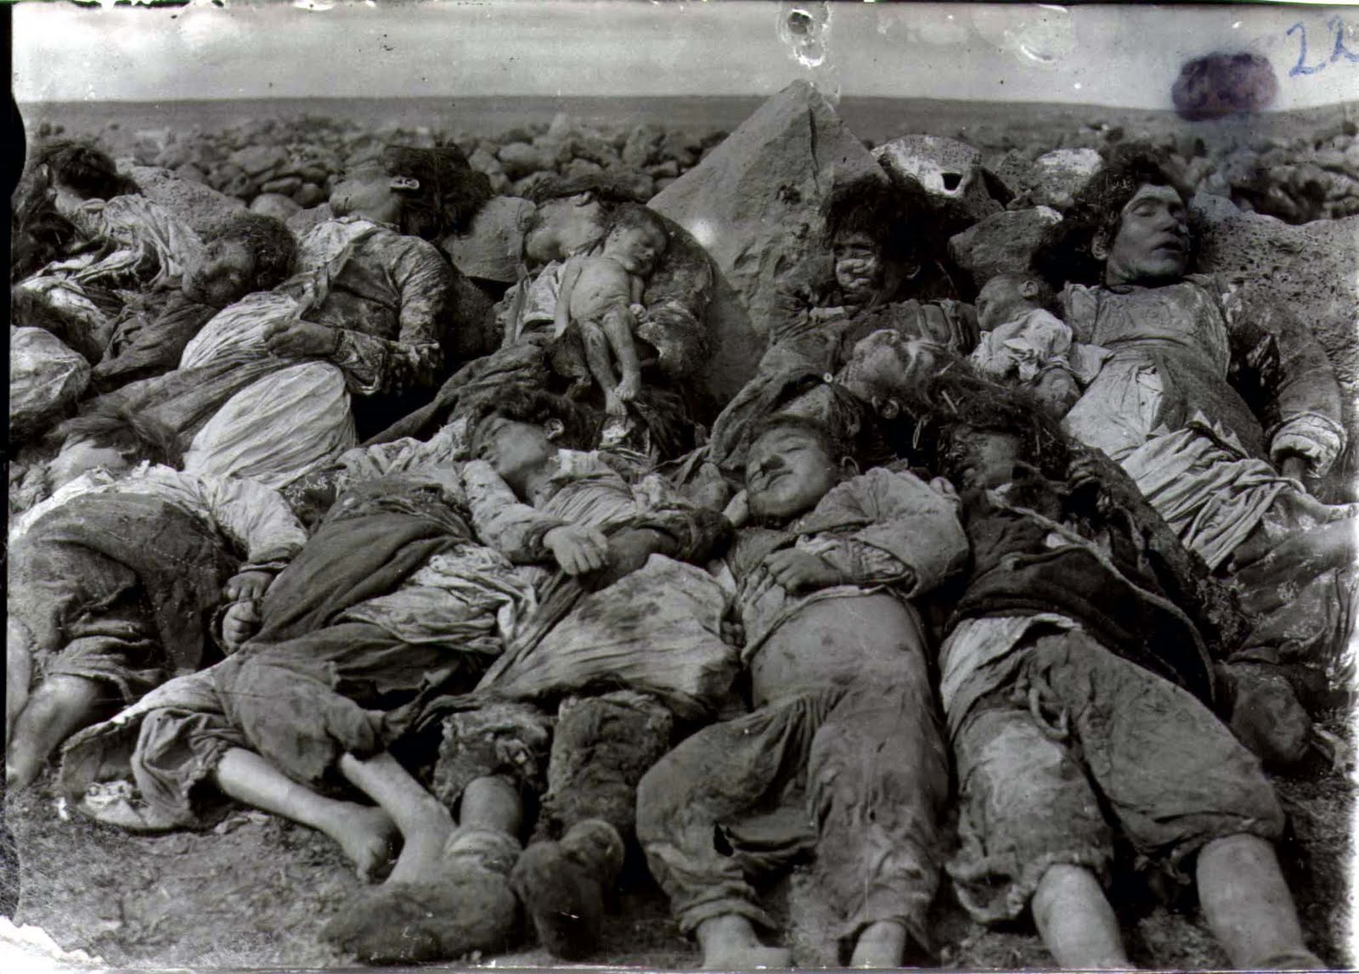
Besides the Holocaust, there are other examples of Genocide:
The Armenian Genocide (1915)

Slide 4
Armenian Genocide
1.5 Million Armenians killed by the Ottoman Empire (Turks) during WWI
The Armenians were an ethnic minority living inside Turkey.
They were systematically “deported” to the Syrian Desert where they were shot or left to die
In some cases they even used crucifixion as a method of killing!

Slide 5
Armenian girls killed by crucifixion

Slide 6
The Rwandan Genocide (1994)

Slide 7
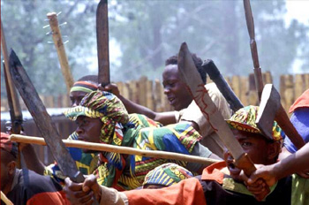
Rwandan Genocide
1 Million Tutsi (minority ethnic group) killed by the Hutu majority in 1994
The U.N. did not stop the killings
Primarily carried out by mobs of Hutus using machetes (long blades) to hack the Tutsi to death

Slide 8
Cambodian Genocide
In Cambodia, Pol Pot, leader of the Khmer Rouge massacred more than a million Cambodians.
His communist government made urban dwellers move to the countryside to work in collective farms and on forced labor projects.
The combined effects of executions, strenuous working conditions, malnutrition, and poor medical care caused the deaths of 25% of the Cambodian population in only four years.

Slide 9
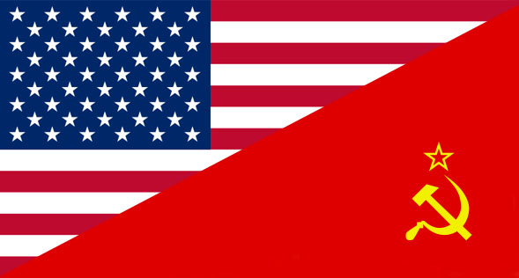
Land, Political Boundaries, and Power
Following the War, many European powers lost their empires! (Imperialism was ending!)
Two new “Super Powers” emerged at the end of the war!

Slide 10
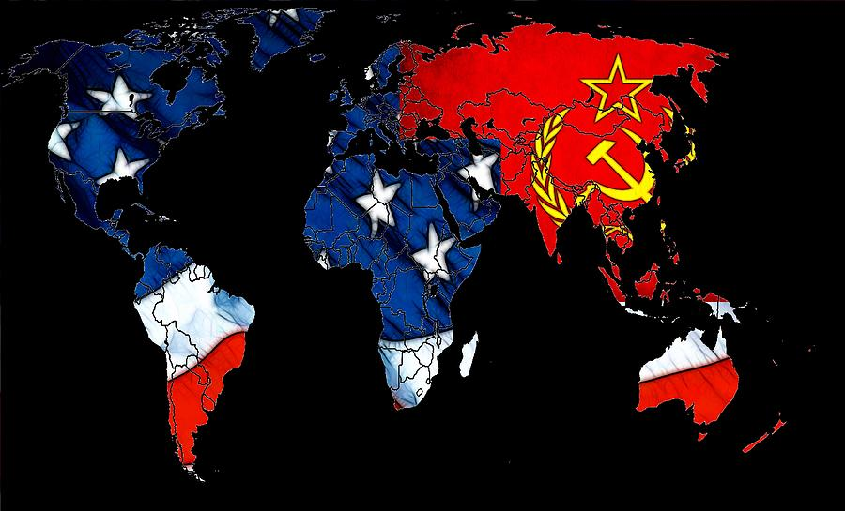
The US wanted a democratic world led by the US!
USSR wanted to spread Communism to other nations and lead them!
This became known as The Cold War!

Slide 11
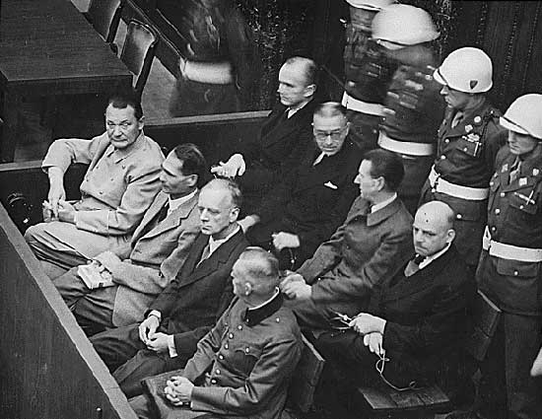
The Nuremberg Trials
Military tribunal (court) set up to put Nazi leaders on trial for war crimes
Charged with “crimes against humanity” (the murder of millions people
1946- 12 Nazi leaders were sentenced to death

Slide 12
Creation of The United Nations
Replaced the League of Nations!
Peace-Keeping organization…with a military!
Also has a Security Council: makes decisions on when to use the UN
Members: The U.S., Great Britain, France, China, and the Soviet Union

Slide 13
Germany Split in two!

Slide 14
TWO GERMANYS!
West Germany was Democratic
East Germany was Communist
The Capital: Berlin was located in East Germany
The Allies divided Berlin into West and East as well!
Stalin controlled East Germany and East Berlin
The U.S., France, and Great Britain occupied West Germany and West Berlin
Germany and Berlin divided among the 4 Allied Powers

Slide 16
Japan Occupied!
U.S. occupation of Japan under Douglas MacArthur’s administration
Japan became a Democracy (Constitutional Monarchy)
U.S. helped to develop Japan’s economy and rebuild
Japan’s military was eliminated!
Today, the U.S. provides Japan’s security
Today, Japan is a wealthy nation in Asia!

Slide 17
The Universal Declaration of Human Rights
Written by the United Nations
Establishes basic rights and freedoms for ALL human beings
Also creates a Code of Conduct for the treatment of people under the protection of their government

