Slide 1
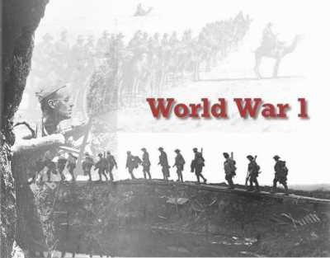

Slide 2
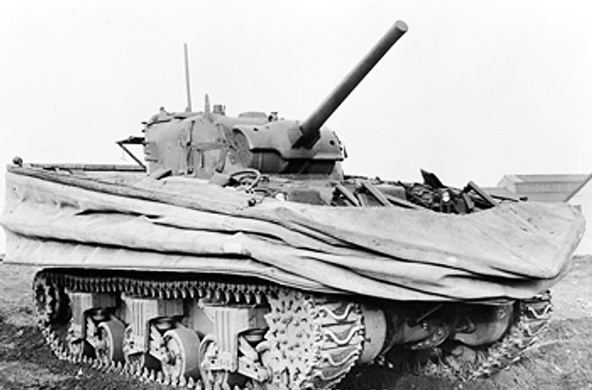
Causes of World War I
Militarism
The glorification of armed strength and the ideals of war
Each nation wanted a stronger military than a potential enemy!!
Massive armament began – the build up of a country’s military strength and weapons… very dangerous!

Slide 3
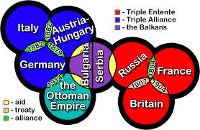
Causes of World War I
Alliance System
Defense Agreements
Triple Entente: Great Britain, France and Russia
Allies – when Italy and US join
Triple Alliance:
Germany, Italy and Austria-Hungary
Later called “Central Powers”

Slide 4
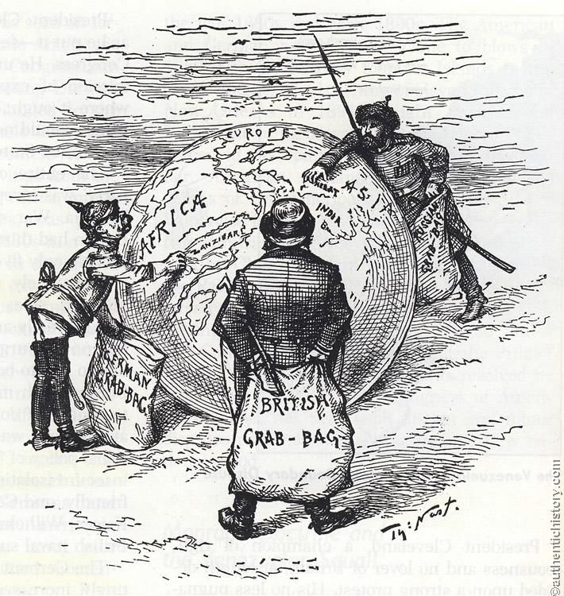
Causes of World War I
Imperialism
Stronger countries extending political and economic control over weaker countries
Provided raw materials and markets for manufactured goods

Slide 5
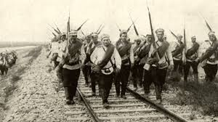
Causes of World War I
Nationalism
A devotion to the interests and cultures of one’s nation…putting your country before peaceful coexistence…dangerous!
Created competition for power and resentment among countries who were being controlled

Slide 6
Where’s Hitler? There he is!

Slide 7
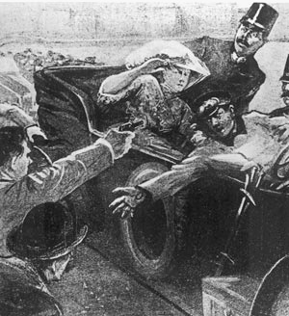
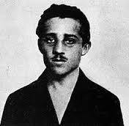
The immediate cause of WWI was…
… the assassination of Archduke Franz Ferdinand, heir to the Austrian throne.
Location of the Assassination: The Balkans Southeast European region of many different ethnic groups – partly controlled by the Austrian Empire and disputed over by Russia
The assassin, Gabrillo Princip

Slide 8
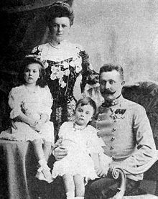
Austria’s Response
Outraged by the Archduke’s murder, and backed by German military support, Austria-Hungary submitted demands to Serbia or face war
Serbia, knowing it had full Russian military support, refused to accept Austria-Hungary’s demands
Austria-Hungary declared war on Serbia on July 28th

Slide 9
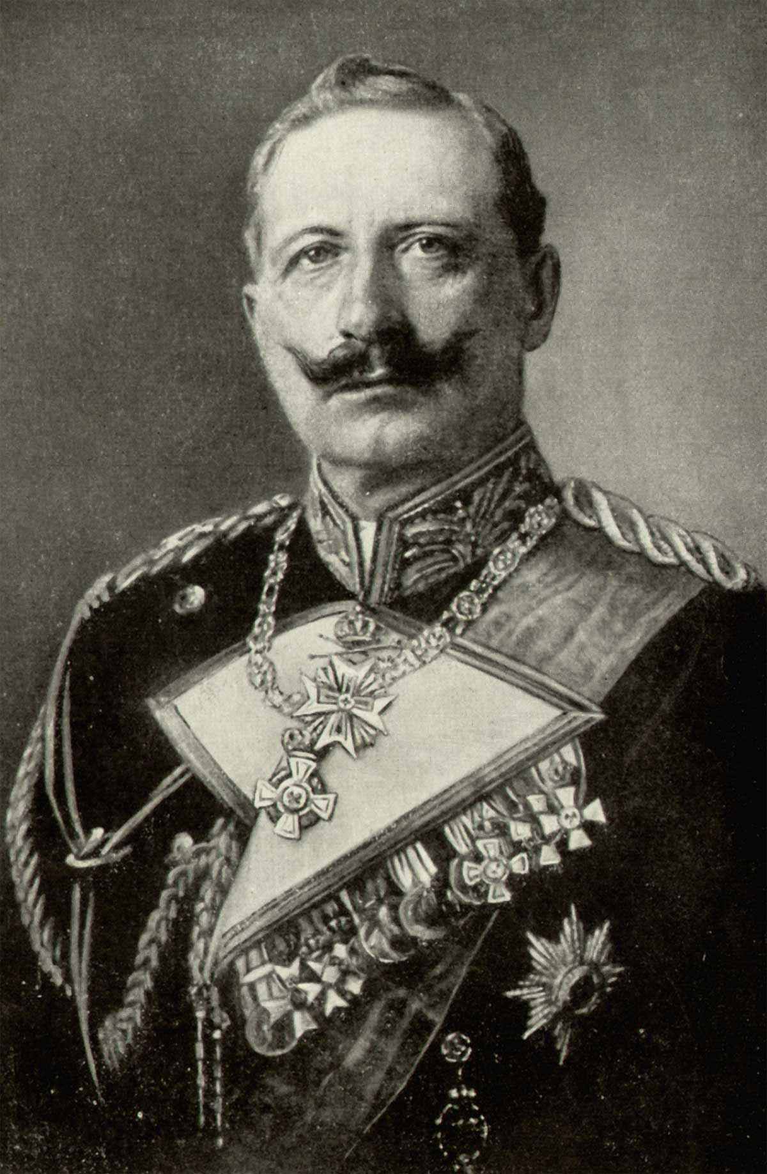
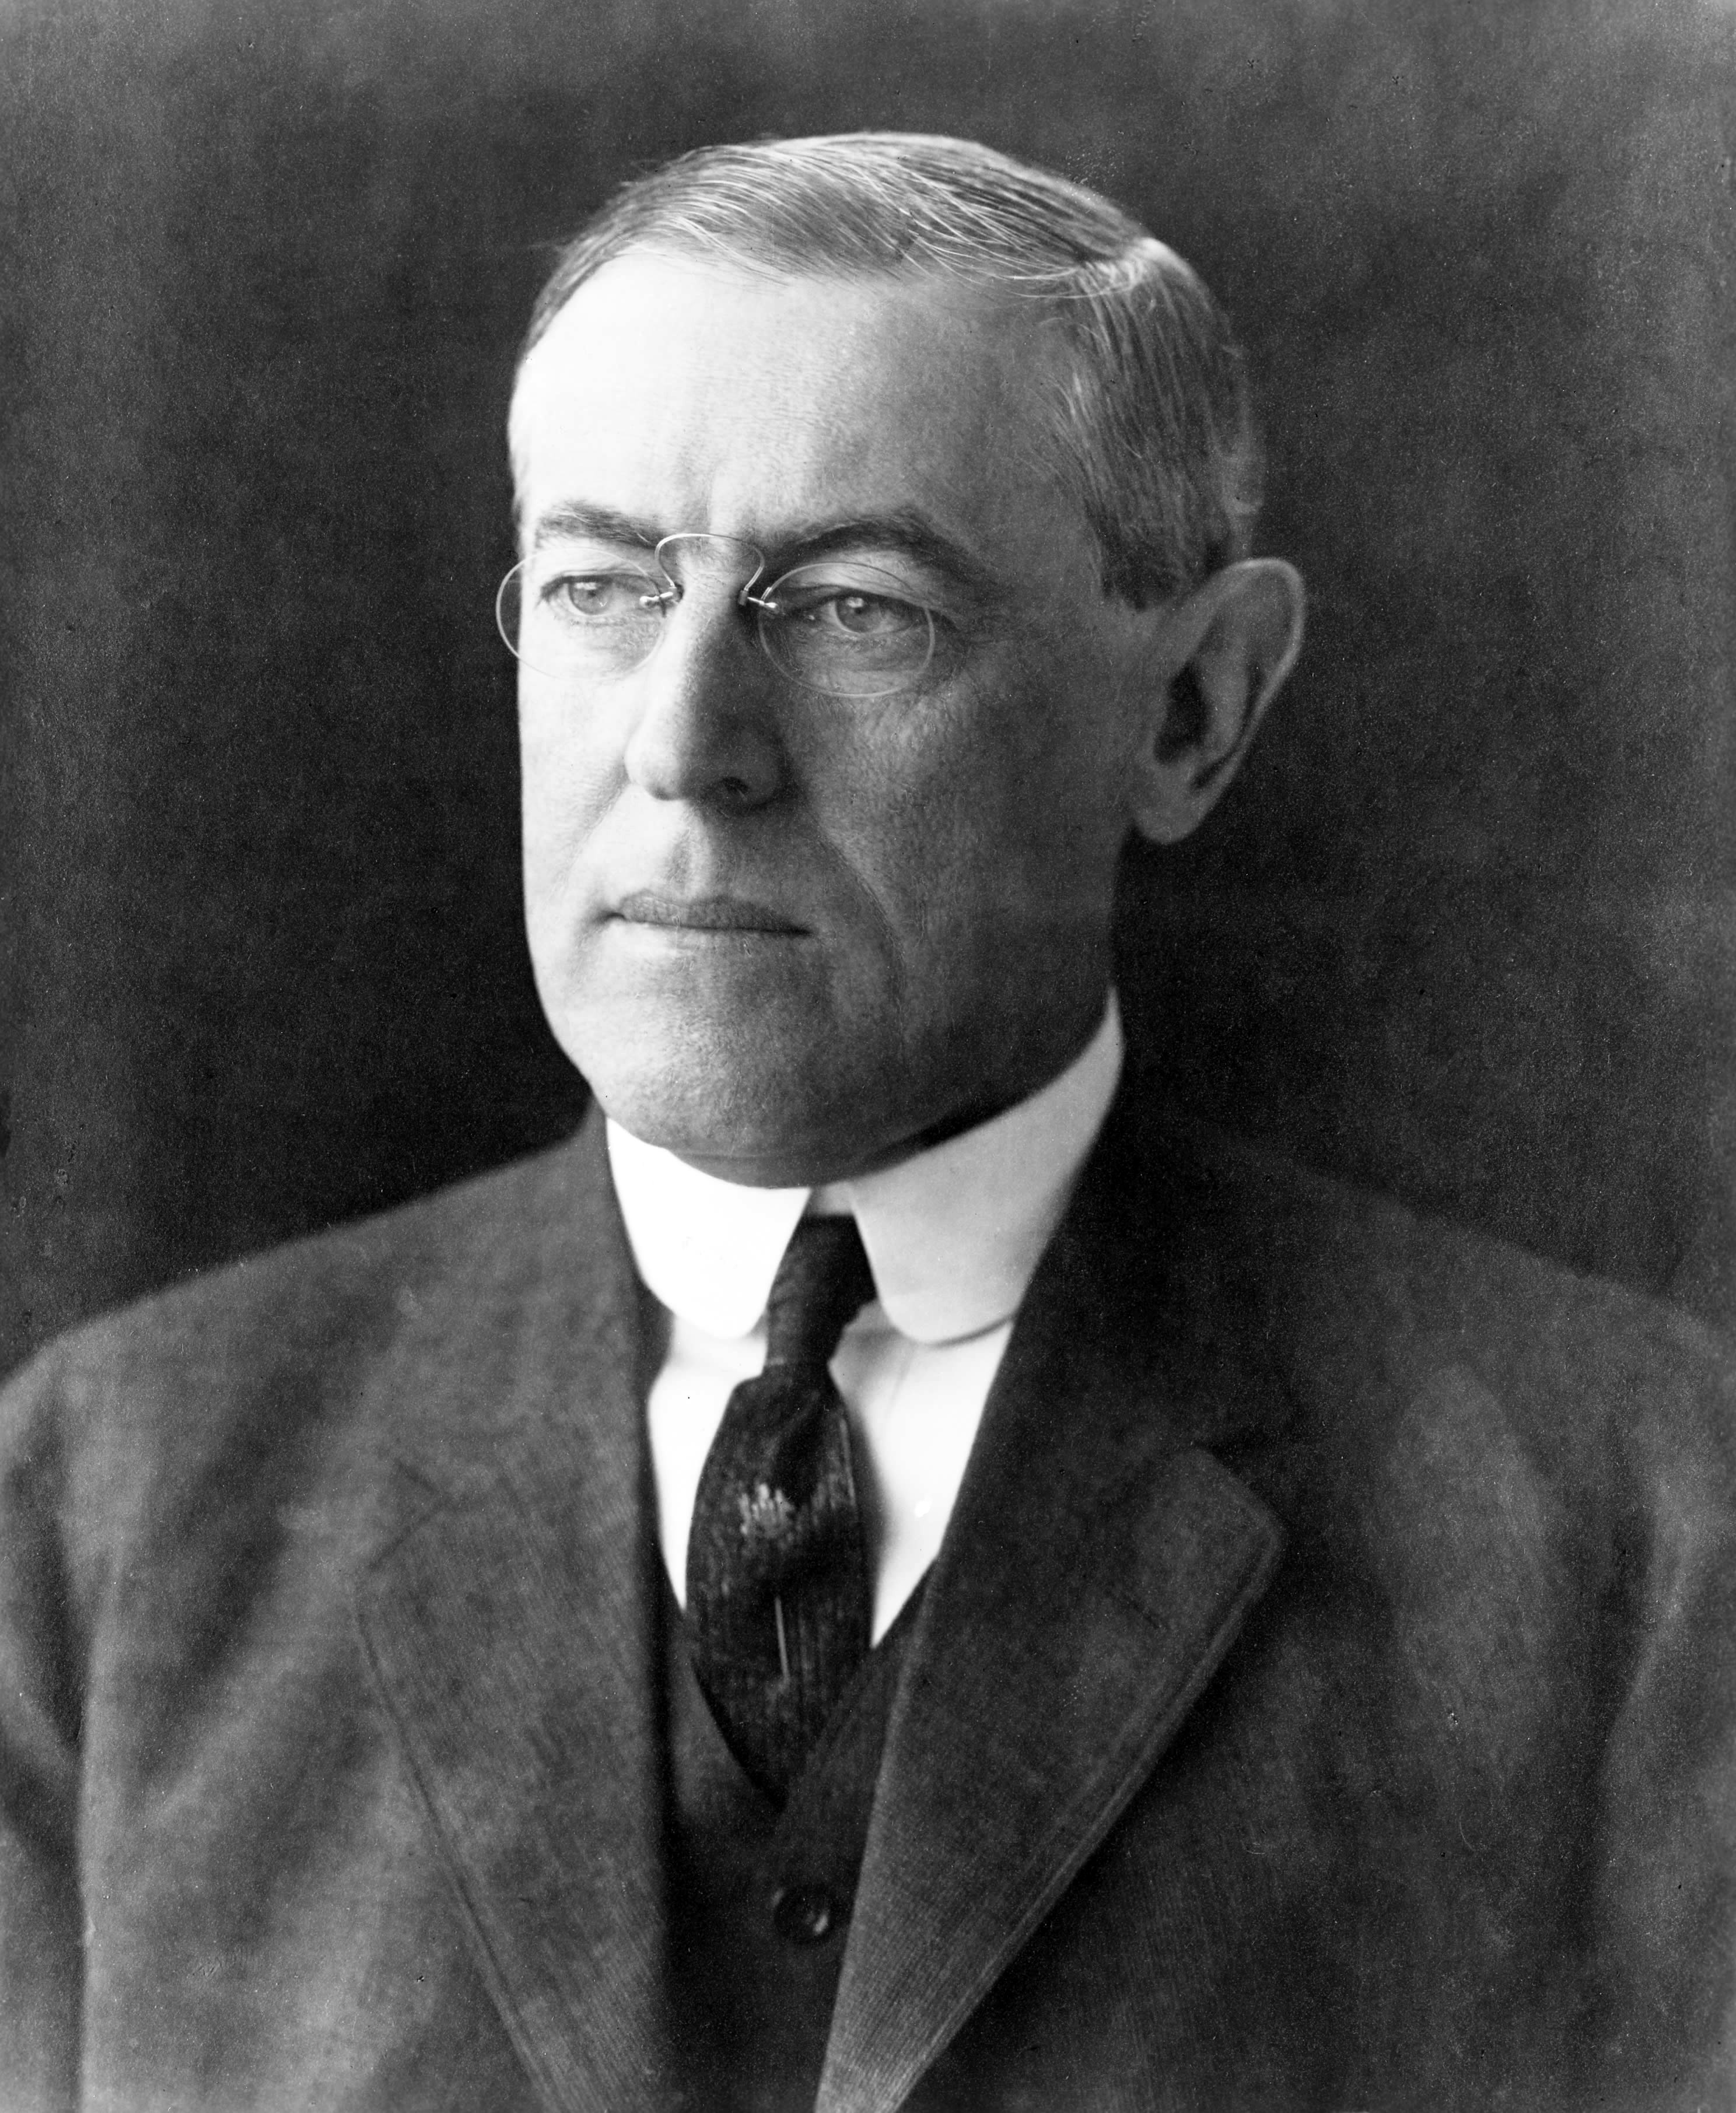
The Start of War
Aug. 3rd, 1914: Germany invaded Belgium
Triple Alliance (Austria-Hungary, Germany and Italy) went to war with the Triple Entente(Britain, France and Russia)
Leaders:
US: President Woodrow Wilson
Germany: Kaiser Wilhelm II – emperor of Germany during World War I

