Slide 1
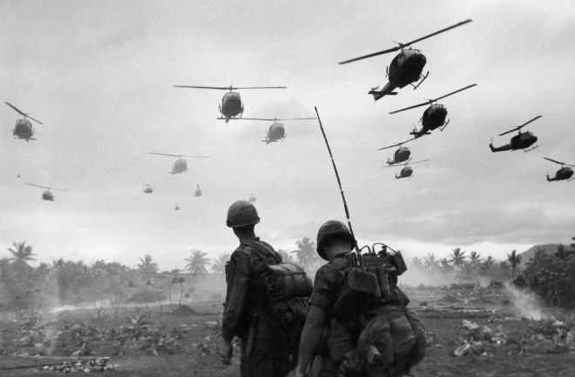
The Cold War Continues…in Vietnam

Slide 2
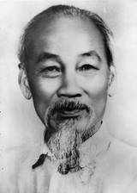
Before the Vietnam war:
French Imperialism led them to take Vietnam as a colony: French Indo-China
Nationalists inside Vietnam wanted to end French rule and demanded independence
Ho Chi Minh: influenced by Communist theory and trained by the Soviet Union to promote worldwide revolution
Lived in exile and gathered support for revolution with other Vietnamese exiles
Ho Chi Minh

Slide 3
During World War II:
During the war, Vietnam was occupied by…yep, you guessed it…Japan!
Ho Chi Minh returns to Vietnam to fight against the Japanese
He forms the Viet Minh – a Communist-majority independence movement and adopts the name Ho Chi Minh which means “Bringer of Light”

Slide 4
After World War II
After the Japanese were defeated, the Viet Minh declare their independence…the French disagree!
In 1946, war breaks out between the Viet Minh and France
After 8 long years of war, Vietnam is left divided at 17 degrees north latitude -Communist North and a non-Communist South – the French withdraw

Slide 5
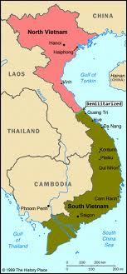
US Reaction:
The US fears that the Communist north will try to reunite Vietnam into one Communist nation
Communist guerilla fighters (supported by Ho Chi Minh) inside South Vietnam, called the Viet Cong, attack the South Vietnamese government
Domino theory – the US believes if Vietnam falls to communism, the other Southeast Asia countries will too!
By 1965, the US begins to send troops

Slide 6
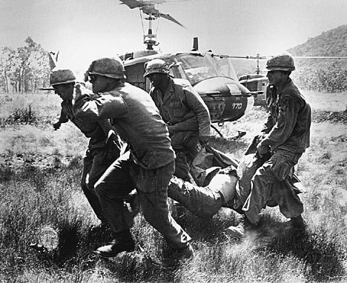
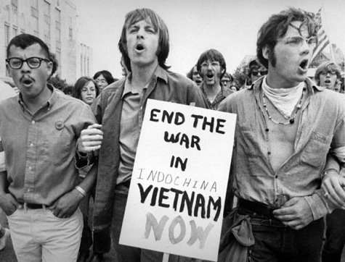
The us goes to war:
Following the policy of containment, President Lyndon Johnson sends thousands of US troops into South Vietnam to defeat the Viet Cong and support the South Vietnamese
After years of fighting, the US cannot defeat the Viet Cong or stop the supply line to North Vietnam (Ho Chi Minh Trail) – thousands of US troops are killed
The Viet Cong’s guerilla tactics make it impossible for the US to defeat them
The longer the conflict lasts, the stronger the anti-war movement becomes in the US

Slide 7
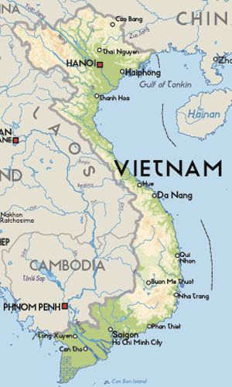
The us withdraws:
By the time Nixon became president, the US wanted an end to the war
Plan: gradually withdraw and let South Vietnam take over the fight
Result: in 1975 South Vietnam was defeated by the Communist North after US troops withdrew
Considered America’s first “loss”
Today, Vietnam is one Communist nation – they renamed the South Vietnamese capital of Saigon to Ho Chi Minh City – ouch!

