Slide 1
Triangular Trade and Slavery: HOW things were traded!
WHII.4e, f

Slide 2
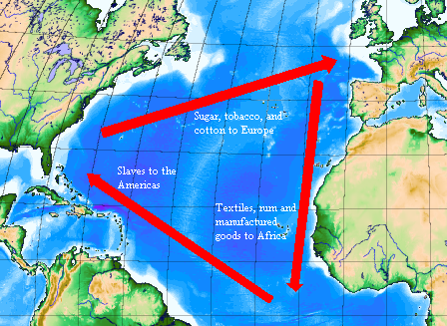
Triangular Trade (Atlantic Slave Trade)
Europeans created a trade pattern linking them to their colonies in the Americas and to Africa
This trade pattern was known as Triangular Trade

Slide 3
Traded?
Sent To?
Europe
Manufactured goods: Guns, Rum, Textiles
Sugar, Molasses, Cotton, Tobacco, Precious Metals
The
Americas
Middle Passage: Forced journey of Slaves to the Americas
Africa
Slaves, Ivory, Gold

Slide 4
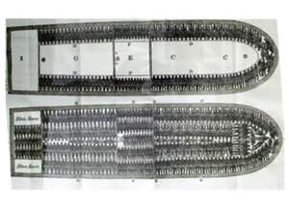
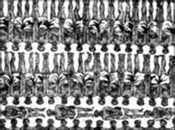
The Middle Passage
The middle leg of the transatlantic trade triangle.
Africans were packed tightly into dark holds of large ships.
20% of Africans aboard each slave ship perished during the brutal trip from disease and physical abuse.
The Middle Passage

Slide 5
Causes of African Slavery
Benefits of African slaves
Demand
Already exposed to European diseases
Experienced in farming
Did not know The Americas
Skin color made them stand out
Natives in the Americas began dying by the millions, increasing the need for slave labor to keep the plantations running.

Slide 6
African Imports/Exports: Add to the Africa box on your notes please!
IMPORTS | EXPORTS
Manufactured Goods from Europe (products that have been built by hand or machine for sale) New Food Products (Peanuts, Corn) | Slaves Raw Materials : Gold, Ivory (products from their natural state, that have not been changed in anyway)

