Slide 1
The Scientific Revolution A changing view of the world http://www.youtube.com/watch?v=4RiU2T4Psyc

Slide 2
Scientific Revolution
The Scientific Revolution
Emphasis on reason & systematic
observation of nature
Formulation of the scientific method
Expansion of scientific knowledge

Slide 3
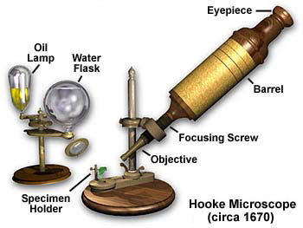
A New Understanding
Discoveries led to doubt
-Columbus
Scholars challenged traditional thought
-Copernicus & Galileo
Inventions
-Telescope, Microscope

Slide 4
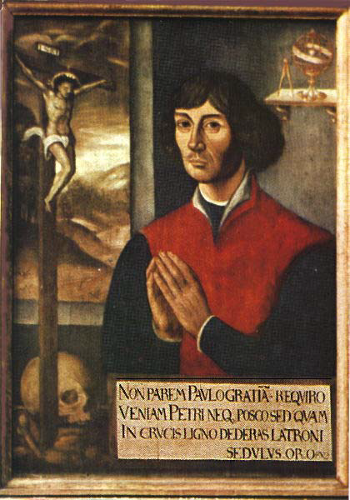
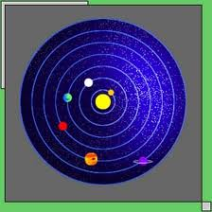
Nicolaus Copernicus
-Polish Astronomer
-He disproved Geocentric Theory
-Discovered Heliocentric theory (sun-centered)-Stars and planets revolved around the sun
-“Now circles the sun”

Slide 5
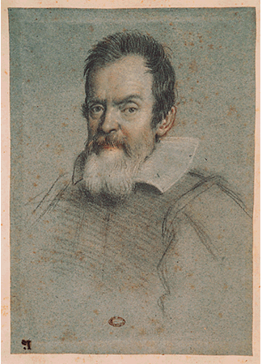
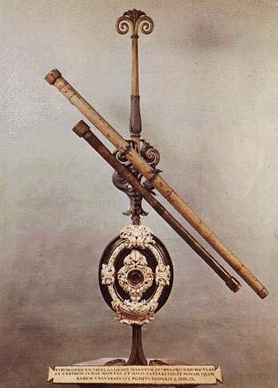
Galileo Galilei
-Italian scientist
-Improved telescope
-Observations proved Copernican view
- Moon, Planets, & Stars
-Discovered Laws of Motion
objects accelerate at fixed & predictable rates
-1633 – Church forced him to recant & placed under house arrest
-“Good guy Galileo”

Slide 6
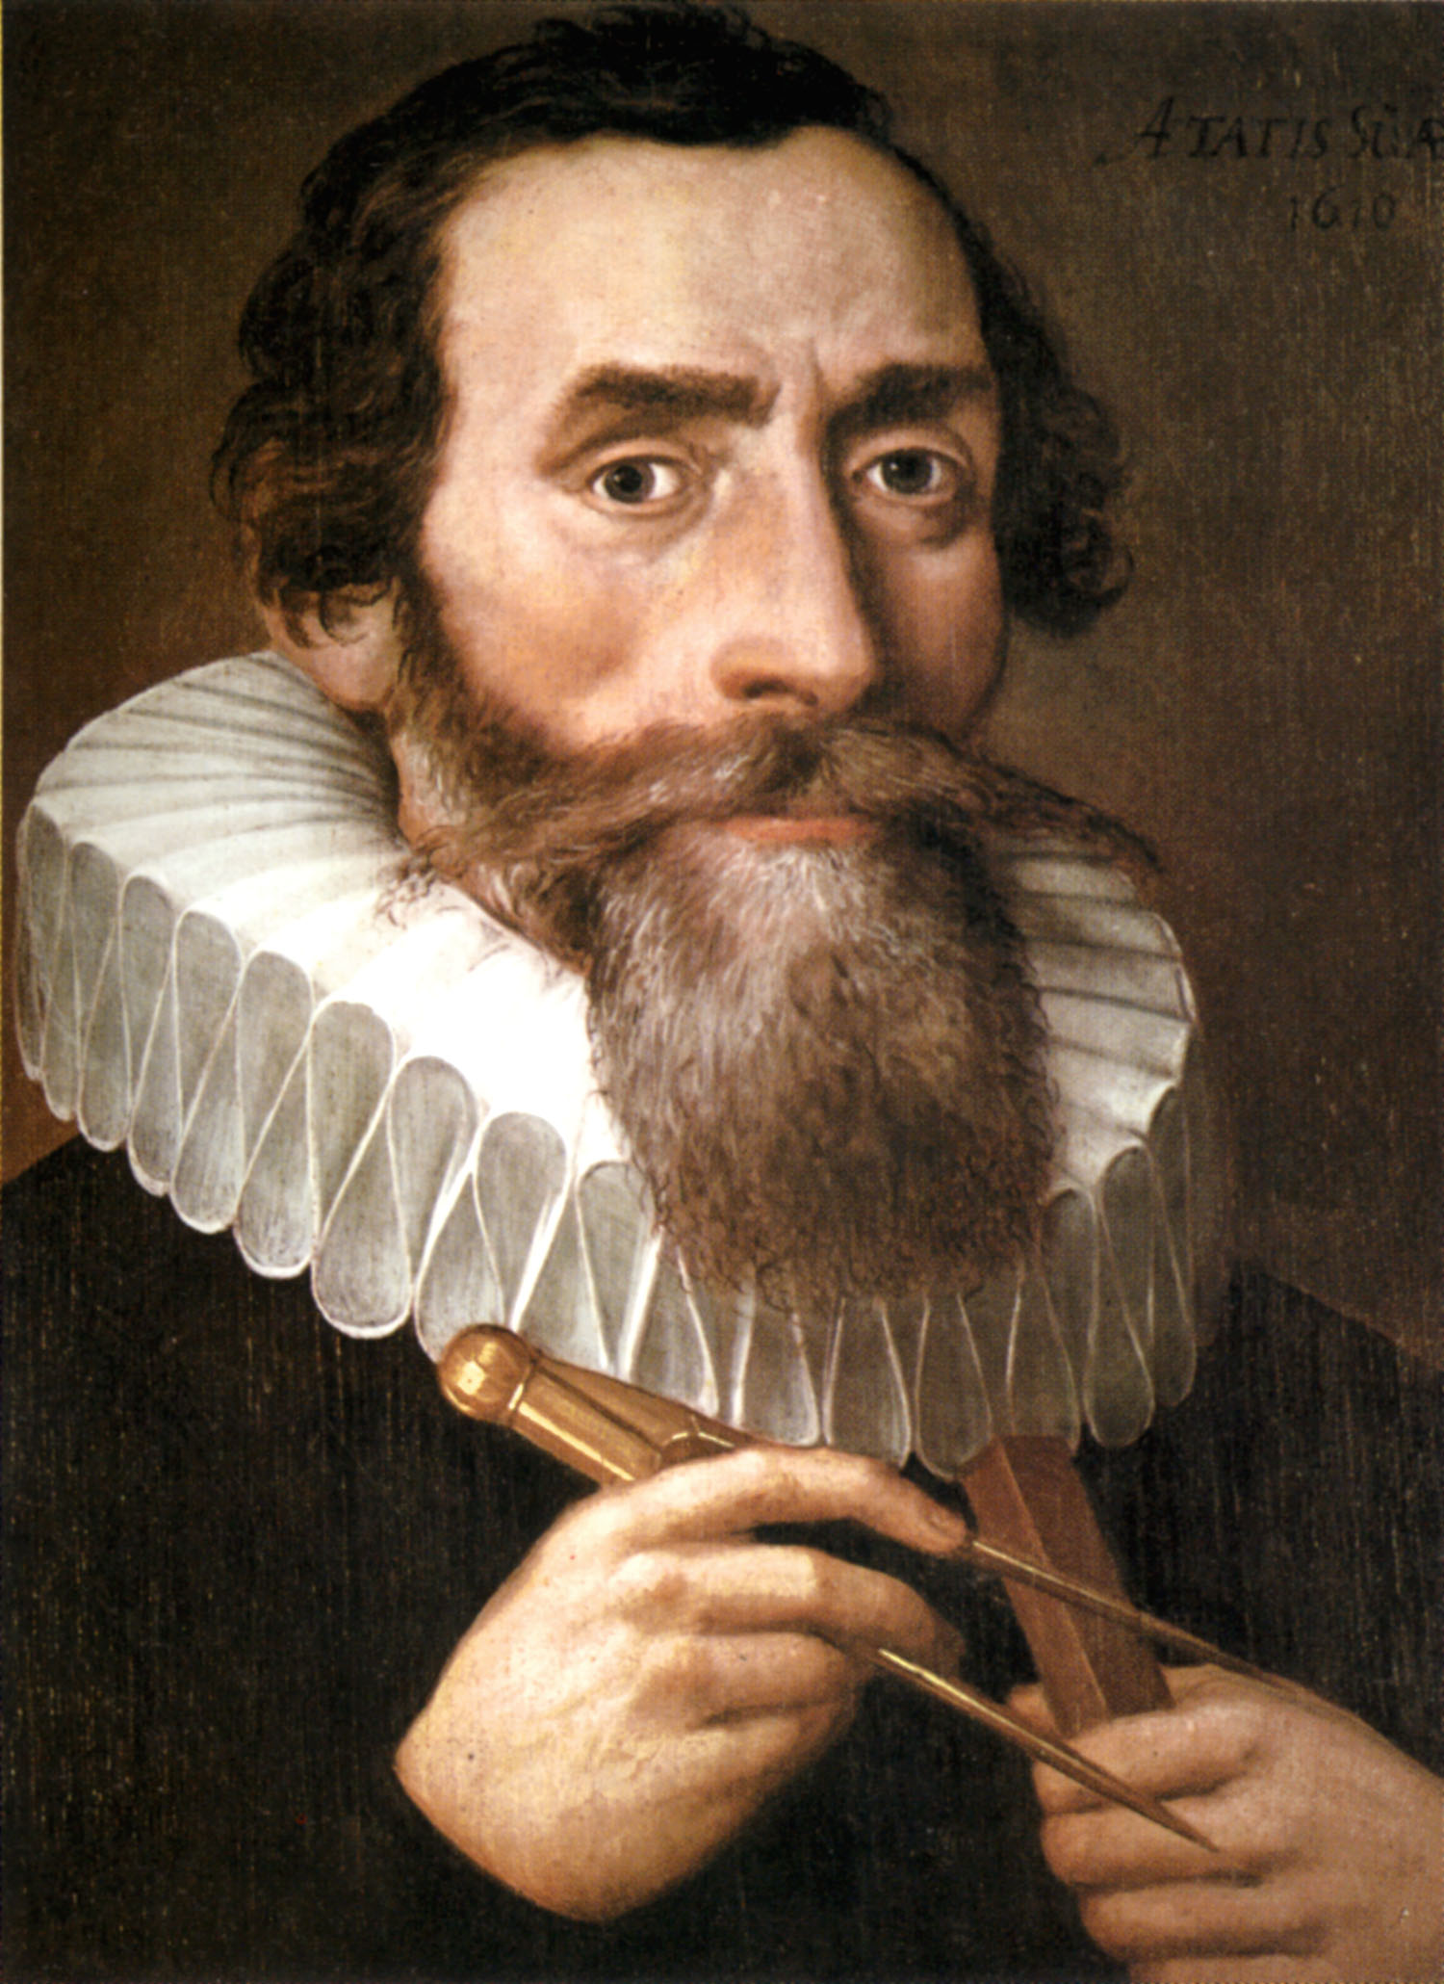
Johannes Kepler
-Danish Mathematician
-Concluded that certain mathematical laws govern planetary motion
-Planets revolve around the sun in elliptical orbits instead of circles
-“Jupiter Keeps spinning”

Slide 7
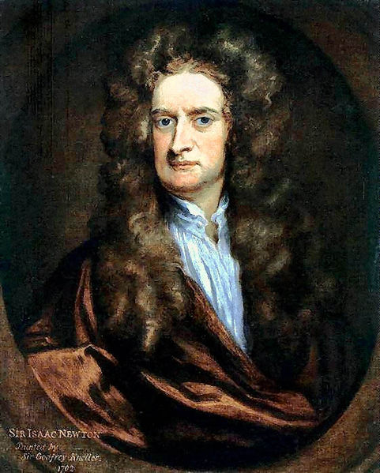
Isaac Newton
-English Scientist
-Laws of motion same for earth & universe
-Law of universal gravity
-Wrote Mathematical Principles of Natural Philosophy
-“I now know apples fall”

Slide 8
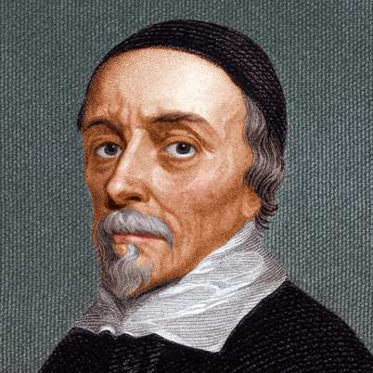
William Harvey
-English Doctor
-Worked on human anatomy & published On the Motion of the Heart and Blood in Animals
-Heart acted as a pump to circulate blood throughout the body (Blood Circulation)
- “When & how blood circulates”

Slide 9
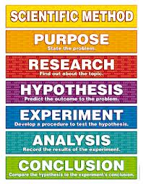
Scientific Method

