Slide 1
Russian Revolutions and Rise of Communism

Slide 2
Causes of 1917 revolutions
The Russian Revolution took place in November of 1917 when the Bolshevik Party forces took over the government offices in Petrograd.

Slide 3
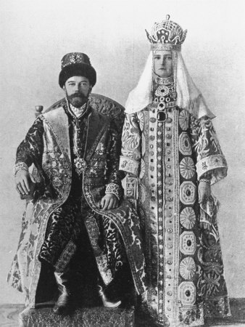
Causes
Weak leadership of Czar Nicholas II-
He clung to autocracy (a government controlled by a single person) despite changing times and widespread suffering of his people
He will be the last monarch Russia will ever have!

Slide 4
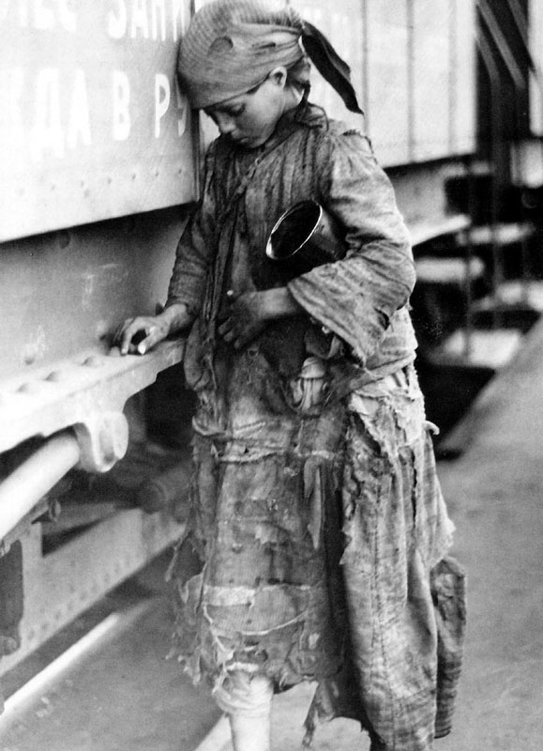
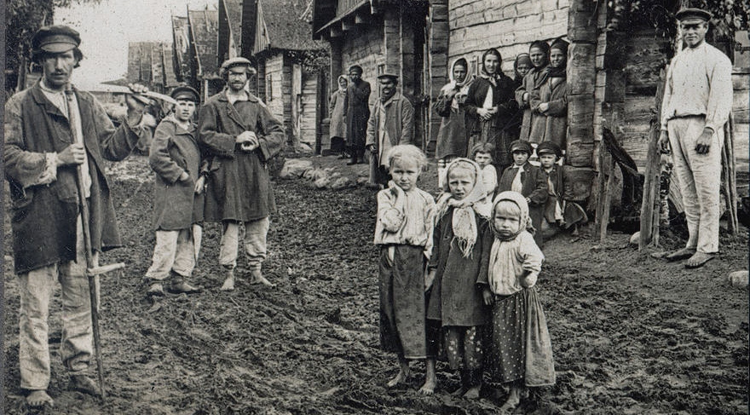
Causes
At home:
Large landless peasantry – as Russia industrializes, more people moved off the land in search of better jobs
Poor working conditions, low wages and hazards of industrialization

Slide 5
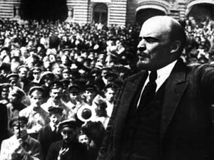
Causes
New Ideas for Revolution!
Revolutionary movements wanted worker-run government (Communism)
The Bolshevik Party – made up mostly of workers, considered themselves the leaders of the working class and eventually will take over Russia
Leader – Vladimir Lenin

Slide 6
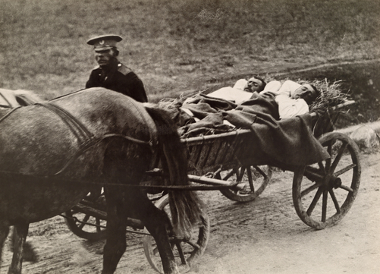
Causes
Russian Defeats!
The Russians were defeated by the Japanese in the Russo-Japanese War (1905)
Led to rising unrest among the people and dislike for the Tsar
World War I – Russian army suffered terrible casualties
At home people lacked food and fuel…again they turn against the Tsar!

Slide 7
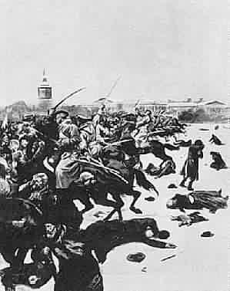
Causes
Bloody Sunday:
1905: St. Petersburg – unarmed protestors are gunned down by the Tsar’s soldiers outside his winter palace.
This key event will help turn public opinion against the Tsar and lead to the Russian Revolution in 1917!
1917: March Revolution – soldiers join the protestors instead of stopping the revolution – it will be the end of Autocracy and the end of the Tsar!

Slide 8
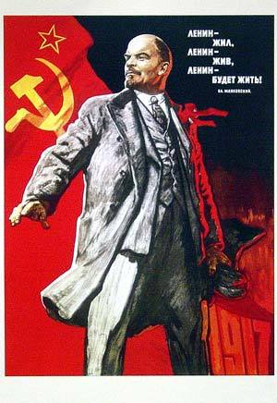
Consequences
Communist Party comes to Power!
Government is taken over by the Bolshevik Party, Lenin’s party
Farmland is distributed among farmers, and factories are given to workers
Banks are nationalized and a national council is assembled to run the economy
Russia pulls out of WWI, signing the Treaty of Brest-Litovsk, conceding much land to Germany

Slide 9
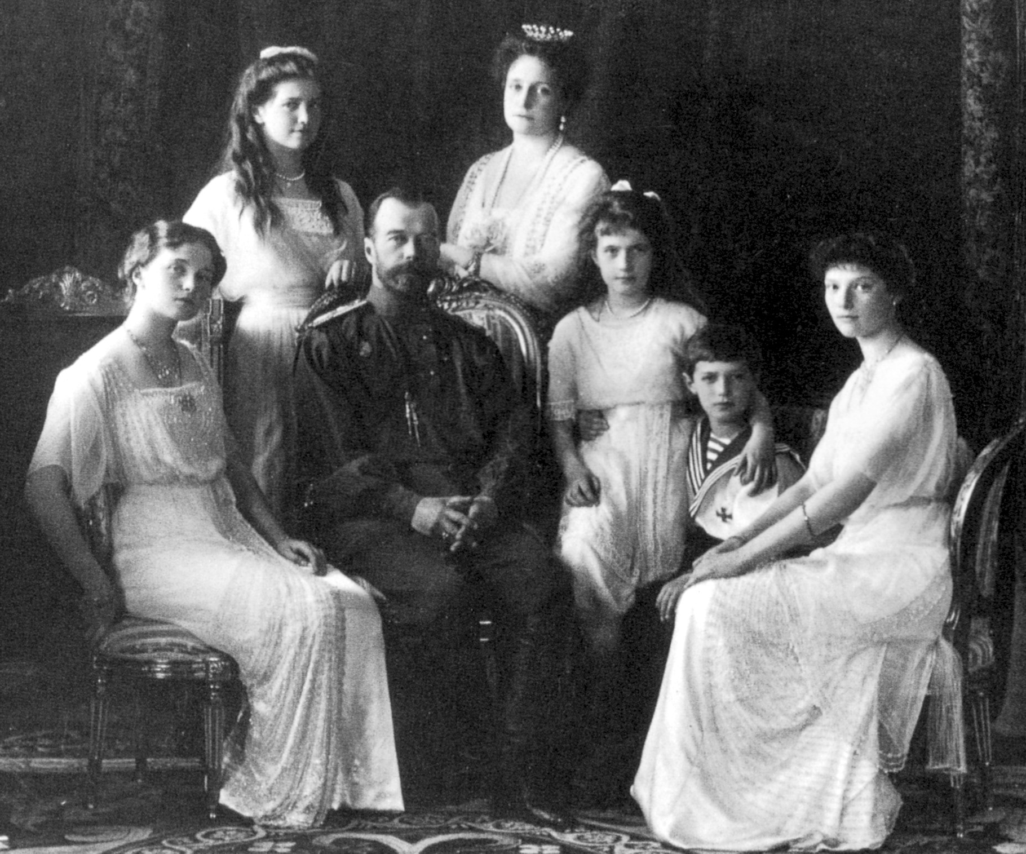
Consequences
No more Monarchy in Russia!
Czarist rule ends, Nicholas II, his wife and five children are executed

Slide 10
Consequences
Civil War Breaks out in Russia!
Between Bolsheviks (red) and anti-Bolsheviks (white) forces, from 1918-1920. Around 15 million die in conflict and the famine.
The Russian economy almost destroyed!
Industrial production drops, trade ceases, skilled workers flee country.
Lenin introduces New Economic Policy to combat economic decline and raise food production
Lenin’s New Economic Policy: a plan to help recover Russia’s economy by combining state-run industries (banks, large industries) with private ownership (small businesses)

Slide 11
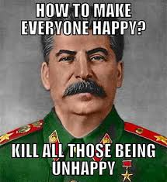
Consequences
Power and Control!
Lenin asserts control with cruel methods (prison camps)
When Lenin dies, Joseph Stalin takes control of Communist Party.
Stalin transforms Russia to totalitarian dictatorship!
Uncle Joe says: “Death solves all problems – no man, no problem!”
“One death is a tragedy; one million, a statistic!”

