Slide 1
The Legislative Branch: Congress

Slide 2
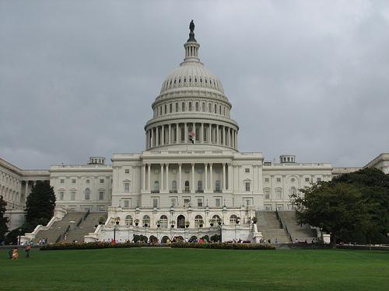
The Role of the Legislative Branch
Congress is the body through which the will of the people becomes law
Congress members serve by balancing the needs of their constituents, interest groups, and the nation as a whole

Slide 3
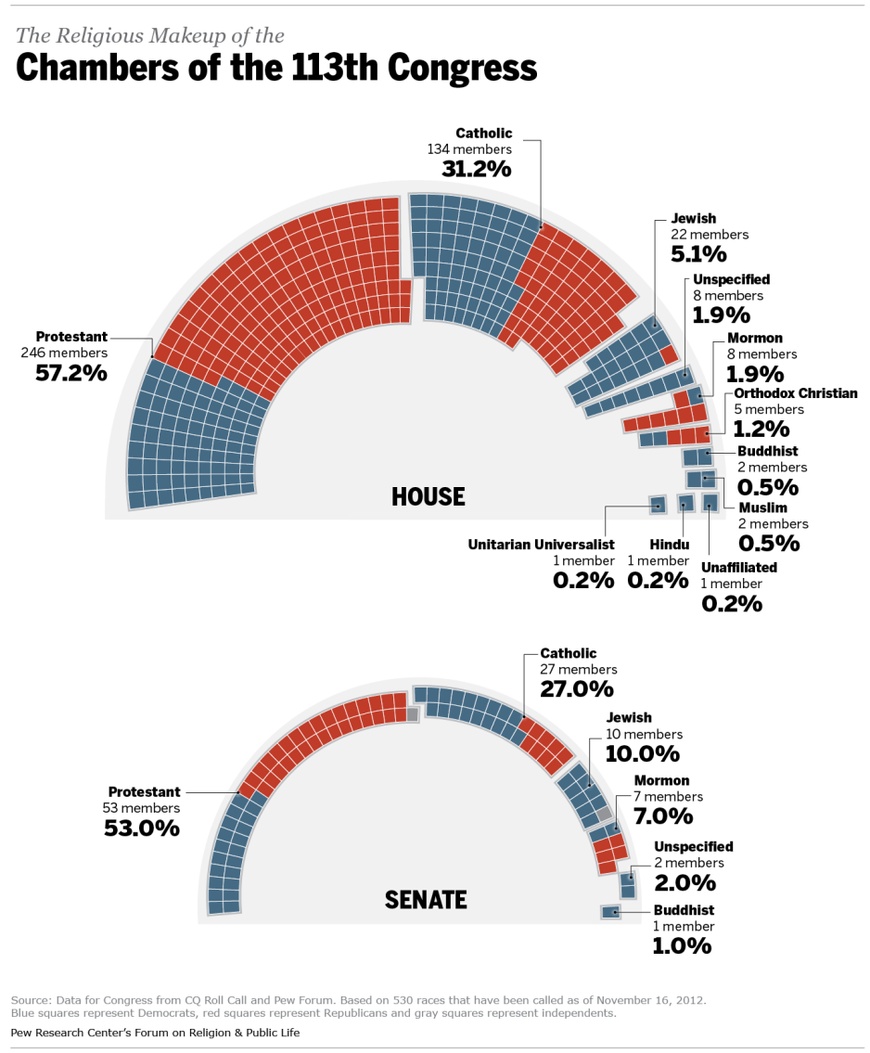
Organization of Congress
Per the Great Compromise, the US Constitution established Congress as a bicameral body
The House of Representatives is based on population and has 435 members
The Senate is based on equal representation from each state and has 100 members
The House has always been popularly elected; the Senate was chosen by state legislatures until 1913

Slide 4
Congressional Elections
Every member of the House of Representatives seat is contested every two years, while a third of Senate seats are also up every two years (senators from the same state do not come up for reelection at the same time)
Even though big turnover is possible, about 90% of incumbents win
If a member leaves a seat open for whatever reason, the state governor calls for a special election
There are no term limits for either house

Slide 5
Congressional Benefits & Perks
Salary of $174,000 (more for leadership)
Office space, stationary, postage
Low-cost life insurance
Medical coverage
Gym
$ for office staff, trips home, telephones, etc.
Travel allowance
Tax deduction for 2 residencies
Pension of up to $50,000 a year
Free from arrest on the way to or from Congress, and in session
Can’t be sued for anything said in session
Special License Plates

Slide 6
Checks and Balances
Congress has several ways to check the other two branches
Can approve or deny federal spending/appropriation (power of the purse- exclusive to the House)
Can approve or reject treaties (exclusive to the Senate)
Can approve or deny Presidential appointees (exclusive to the Senate)
Oversight- making sure the Executive Branch is following the laws Congress has passed
Impeachment of members of the Judicial & Executive Branches (House charges, Senate tries- 2/3’s vote to remove)

Slide 7
The Powers of Congress
Congress has only those powers granted to it by the Constitution
The specific powers are laid out in three different ways:
Expressed powers
Implied powers
Inherent powers
There are also powers denied to Congress
Cannot pass ex post facto laws, bills of attainder, or suspend writ of habeas corpus

Slide 8
Expressed Powers
Article I Section 8 specifically grants powers to Congress
Most fall into three categories
Financing (levy taxes, borrow money, coin money)
Commerce (regulate commerce)
Defense (declare war, raise armies, provide navy)
Other Powers
Provide for Naturalization
Establish a post office
Structure the Federal Judiciary
Grant patents and copyrights
Wieghts & Measures

Slide 9
Implied Powers
Powers that belong to Congress because they can easily be deduced from an expressed power, as created by the Necessary & Proper/Elastic Clause
The US Supreme Court ruled in McCulloch v. Maryland (1819) that the Constitution did not need to explicitly give Congress the power to create a bank- it was “necessary and proper” to the execution of expressed powers
Examples:
Levy taxes > punish tax evaders
Coin money > print money
Raise armies > establish a draft
Regulate commerce > establish minimum wage

Slide 10
Non-Legislative Powers
Congress also possesses powers not related to the lawmaking process
For Example:
Constitutional Amendments
Electoral Duties
Investigatory Power
Subpoena Power (requiring a person to testify via a document)

Slide 11
House of Representatives
Designed to be the most representative body of the people
The US Constitution grants each state one representative
Qualifications
25 years old
US citizen for 7 years
Must live in the state he or she represents
The chamber was capped at 435 members in 1929
Seats are apportioned among states on the basis of their respective populations

Slide 12
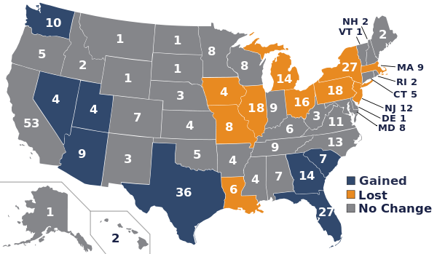
Apportionment
Congress has to redistribute the seats after each census every 10 years
States win or lose seats based on their population gains or losses (VA has 11 seats, CA has 53)
One seat represents roughly 710,000 people per the 2010 U.S. Census

Slide 13
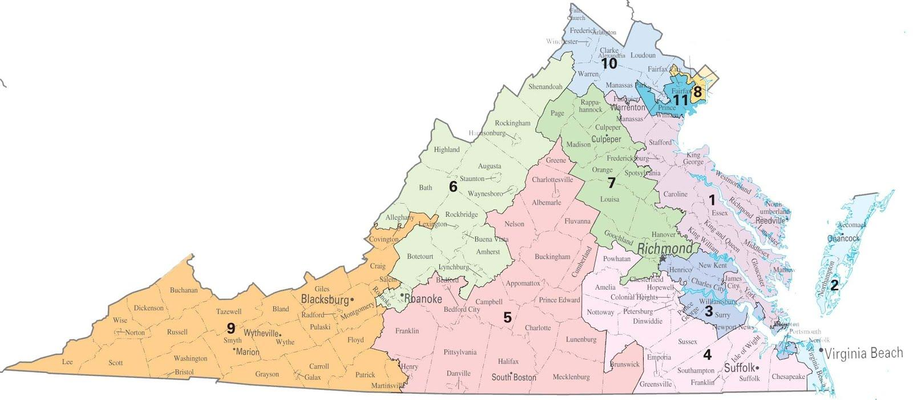
Reapportionment
After the seats are redistributed, state legislatures divide their states into the allotted number of districts
Each district must be a compact, connected territory and have relatively the same number of people in each one
The Supreme Court ruled that creating disproportionate districts or districts drawn to disenfranchise or benefit minorities is unconstitutional

Slide 14
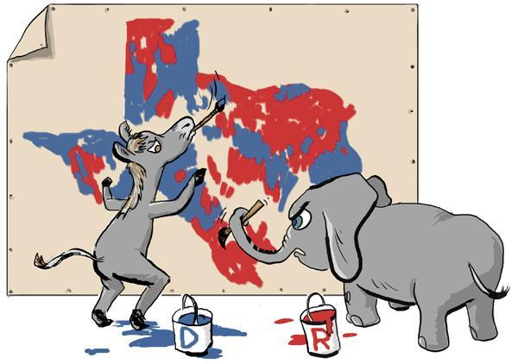
Gerrymandering
Gerrymandering- drawing districts to the advantage of the majority party in the state legislature
Two gerrymandering methods:
Concentrate opposing voters in one or few districts to protect seats
Spread the opposition thin to limit the ability for a party to carry any district

Slide 15
US Senate
The US Constitution grants each state two Senators
The framers hoped that a smaller and more exclusive Senate would be more enlightened and responsible than the House
Qualifications
30 years old
US citizen for 9 years
Must live in the state he or she represents

Slide 16
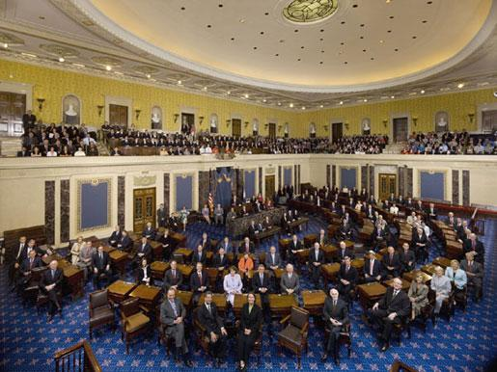
Political Clout
Because of its size, Senate members get more press than the House
They are more likely to be regarded as national political members and tend to have more clout in state politics than House members
The Senate is a prime source for Presidential candidates

Slide 17
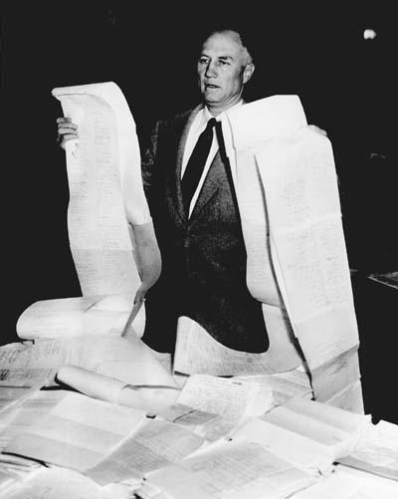
Senate Traditions
Unlike the House, there are no rules for debate in the Senate
Filibuster- “talk a bill to death”
The threat of filibusters have been used to slow or derail bills as well as treaties and appointments
Cloture rule (60 votes) can end a filibuster

Slide 18
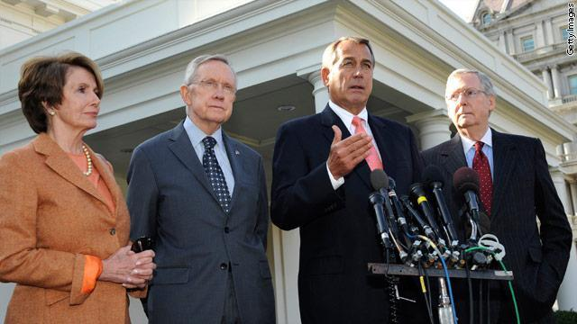
Congressional Leadership
Both houses elect its leadership during party caucuses
The majority party elects the Speaker in the House, and their floor leader and floor whip in both chambers
The minority party elects their floor leader and floor whip in both chambers

Slide 19
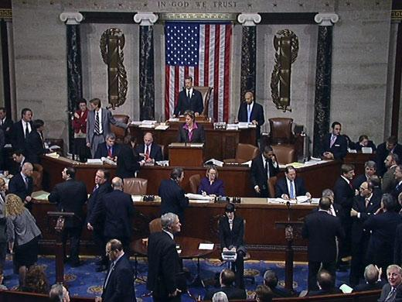
House Leadership
Speaker of the House- the presiding officer of the House
Powers of the Speaker:
Preside over debates
Allows members to speak on the floor
Assigns bills
Makes rules for debate of bills
Assigns members to committees
Floor leaders:
Majority Leader- assists the speaker
Minority Leader- opposing party’s spokesperson
Whips- encourage party members to get on board with the wishes of party leadership

Slide 20
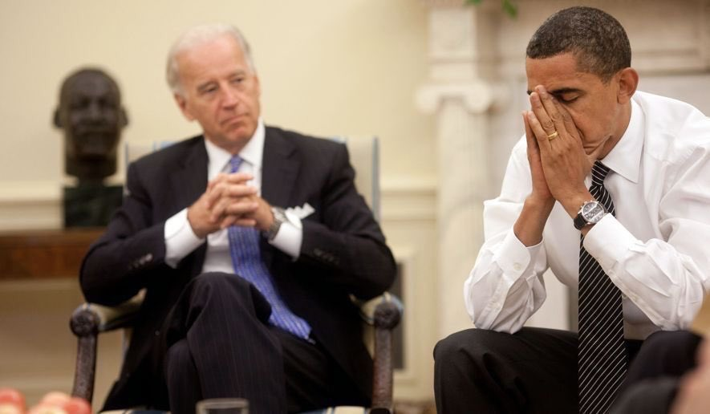
Senate Leadership
The Vice President serves as the president of the senate (breaks ties in voting)
President Pro Tempore- longest serving member of the majority party
Floor leaders:
Majority & Minority leaders are the chief strategists and spokespersons for their respective parties
Whips play the same role in the Senate as they do in the house

Slide 21
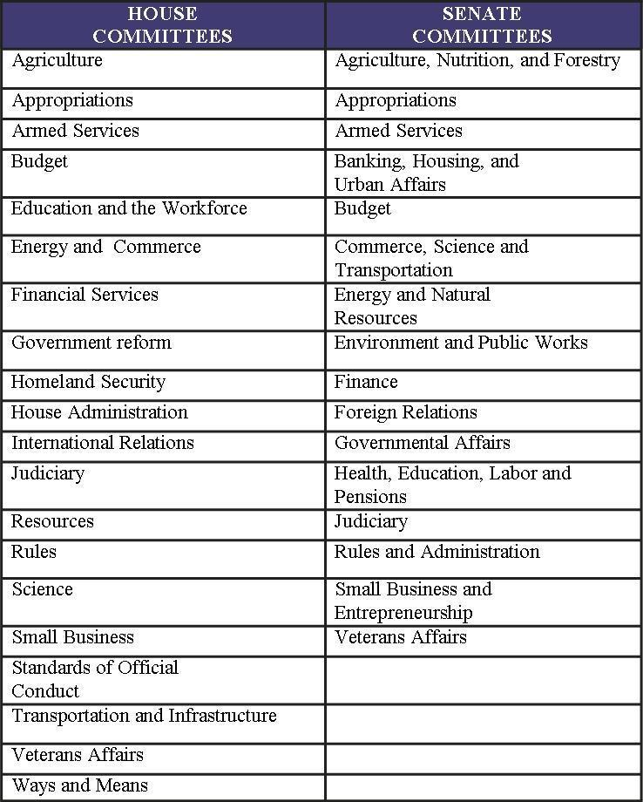
Committees
Committees are used by both houses to gather information on specific issues
Both houses have organized permanent “standing” committees, 20 in the House and 16 in the Senate
House members can serve on up to two standing committees; Senators can serve on up to three

Slide 22
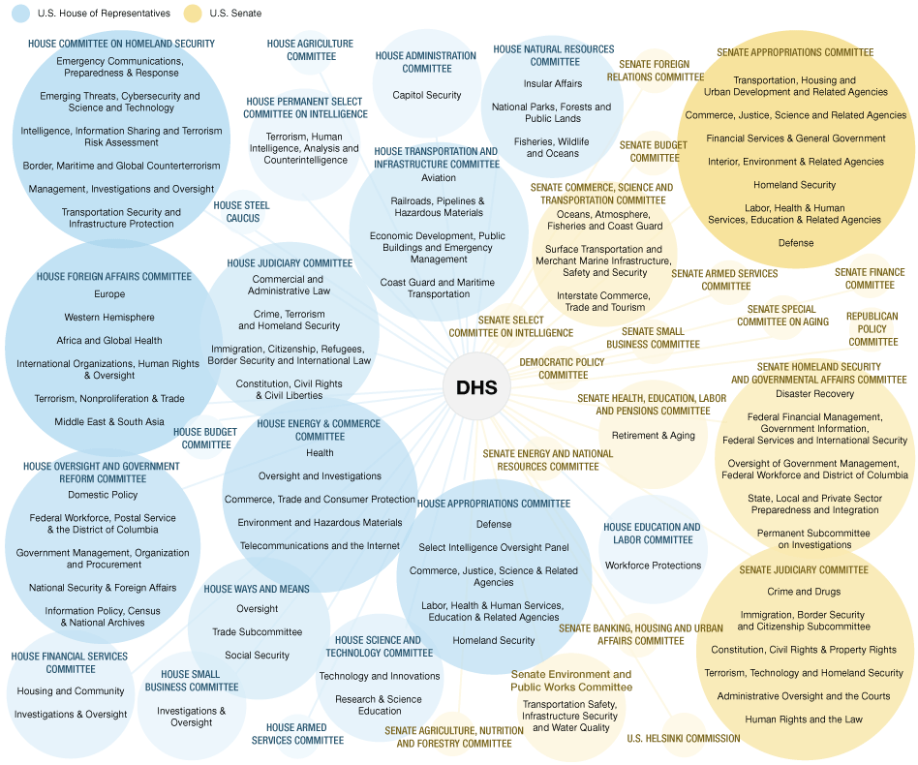
Committee Structure
Each committee is headed by a chairperson, chosen by the majority party and usually based on seniority
Committees typically have three or four subcommittees that have a more narrowed focus

Slide 23
Example of Subcommittees
Armed Forces
Emerging
Threats
and Capabilities
Readiness
and Management
Support
Senate Power
Strategic Forces
Airland Forces
Personnel

Slide 24
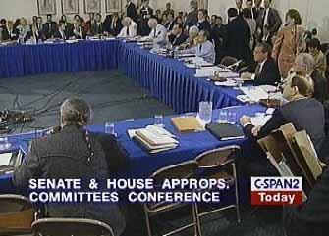
Other types of Committees
Select Committees- temporary committees set up to investigate current issues and/or problems
Joint Committees- composed of members of both houses
Conference Committees- temporary joint committees created to iron out different versions of the same bill from both houses

Slide 25
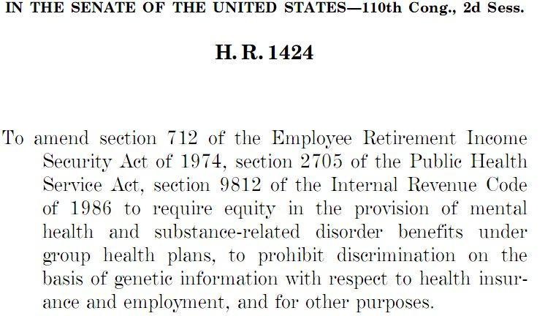
How does legislation get passed?
Bill start as ideas from Congress, the President, privates citizens, and/or interest groups
Bills can be introduced in by a member in either house
They are called the bill’s sponsor (there can be more than one)
Bills are given numbers, then are sent to the appropriate committee (where most bills die)

Slide 26
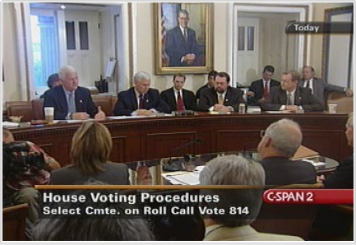
Committee Action
The bill is then referred to a subcommittee, where research and public hearings on the bill take place
The subcommittee reports back with the standing committee, recommending what course of action should be taken
The committee then takes one of three actions on the bill
Report favorably
Pigeonhole (refuse to report the bill)
Report bill unfavorably (rare)

Slide 27
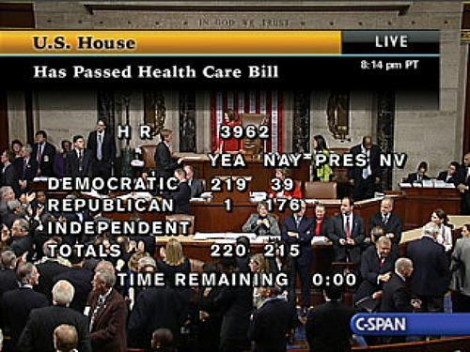
House Floor Action
The bill then is considered on the floor and passed or defeated with a majority vote (the House Rules committee determines rules on debate and rather or not the bill can be amended)
In the House, a quorum (218 votes) or the Committee of the Whole (100 votes) is needed to conduct business

Slide 28
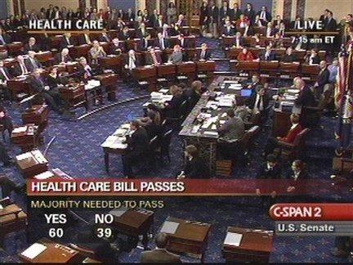
Senate Floor Action
Same as the House, the Senate votes to pass or defeat a bill with a majority vote
There are no rules for debate on the Senate floor
Senators can filibuster bills to prevent action on it
Only Senators can add riders to bills (provisions unrelated to the bill)

Slide 29
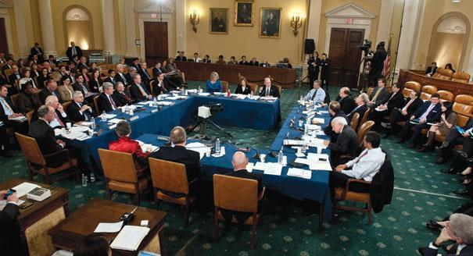
Becoming a law
House and Senate bills must be identical, so sometimes conference committees are necessary (their work must be approved by a majority vote in both houses)
If passed by both houses, the bill goes to the president, where it can be signed into law, vetoed, or take no action (Congress in session- bill passes; Congress out of session- bill dies AKA pocket veto)
Either house can override a presidential veto with a 2/3’s vote

