Slide 1
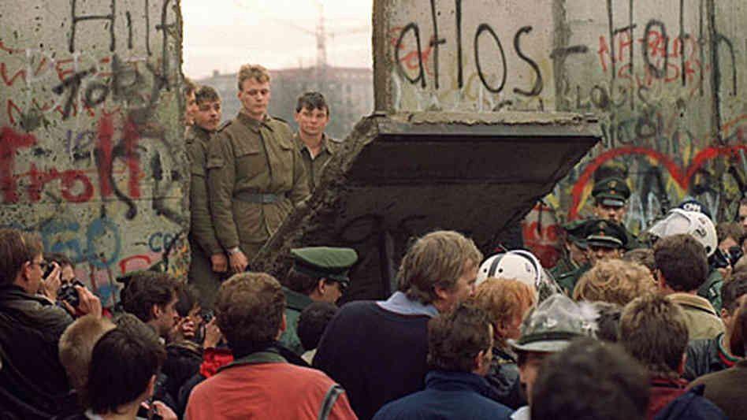
The Cold War Ends
Collapse of Communism in the Soviet Union & Eastern Europe

Slide 2
Cold War Predictions
Why did the Soviet Union “lose” the Cold War?
Why did Communism collapse inside Russia?
Remember:
Deterrence...led to?
Satellite Nations...were?
The Iron Curtain...created?

Slide 3
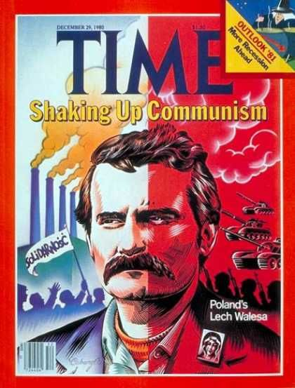
Problems FOR the Soviet Union
Increased military expenses to compete with the US were hurting the USSR
Inefficient with state-controlled economy, no real growth
Rising nationalism in Soviet Satellites

Slide 4
Fall of Berlin Wall
By 1989, public protests grew among the citizens of East Germany
The Communist government decided to lift the travel ban to the West
People rushed to the wall to go west for the first time in 28 years!
The wall came down!!!
By October of 1990, East and West Germany were united into one Germany...Communist-free!

Slide 5
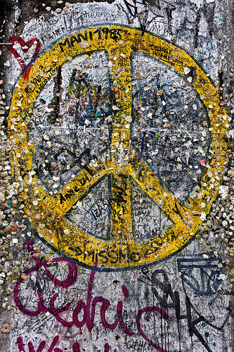
Wall Graffiti – the world’s canvas!

Slide 6
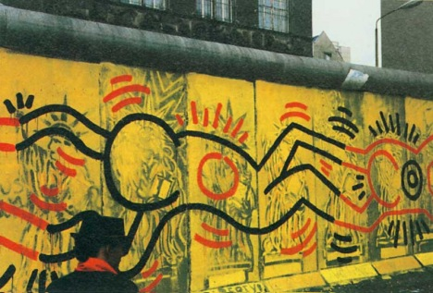

Slide 7
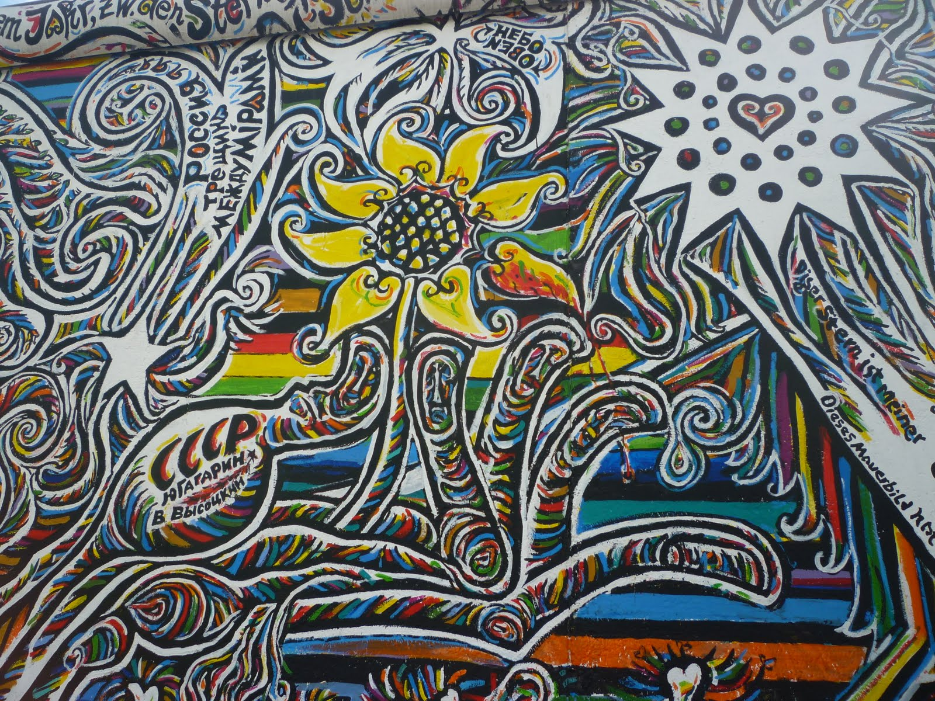

Slide 8
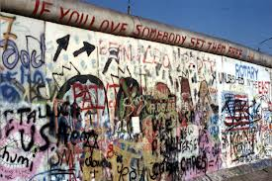

Slide 9
Problems AT HOME for the Soviet Union

Slide 10
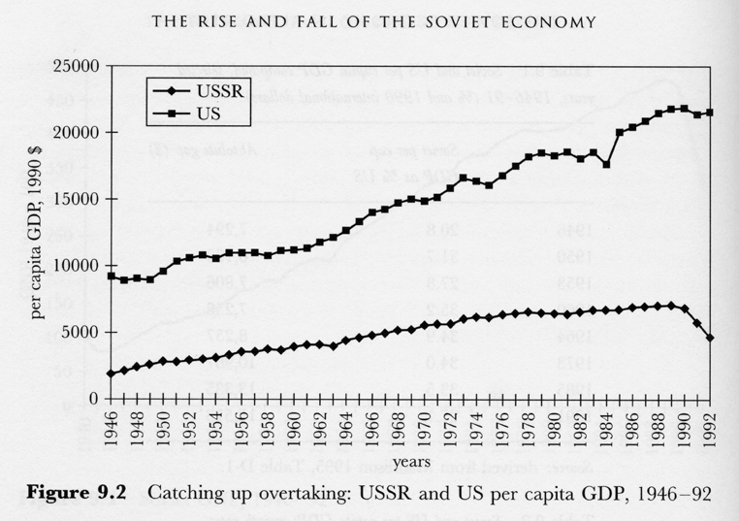
Soviet Economic Collapse
The Soviet Union was a totalitarian state.
Silence rewarded and Individualism discouraged
As a result…
Soviet society rarely changed and the Soviet economy became stagnant (didn’t grow).

Slide 11
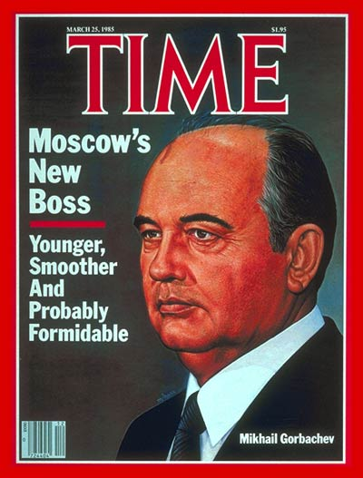
Gorbachev’s Reforms
Mikhail Gorbachev comes to power in 1985
Decides to Institute new Soviet policies in order to save the Soviet economy and the Communist government
Glasnost (political)
Perestroika (economic)

Slide 12
Gorbachev’s Policies
Glasnost gave Soviet citizens a political voice to…
complain about economic problems
give solutions
Perestroika
economic restructuring
Gorbachev allowed local managers to gain authority over farms and factories
Set prices and wages
Increased production and efficiency
Side-effect: giving the people a voice led them to demand democracy!

Slide 13
Breakup of the Soviet Union
Soviet citizens demanded the resignation of Mikhail Gorbachev
Communist “hardliners” try to overthrow Gorbachev (military coup) by sending the military in to Moscow, but the troops refuse to act against the people!
Gorbachev loses power and is forced to resign
Boris Yeltsin became the Russian Federation’s first elected president
Free elections caused Soviet satellite nations to declare independence

Slide 14
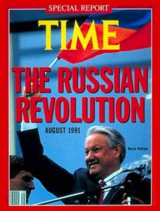
Moscow, 1991

