Slide 1
WHII 2c., 15a., 15b. World Religions
Essential questions:
Where were the five world religions located around 1500 A.D.?
What are some of the characteristics of the five major world religions?
Where are the followers of the five world religions concentrated?

Slide 2
World Religions
With your elbow buddy discuss:
What is the difference between monotheistic and polytheistic?
What religions do you know that are monotheistic?
What religions do you know that are polytheistic?

Slide 3
Categories of Religion
Monotheism:
Belief in one god (Christianity, Judaism, Islam)
Polytheism:
Belief in more than one god (Hinduism)
Non-theism:
Does not worship any god (Buddhism)

Slide 4
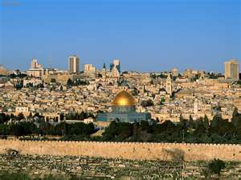
Judaism
Belief: Monotheistic (1st)
Deity: God (Jehovah)
Founder: Abraham (Prophet)
Holy Book: Torah (written record & beliefs) and The 10 Commandments (laws, moral and religious conduct)
15.1 million followers
Leaders: Rabbis
Holy sites/Cities: Israel and Capital City of Jerusalem

Slide 5
Judaism: 1500

Slide 6
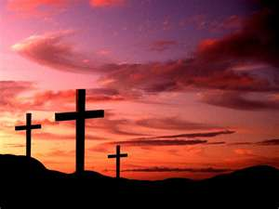
Christianity
Belief: Monotheistic, Life after Death
Founded: Middle East (Israel)
Deity: God (Trinity-Father, Son and Holy Spirit)
Founder: Jesus (prophet and son of God)
Holy Book: Bible (life and teachings of Jesus in the New Testament)
2.1 billion followers world wide
Holy sites: Jerusalem, Israel
Leadership: Priests establish Christian Doctrine, Church Councils

Slide 7
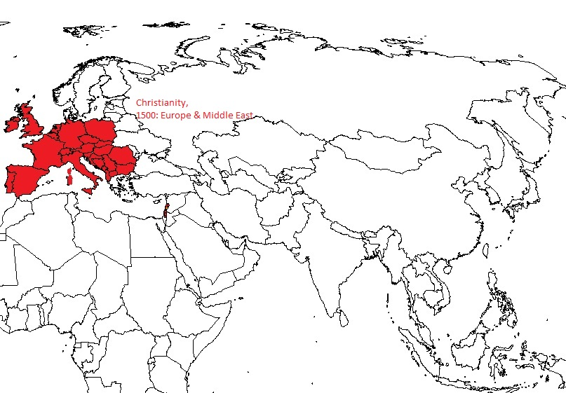
Christianity: 1500

Slide 8
Islam
Belief: Monotheistic, 5 Pillars of Islam
Founded: Middle East (Saudi Arabia)
Deity: Allah (God)
Founder: Muhammad (Prophet)
Holy Cities: Mecca, Medina
Holy Book: Koran/Qur’an
Leadership: No clergy but a scholar class who lead prayers
5 Pillars of Faith:
Faith
Alms giving
Pray 5 times a day, facing Mecca
Fasting
Pilgrimage to Mecca

Slide 9
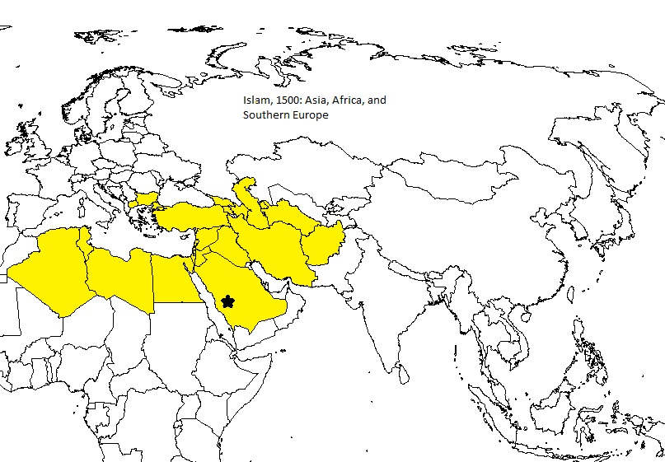
Islam: 1500

Slide 10
Hinduism
Belief: Polytheistic
Founded: India
Deity: Many forms of one god
Founder: None
Holy Writings: Vedas and Upanishads
Laws: Karma (actions = future consequences)
Reincarnation (rebirth) based on a person’s Karma
Leadership: Brahmin Priests, monks, gurus

Slide 11
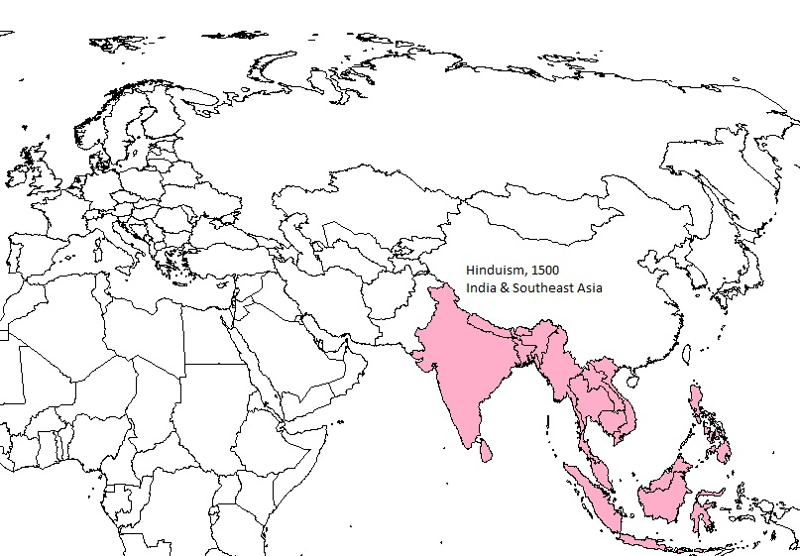
Hinduism: 1500

Slide 12
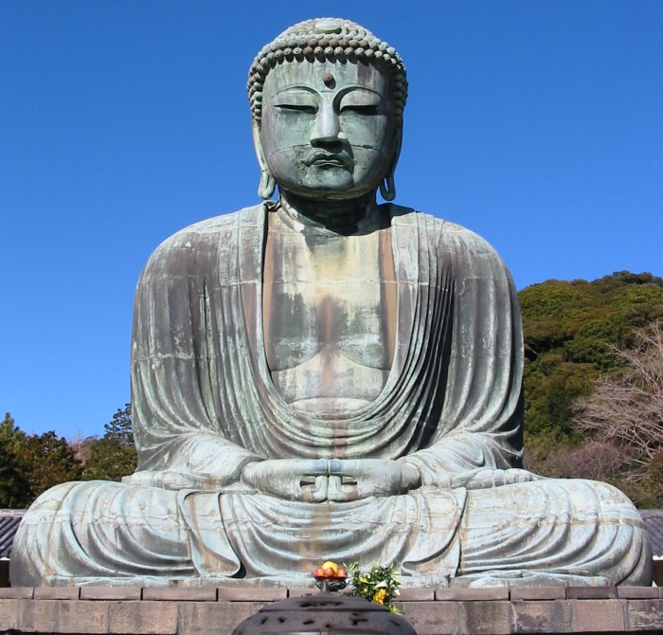
Buddhism
Belief: Non-theistic
Founded: India
Deity: No Gods
Founder: Siddhartha Gautama
Leadership: Buddhist monks and nuns
Beliefs: 4 Noble Truths, Eightfold Path to Enlightenment
Spread to Asia and into China with the missionary, Asoka’s travels & writings

Slide 13
Beliefs
Laws:
4 Noble Truths
Suffering exists
Desires make us suffer
End desires=end suffering
To end desires must follow Eightfold Path
8-fold path: follow steps to reach Nirvana (Enlightenment)

Slide 14
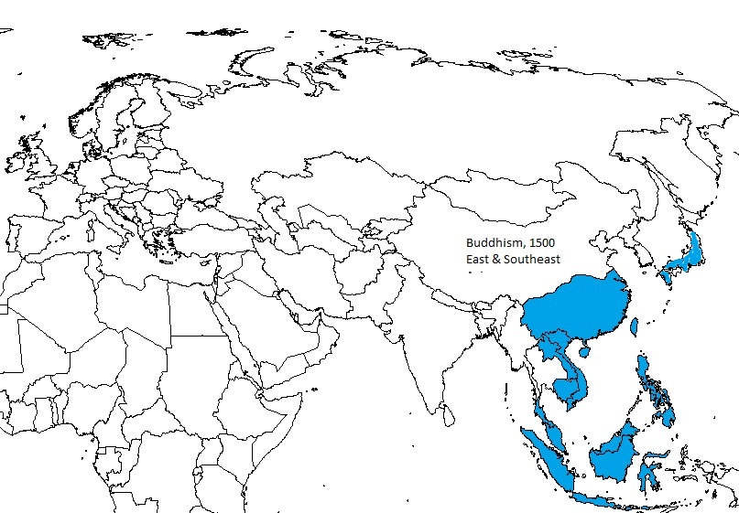
Buddhism: 1500

Slide 15
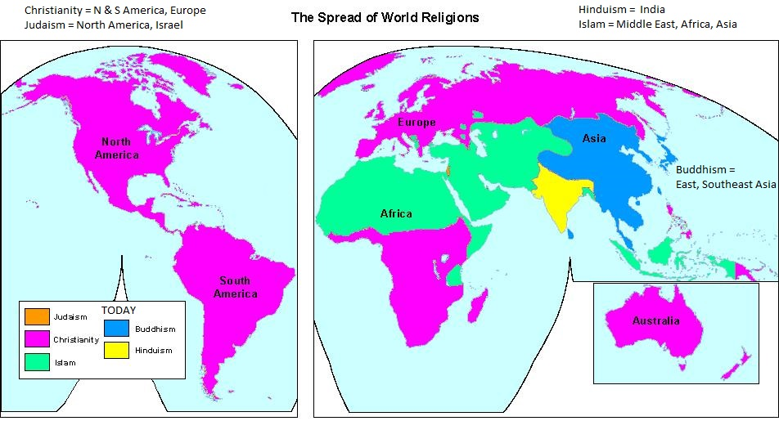
The 5 Religions Today

