Slide 1
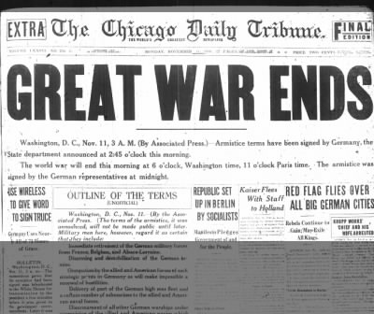
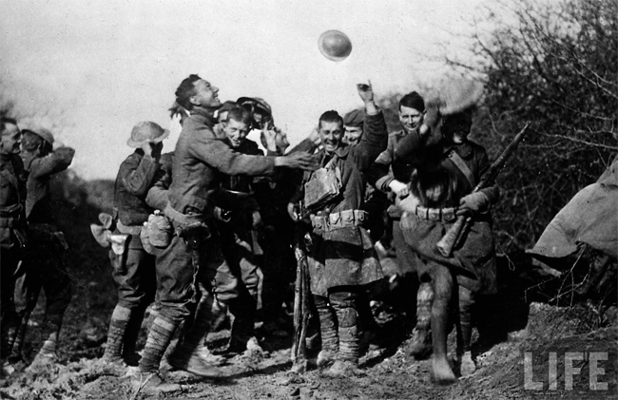
Outcomes of WWI
End of the War & Global Impact

Slide 2
Armistice Day
November 11, 1918 – World War I ends at the 11th hour of the 11th day of the 11th month!!!
Armistice is declared: when warring countries formally agree to stop fighting until a peace plan can be reached!
Today we still celebrate this day but now we just call it Veterans’ Day – November 11th

Slide 3
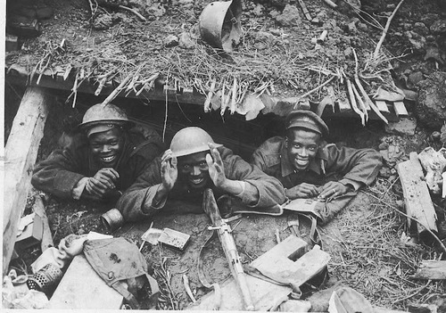
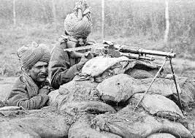
Outcomes of WWI
Imperialism went to war!
Colonized people of Africa and India fought for their Mother Countries in World War I
This led to an increase in demands for their independence from their Mother Countries!

Slide 4
Outcomes of WWI
The End of Empires!
Russian Imperial collapse when the Tsar and his entire family are killed during the Communist Revolution, ending monarchy in Russia!
The Ottoman Empire comes to an end and the Allies will divide up its territories for themselves!
German Kaiser will abdicate (give up) the throne in 1918 and Germany will lose land in the peace Treaty
The Austrian-Hungarian empire will fall and new countries will be carved from its territories!

Slide 5
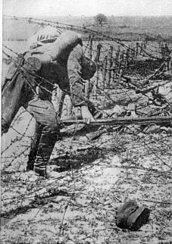
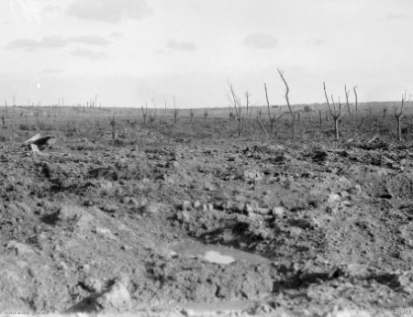
Outcomes of WWI
The Enormous Cost of Lives!
Russian Casualties: 9.2 Million
German Casualties: 7.1 Million
French Casualties: 6.2 Million
US Casualties: 323,000 men
WWI TOTAL CASUALTIES: 37.5 Million men!
Property and land were also destroyed!

Slide 6
President Woodrow Wilson’s Plan for Peace
The Fourteen Points
Woodrow Wilson outlined a plan for a just and lasting peace while the war was still raging on! He called his plan the 14 Points. It Included:
An end to secret treaties (Zimmerman?)
Freedom of the Seas (submarines?)
Free Trade between countries
Reducing armies and navies (Militarism?)
Fairness toward colonized people (Imperialism?)
Suggestions for changing borders (Nationalism?)
Point 14 = THE LEAGUE OF NATIONS

Slide 7
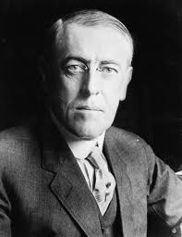
The League of Nations: Pros vs. Cons
PRO: An international cooperative organization of nations
PRO: Designed to prevent future wars!
CON: Despite being invented by the US President, the US refused to join it (tired of the war and not wanting to get involved in European affairs again!)
CON: The League had no military, no enforcement power!

Slide 8
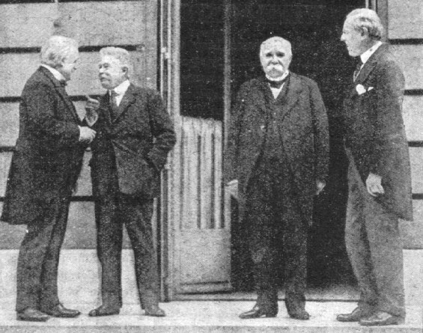
The Paris Peace Conference
Meeting to design a peace plan for WWI
“The Big Four”
Woodrow Wilson, USA
Georges Clemenceau, France
David Lloyd George, Great Britain
Vittorio Orlando, Italy
Not represented:
Russia
Germany and its allies

Slide 9
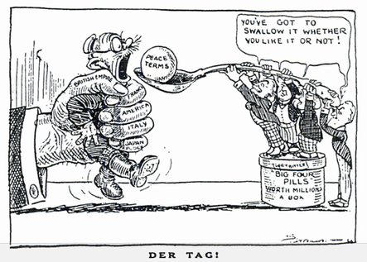
The Treaty of Versailles
June 28, 1919
The Big Four (minus Wilson) refused to accept Wilson’s peace plan EXCEPT for the 14th point → The League of Nations
Instead, they wanted to punish Germany for the war!
Question: What risk do you take when you punish the loser of a war?

Slide 10
Germany’s Punishment
Lost German land to France and Poland!
Restrictions put on their military – had to take apart their military!
War Reparations : had to pay the winners (Britain and France) $5 Billion ($20 Billion today)
The War Guilt clause
Had to accept sole responsibility for the war…wait…what was the immediate cause again???
Germany is so angry over the Treaty and they had no choice but to sign it! (FYI: The Nazi Party is formed less than a year after the Peace meeting…in 1920!!!)

Slide 11
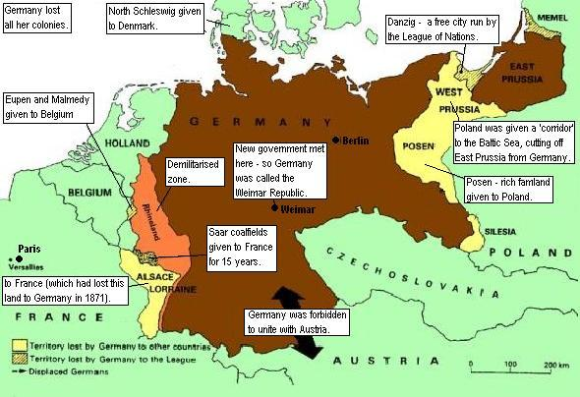
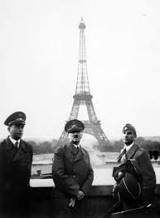
A smaller Germany!
…but not for long!

Slide 12
The Mandate System
Through the Treaty of Versailles, The Ottoman Empire’s territories were divided into MANDATES:
Territories controlled by the League of Nations and the allies until they were judged to be ready for independence
British Mandates: Transjordan (later Jordan), Palestine, Iraq
French Mandates: Syria, Lebanon
Planted the seeds for future conflict in the Middle East based on religious conflict

Slide 13
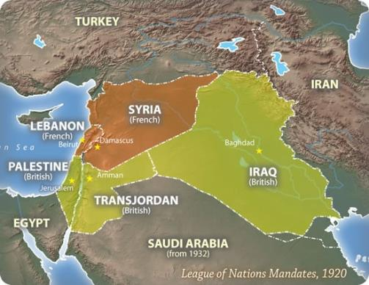
Mandates in Middle East
French Mandates
Syria
Lebanon
British Mandates
Jordan (originally Transjordan)
Palestine
Iraq

