Slide 1
Nationalism and Unification

Slide 2
Philosophies
Conservative: usually wealthy property owners and nobility. They argued for protecting the traditional monarchies of Europe.
Liberal: mostly middle-class business leaders and merchants. They wanted to give more power to the elected parliaments, but only the educated and landowners would vote.
Radical: favored drastic change to extend democracy to all people. Believed gov’t should practice ideals of the French Revolution- liberty, equality, brotherhood.

Slide 3
Nationalism
National pride, economic competition, and democratic ideals stimulated the growth of nationalism.
Nationalism: the belief that people’s greatest loyalty should be to a nation of people or the state who share a common culture and history.

Slide 4
Continental Europe
The terms of the Congress of Vienna led to widespread discontent in Europe, especially in Italy and the German states. Unsuccessful revolutions of 1848 increased nationalistic tensions.

Slide 5
United Kingdom
The United Kingdom (Britain), unlike the rest of Europe, expanded political rights through legislative means and made slavery illegal in the British Empire.

Slide 6
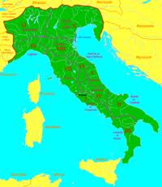
Unification
Italy
Count Camillo Cavour unified Northern Italy (Sardinia). Noble and wealthy.
Giuseppe Garibaldi joined southern Italy to northern Italy – Nationalist leader, armies of common people
The Papal States, including Rome, became the last to join Italy.

Slide 7
German States
Otto von Bismarck led Prussia in the unification of Germany through war and by appealing to the nationalist feelings.
Bismarck’s actions were seen as an example of Realpolitik, which justifies all means to achieve and hold power.
The Franco-Prussian War led to the creation of the German state.

Slide 8
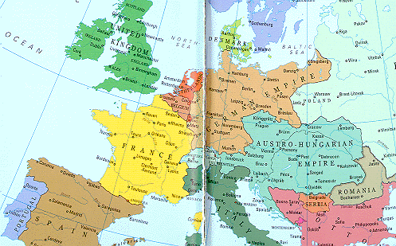
The Rise of Germany

