Slide 1
Napoleon
And the Congress of Vienna

Slide 2
Effects of the french Revolution
The French Revolution left a powerful legacy for world history: secular society, nationalism, and democratic ideas.
Amongst unrest in the country, Napoleon seized power with the support of the people. Awakening of feelings of national pride and growth of nationalism.

Slide 3
Napoleonic Changes
Napoleon supported laws that would strengthen the central government
Set up efficient method of tax collection
Established national banking system
Napoleonic Code
              Uniform set of laws and eliminated injustices
              Encouraged freedom of speech and press
              1804 crowns himself emperor

Slide 4
Napoleon creates an Empire
Napoleon wanted to control all of Europe and reassert French power in the Americas.
Napoleon sold the Louisiana Territory to the U.S. to pay for his siege of Europe
Annexed Austrian Netherlands, Switzerland, Italy, France, Prussia and Russia

Slide 5
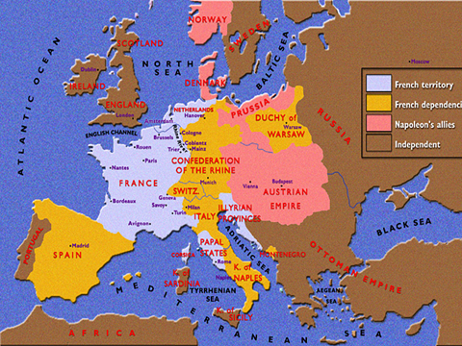
Napoleon’s Empire

Slide 6
Collapse Of the Empire
1812 Invasion of Russia
      Russia refused to stop selling grain to Great Britain
      Napoleon feared Russia was trying to annex Poland
      So he marched 420,000 soldiers into Russia, only about 30,000 would survive.

Slide 7
Collapse of the Empire
            Russians refused to be lured into battle. Practiced scorched-earth policy
            Burned Moscow to prevent Napoleon from taking it
            British exiled Napoleon to St. Helena, remote island in South Atlantic
            Napoleon’s attempt to unify Europe under French domination was unsuccessful.

Slide 8
Congress of Vienna
Meeting of the four great powers that helped to defeat Napoleon
1. Wanted to return Europe to before the French Revolution and Napoleonic Wars
Russia
England
Prussia
Austria

Slide 9
Congress of
Vienna
2. “Balance of Power” doctrine.
  Belief that no one country should dominate Europe
  Maintain peace in Europe if maintain a balance of power
  Kept Europe relatively safe till WWI!

Slide 10
Congress of Vienna
3. Restoration of monarchies.
  Any monarchs driven from their thrones by Napoleon regained their thrones.
  Legitimacy: rulers overthrown by revolutions would be restored
  Tried to contain Revolutionary ideals

Slide 11

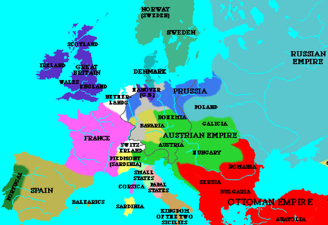
New Political Map of Europe

