Slide 1
The Monroe Doctrine

Slide 2
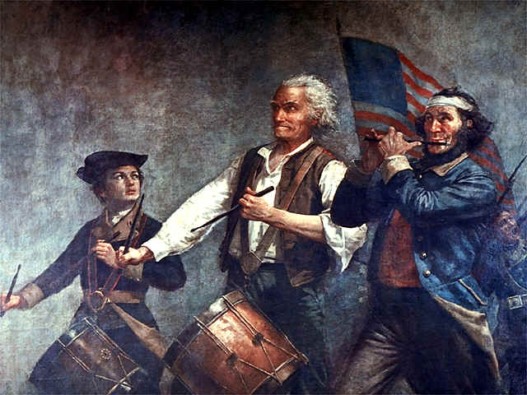
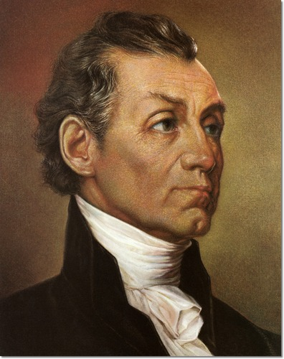
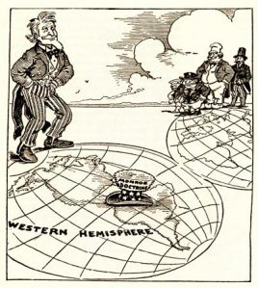
The Monroe Doctrine
After the Revolution, US wished to prevent foreign interference in America
The Monroe Doctrine was issued in 1823 by the President
Alerted Europe that America shouldn’t be considered for future colonization

Slide 3
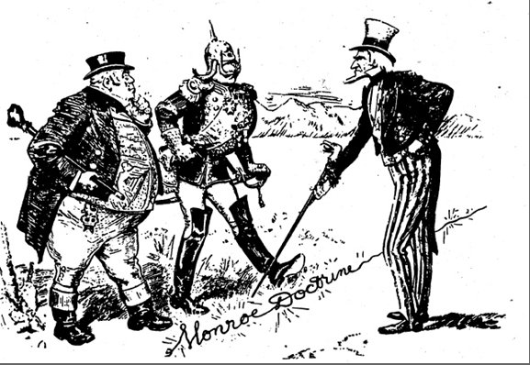
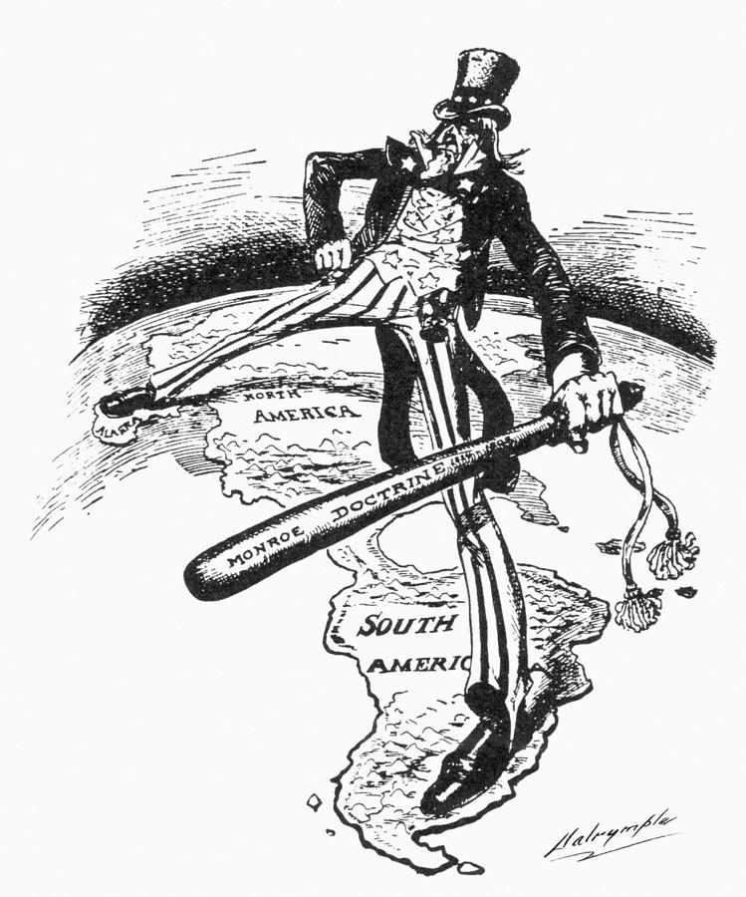
The Latin American Empire
Most Latin American colonies gained independence by early 1800’s
Latin Americans feared Europe would try to reconquer new republics
Latin America supported Monroe Doctrine, but also worried about the US interfering in their affairs

Slide 4
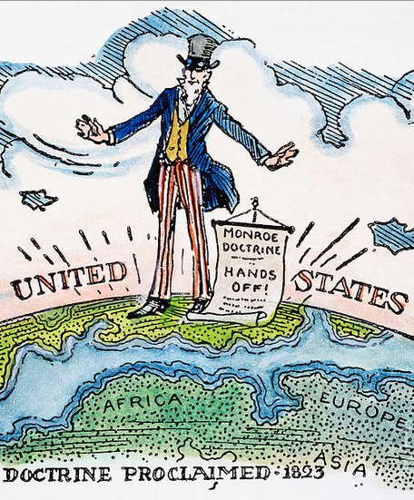
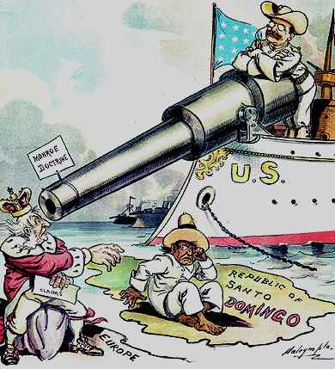
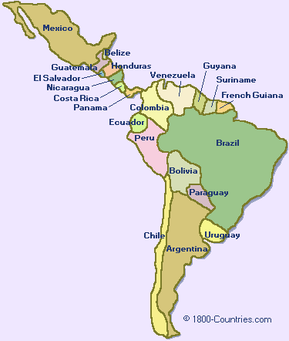
Impact of the Monroe Doctrine
Latin American nations were acknowledged to be independent
Attempts by Europe to impose their system on independent states in the Western Hemisphere
Would be regarded as a threat to US peace & safety

