Slide 1
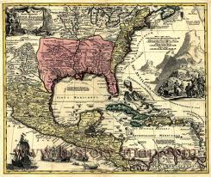
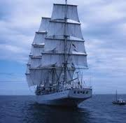
Mercantilism
Was it all bad?

Slide 2
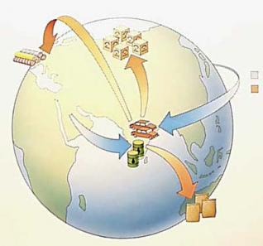
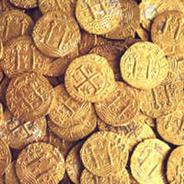
Key Terms:
Import
Export
Trade Deficit
Trade Surplus
Commercial Revolution

Slide 3
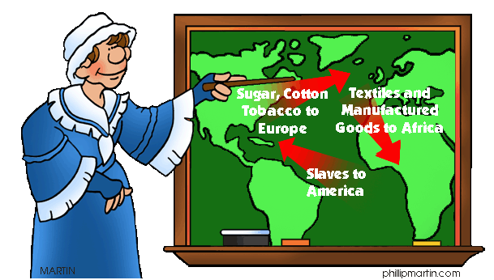
Why Mercantilism?
Economic organization that links European nations to their colonies
European countries competed for overseas markets, colonies, and resources
Goal: European Countries become self-sufficient
Don’t need trade routes or other Empires to buy from if all that they want comes from their own colonies!

Slide 4
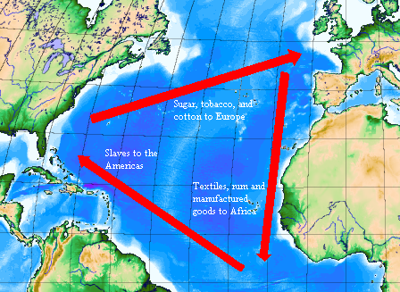
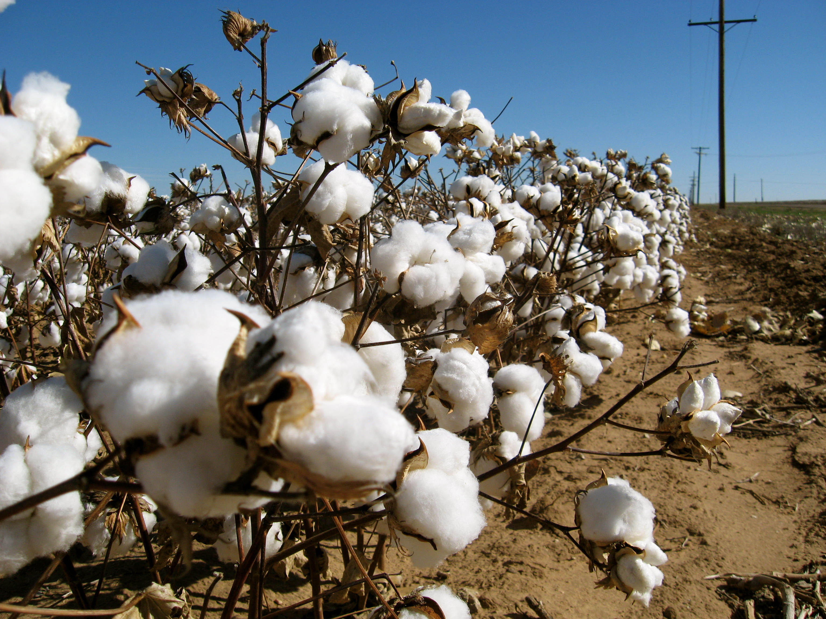
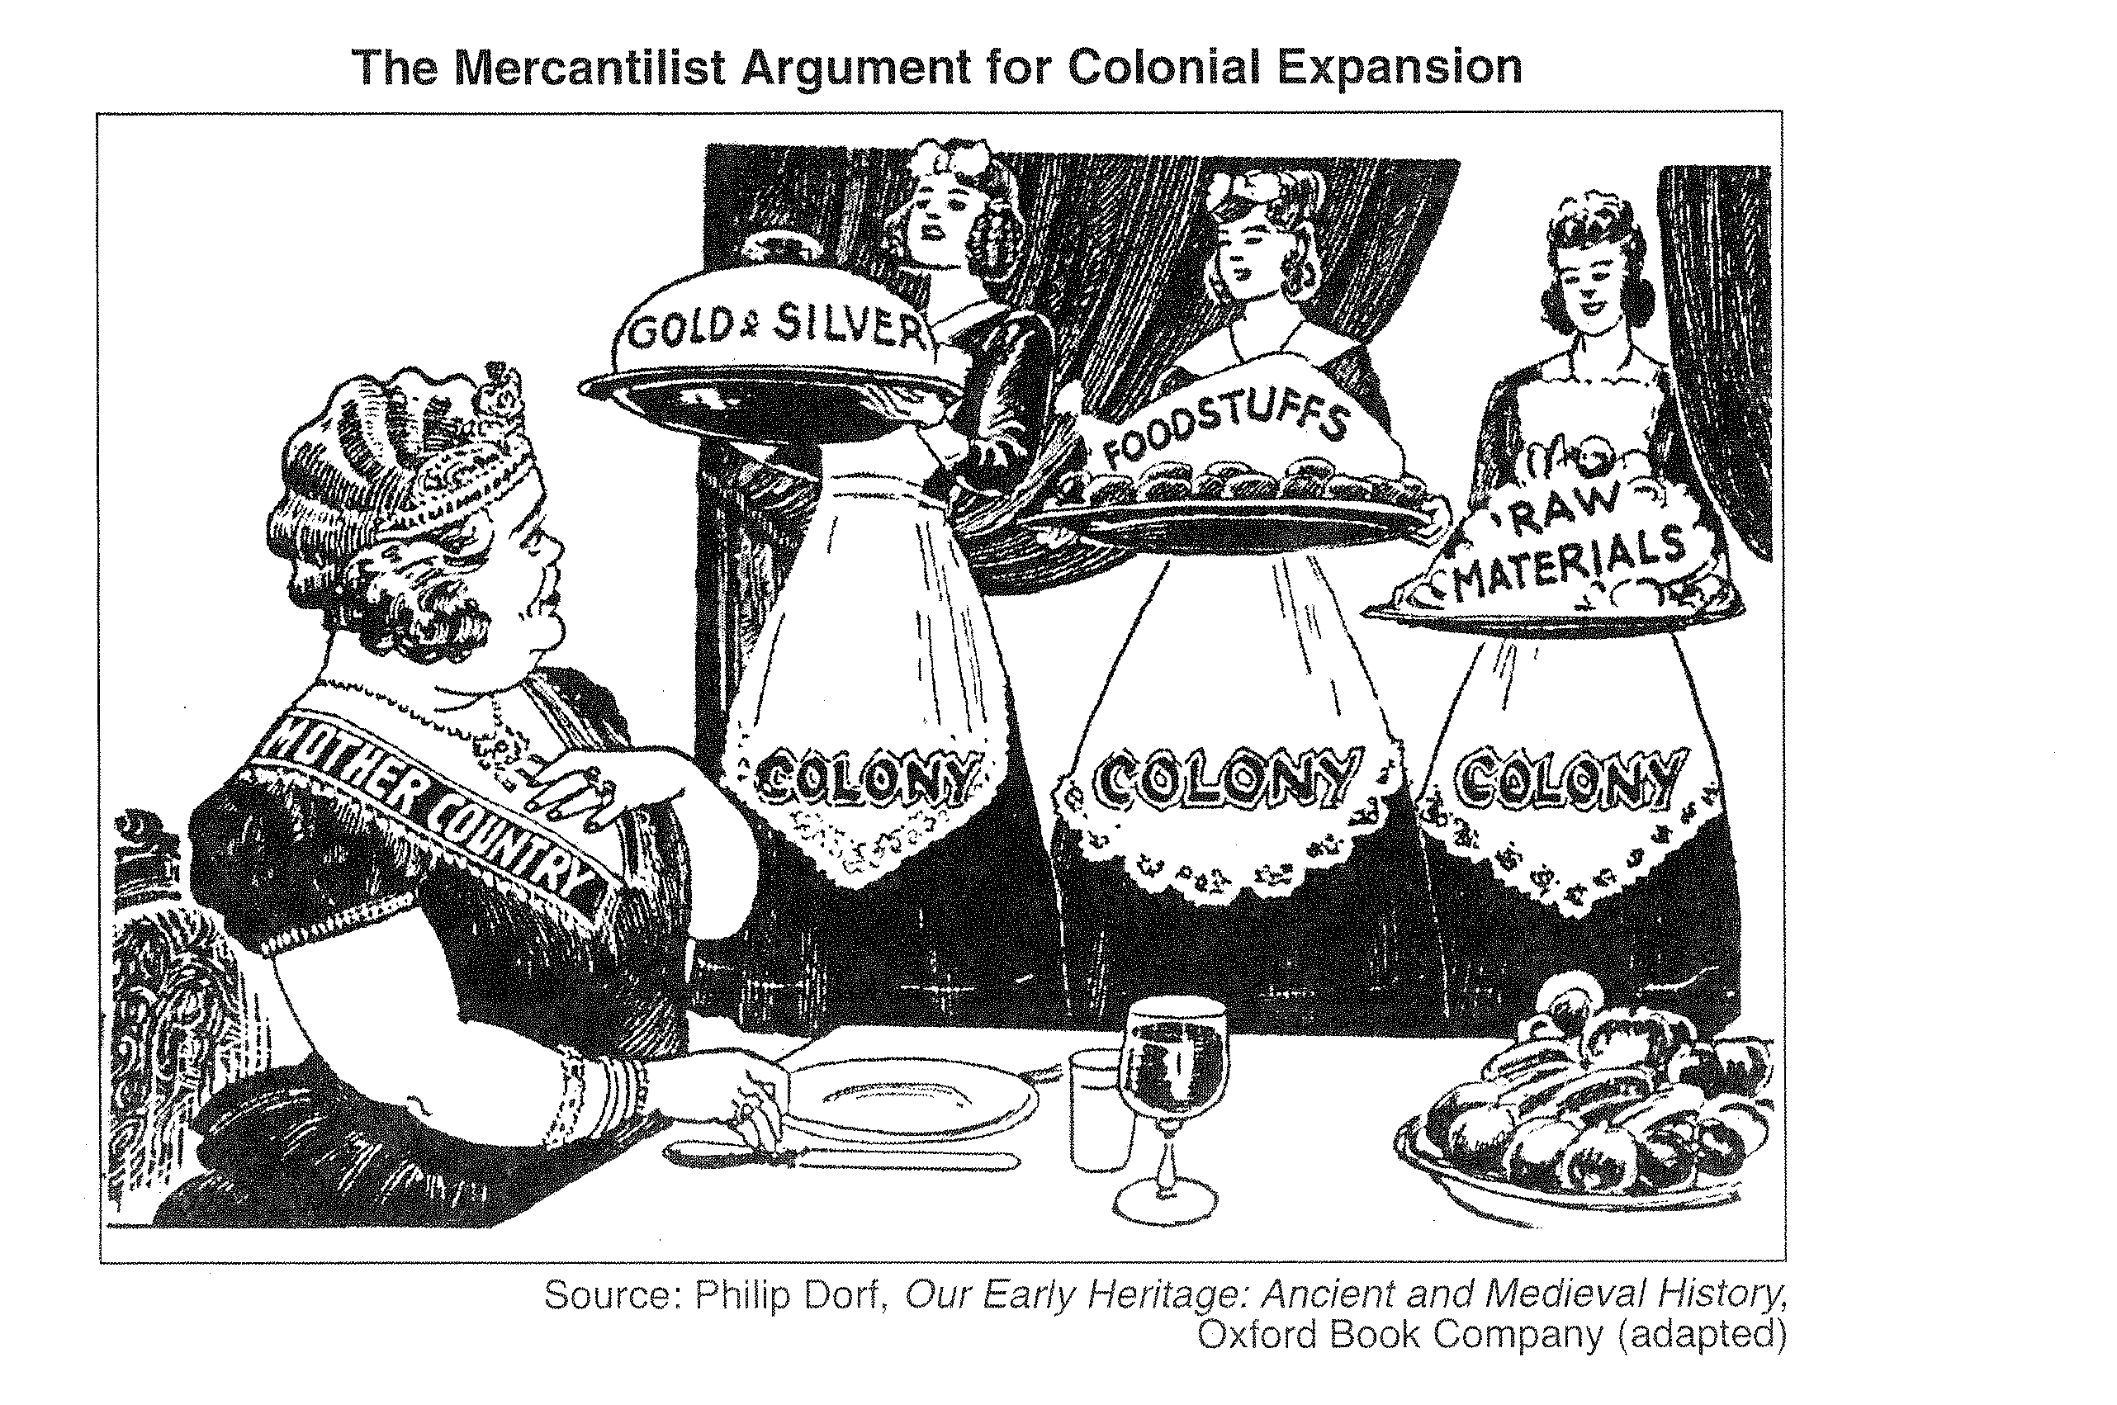
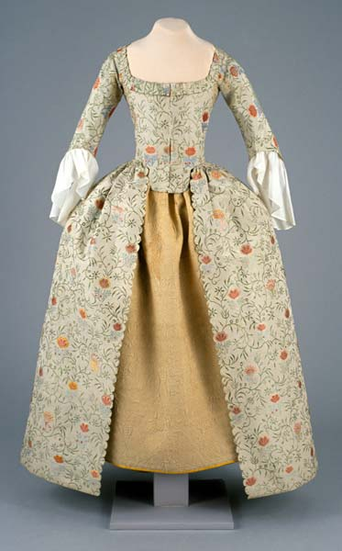
Basic Ideas of Mercantilism
Colonies exist to make the Mother Country wealthy!
Import raw materials from colony to Mother Country
Export manufactured goods from Mother Country to colony
Mother Country exports more than it imports = Favorable Balance of Trade!

Slide 5
Mercantilism: GOOD for Mother Country
Guaranteed markets = (customers/colonists)= $
Protection from competition with other European nations
Trade Surplus!
When colonies are young it limits risk by providing them a reliable trade partner & protection
Raised prices for smugglers selling to colonies!☺

Slide 6
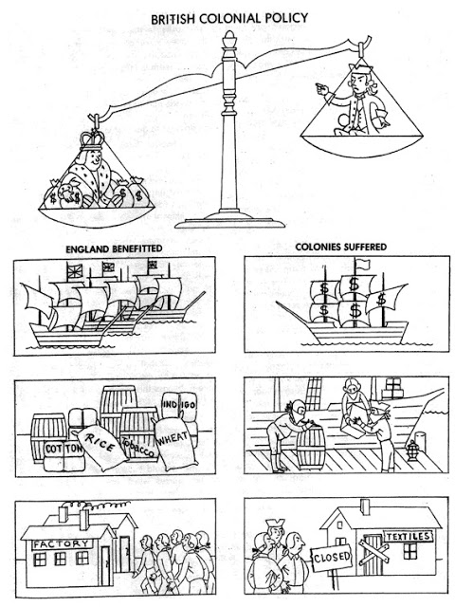
Mercantilism: BAD for Colonies!
Limited colonies’ trade opportunities with other countries (Trade Deficit)
Industrial development only happened in Mother Country
Certain UK industries protected (textiles)
Mother Country controls prices on all goods: imports & exports
Wealth ends up back in the MC

Slide 7
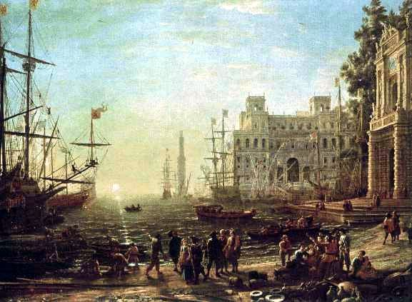
The Commercial Revolution
Colonization changed the European economy and society!
Rise of European cities (industries grow)
wealthy merchant class (social mobility)
Nationalism (pride and national identity)
monarchs grew wealthier and more powerful!
New economic systems emerged:
New money & banking systems created (Stock Companies, Investment Banking)
Economic practices such as mercantilism evolved
Colonial economies are limited by the needs of the Mother Country (colonial resentment and smuggling will grow…until…revolutions…heard of any?) ☺

