Slide 1
Major Events of WWII

Slide 2
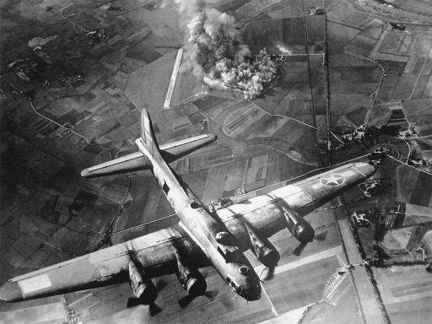
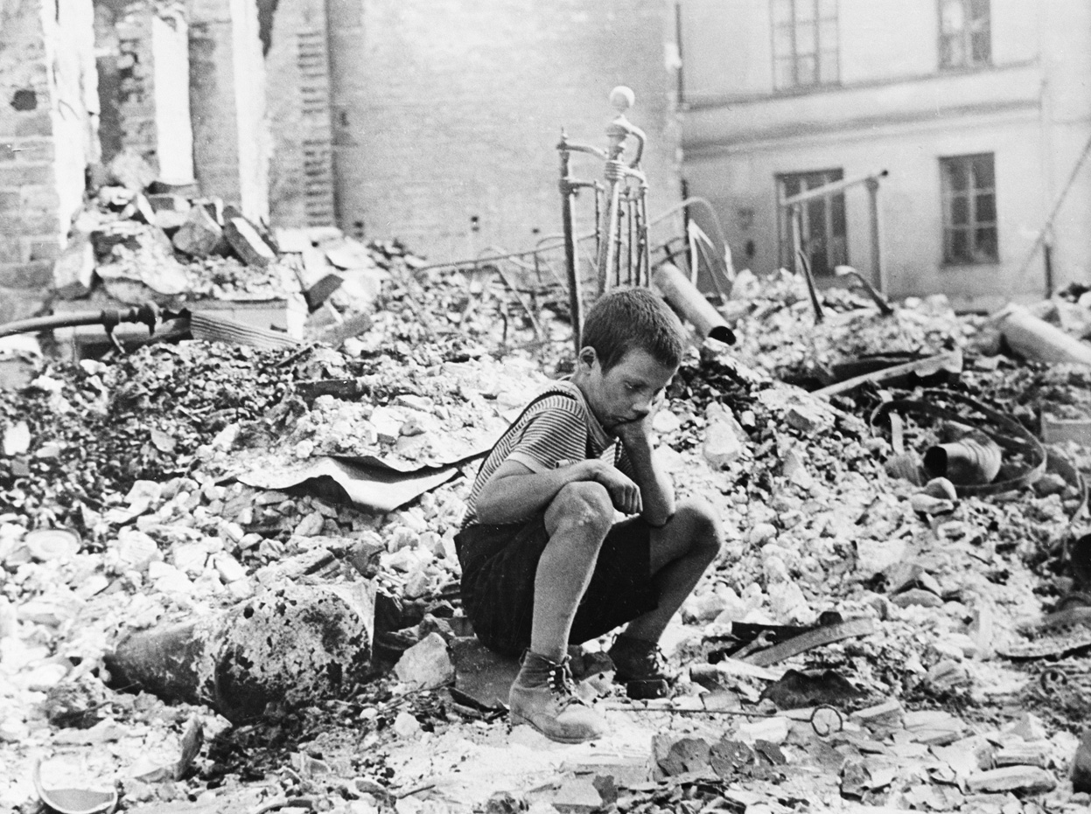
Major events of the war (1939-1945)
German invasion of Poland
September 1st, 1939
Poland fell before France and Great Britain could respond.
Hitler’s Blitzkrieg Attack - “Lightning war”- a combined attack of airplanes, tanks, and infantry (soldiers) to take enemy defenders by surprise and quickly defeat them.

Slide 3
WWII Begins with Poland
The Invasion of Poland marks the beginning of World War II
Invasion ended with Hitler signing a non-aggression pact with the USSR and promised them ½ of Poland as well as Finland, Lithuania, Latvia and Estonia.

Slide 4
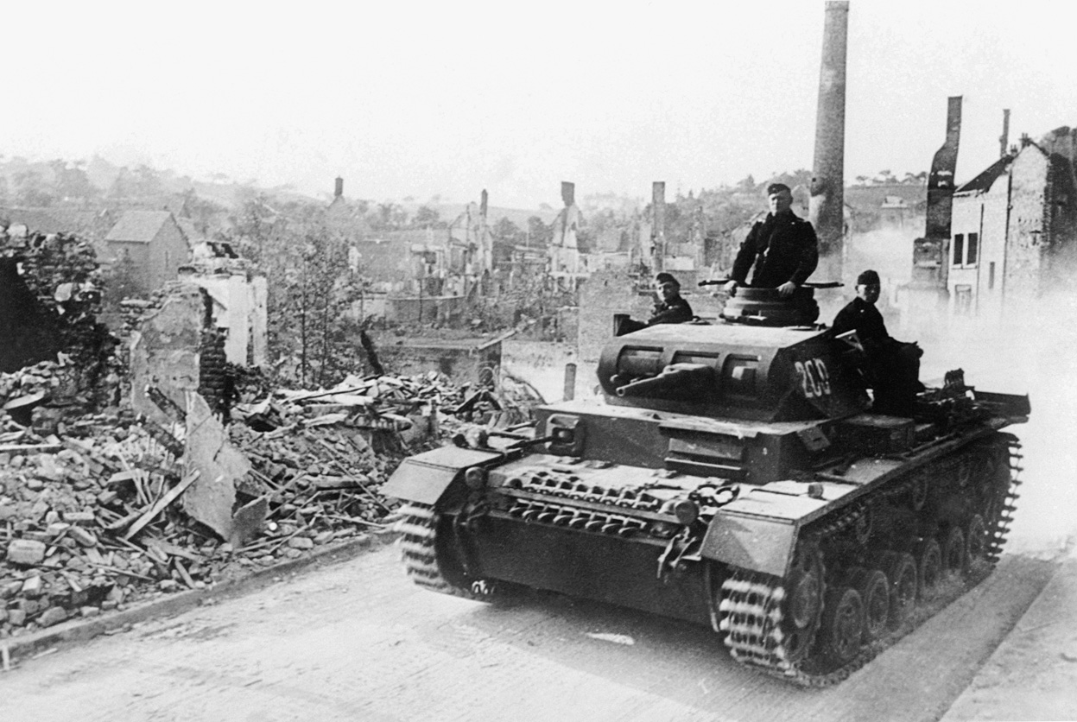
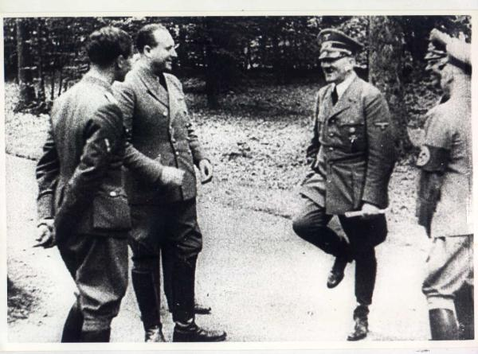
The Fall of France
May, 1940-June 1940
Germany’s organized armored attack on France, forced them to retreat to the sea.
Troops were rescued by British ships, but were unable to resist Germany.
June 22, 1940: France signs an armistice with Germany – the country fell to Germany in six weeks!

Slide 5
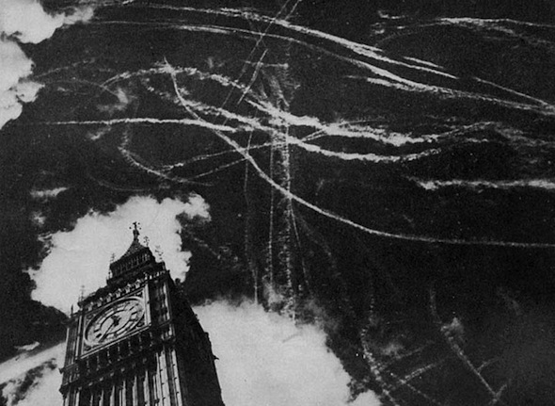
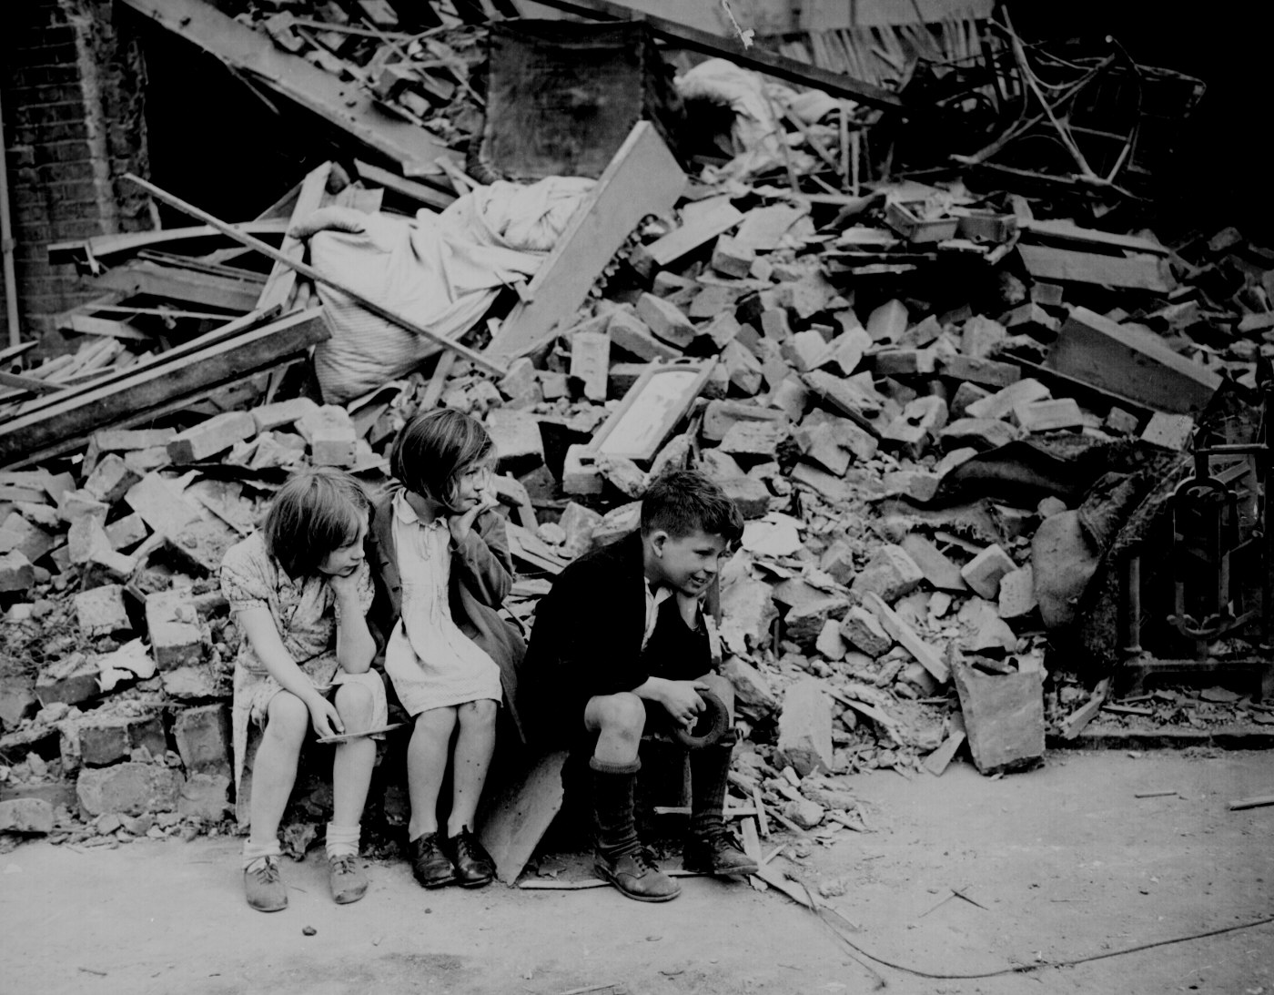
Battle of Britain
September 1940
Hitler’s Luftwaffe (air force) attacked cities to break the British morale and destroy the RAF (Royal Air Force)
Britain retaliated with Radar and the Enigma, a decoder for German secret messages.
Churchill’s speeches kept the British morale up!
May 10, 1941, Hitler called off the attack and turned focus to the Soviet Union.

Slide 6
German invasion of Soviet Union
June 22, 1941
Hitler invades an unprepared Soviet Union.
The Soviets refuse to surrender the city of Leningrad. Germany captures Moscow.
By January of 1943, with the Battle of Stalingrad, Hitler’s lost too many troops to the Russian winter and the Soviet forces, including women and children soldiers!
German troops forced to retreat: turning point in the war! Germany has lost too many men! They can no longer attack, only defend!

Slide 7
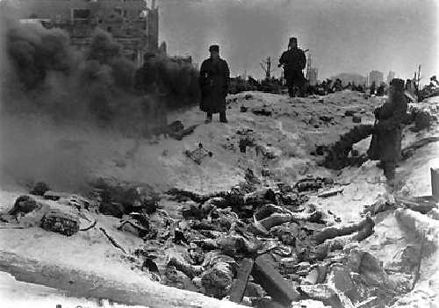
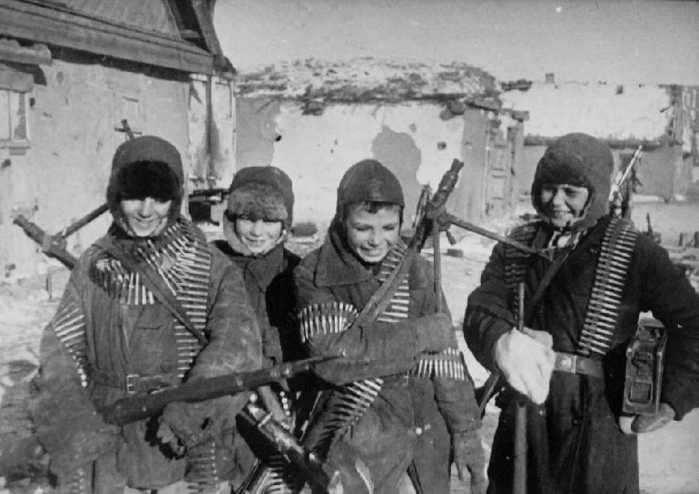
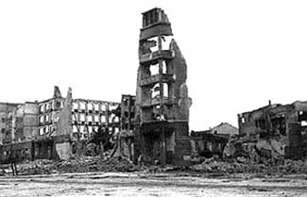
Battle of Stalingrad
Historians estimate over 1 million Soviets died, including civilians in the six month struggle.
Germans lost 500,000 men.

Slide 8
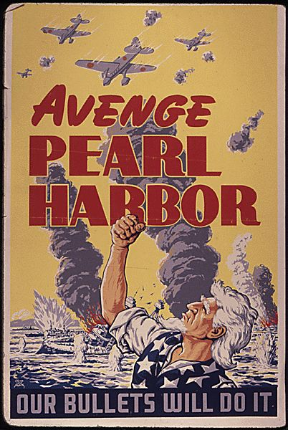
Japanese Attack on Pearl Harbor
December 7, 1941
The US cut off trade with Japan after its brutal invasion of China and its takeover of several islands in the Pacific.
As a result, Japan launched a surprise attack on Pearl Harbor, the US Navy base in Hawaii.
Damaged or sunk 19 ships, killed 2,300 people and wounded 1,100.
US declared war on Japan and its allies…joins the war!

Slide 9
D-Day (Allied invasion of Europe)
June 6, 1944
US General Dwight D. Eisenhower, ordered the attack on Normandy, coast in northwestern France.
Largest invasion force in world history!
After a month after landing at Normandy, Allied troops liberated Paris from the Germans.
By September, Allies moved on to Germany.
April 29, 1945, Hitler married Eva Braun and they committed suicide the next day.
May 7, 1945, General Eisenhower accepted unconditional surrender from Germany. (V-E Day)

Slide 10
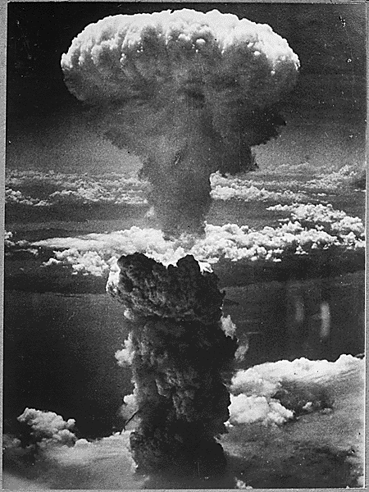
Atomic bombs dropped
August, 1945
President Truman knew there would be heavy U.S. casualties if they invaded Japan, so he offered them an opportunity to surrender. Japan did not reply.
On August 6, 1945, the United States dropped an atomic bomb on the city of Hiroshima. (killed about 80,000 people). Japan did not surrender.
On August 9, a second bomb was dropped on Nagasaki (killed 70,000 people)
Japanese finally surrendered to General Douglas MacArthur on September 2, 1945. (V-J Day)

