Slide 1
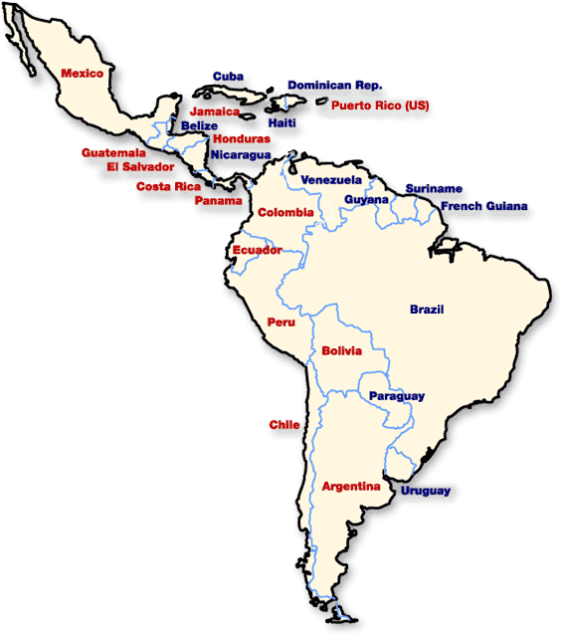
Latin American Colonial System

Slide 2
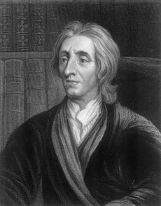
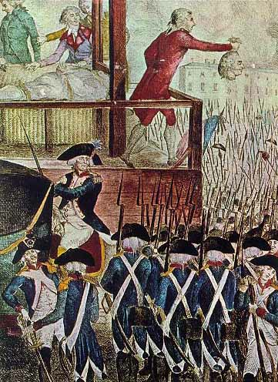
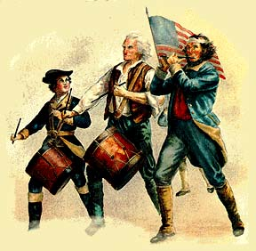
Introduction
The Enlightenment, American, & French Revolutions inspired the revolutions of the Latin American nations as they cast off the European rule.
Latin America = Mexico, Caribbean, & Central & South America

Slide 3
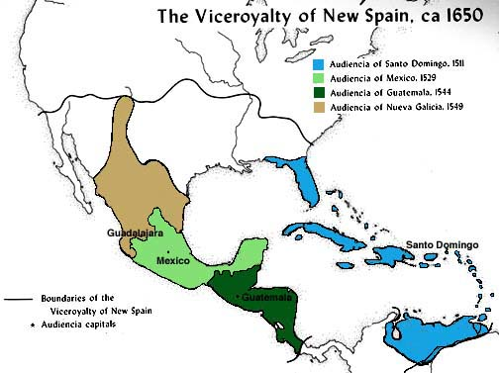
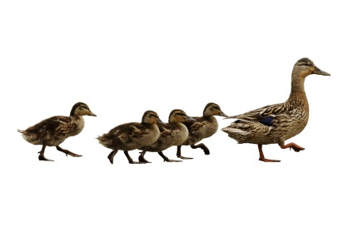
The Colonial System
Spanish Conquistadors & French explorers will set up colonies in Latin America.
Colonial governments mirrored the ways & customs of the mother country.

Slide 4
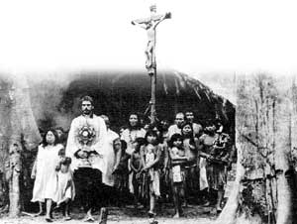
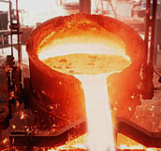
The Colonial System
Jesuit missionaries had firmly established Catholicism in the Latin America.
The colonial economies focused on the mining of precious metals.
The metals were then sent back to the mother country for production.

Slide 5
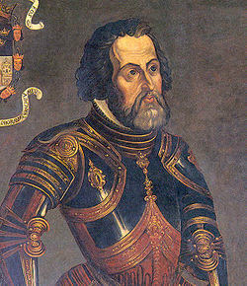
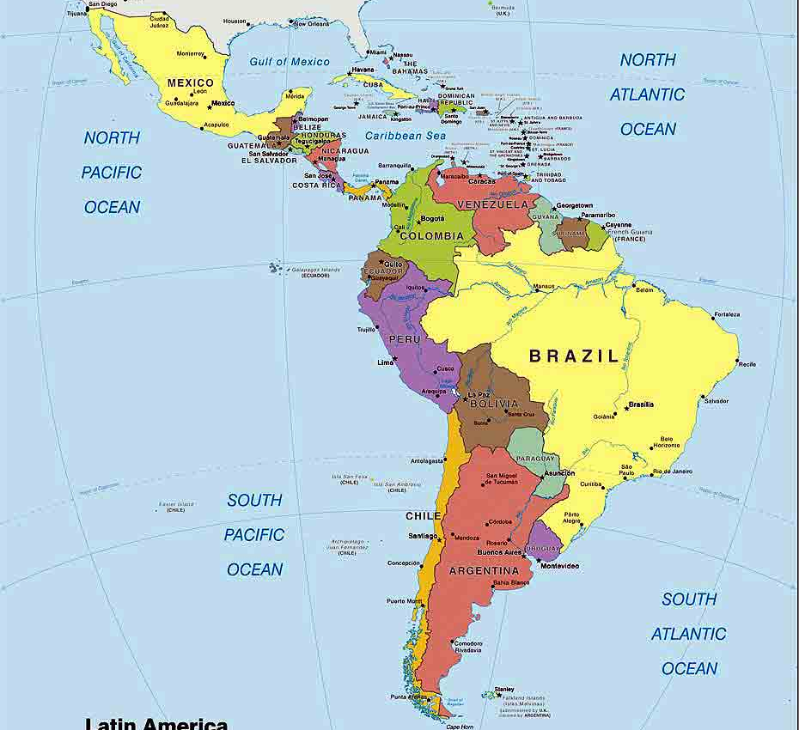
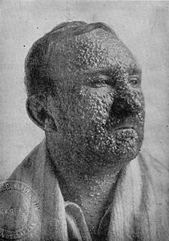
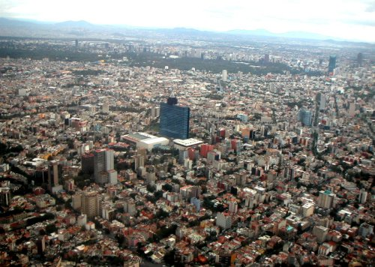
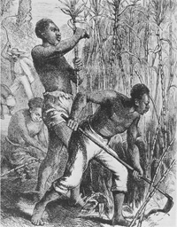
Spanish conquests in Latin America will bring destruction to the Native Americans (Disease!! = Smallpox)
To fill the void of labor, Africans will be brought in as slaves in Latin America.
Major cities developed in Latin America: Havana, Mexico City, Lima, Sau Paulo, & Buenos Aires.

Slide 6
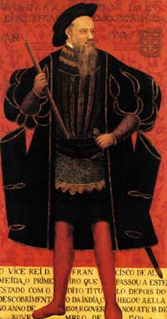
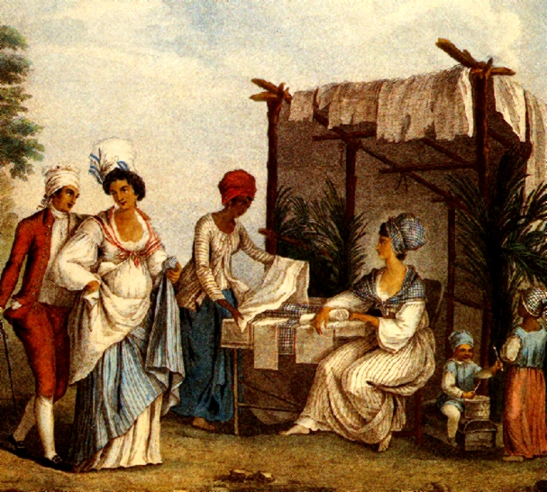
Spanish Colonial Structure
Colonial society sharply divided into classes based on birth:
Peninsulares (viceroys) = men who had been born in Spain, ruled colony in place of king, controlled all wealth & power
Creoles = 100% Spanish, but born in Latin America.
Viceroys
Creoles
Mestizos
Mulattos
Slaves & Indians

Slide 7
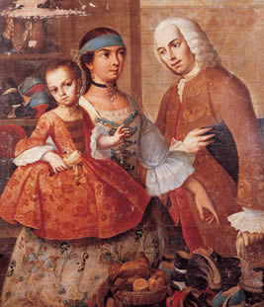
Spanish Colonial Structure
Mestizos/mulattos = Blend of Spanish & American Indian
Slaves & Indians = The bottom of the social & political ladder

