Slide 1
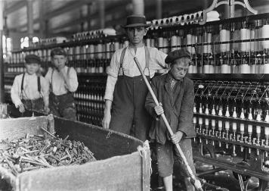
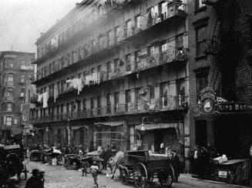
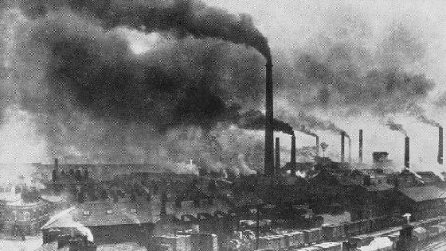
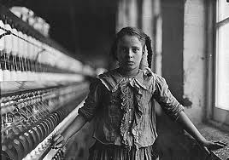
The Industrial Revolution

Slide 2
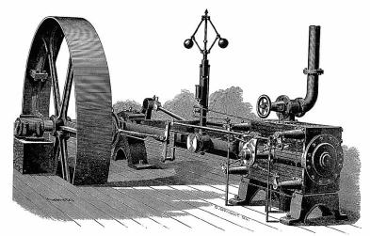
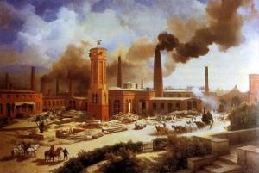
Originated in England because of its natural resources (coal, iron ore) and the invention and improvement of the steam engine
Spread across Europe and then the United States.
Began with cotton textiles (cloth), iron and steel industries

Slide 3
The British Enclosure Movement involved:
1. The wealthy landowners fencing in their land
2. Small farmers were forced off the land
Led to agricultural experimentation, like crop rotation
Crop Rotation: changing the types of crops planted each year to replenish the soil
Wheat
Carrots
Turnips

Slide 4
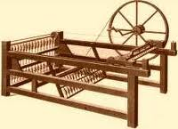
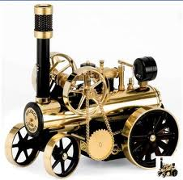
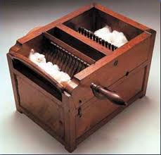
Technology
Advancements in technology created the Industrial Revolution.
Spinning jenny- James Hargreaves
Steam Engine- James Watt
Cotton gin- Eli Whitney
Process for making steel- Henry Bessemer

Slide 5
Advancements in science and medicine
Development of the smallpox vaccination- Edward Jenner
Discovery of bacteria- Louis Pasteur

Slide 6
Impact
Population increases
Increased standards of living for many but not all
Improved transportation: roads, canals, trains
Urbanization: city living instead of country living
Environmental pollution: factory waste
Increased education
Dissatisfaction of working class with working conditions in factories: low pay, long hours
Growth of the middle class

