Slide 1
Imperialism
WHII.9d, e

Slide 2
Linking the Industrial Revolution, Nationalism, and Imperialism together!
Nationalism led European countries to compete for colonial possessions in Africa and Asia – spread their economic, political, and social beliefs around the world
Industrial Revolution’s Wealth produced manufactured goods so Europe could send to their colonial markets and take away all the raw materials back to the Mother Country – sound familiar? This used to be what? (Hint…starts with an “M”)

Slide 3
Linking the Industrial Revolution, Nationalism, and Imperialism together!
Industrial Revolution flooding colonial markets with goods disrupted the traditional industries of the colonies…just like it killed the Cottage Industries in Europe!
Result – Imperialism: European countries extending their power by the taking and controlling of other territories (land).

Slide 4
Forms of Imperialism
Colonies
A country or territory governed internally by a foreign power (example: India, colony of Great Britain)
Protectorates
A country or territory with its own internal government but under the control of an outside power (example: British Nigeria in Africa)
Spheres of Influence
An area in which an outside powers claim exclusive investment or trading privileges (ex. CHINA, SUEZ CANAL)

Slide 5
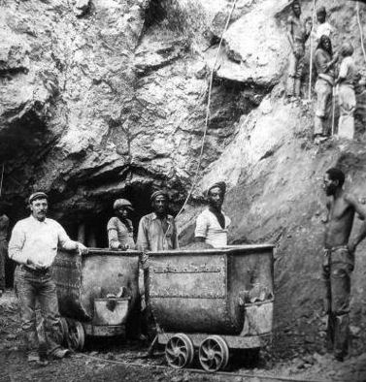
Imperialism in Africa
European domination
Viewed Africans as unable to handle the complex business of running on a country.
“The White Man’s Burden” – Europeans had a Christian duty to “civilize” the barbarians of Africa
Africans rebelled against foreign rule

Slide 6
Imperialism in Africa
Christian missionary efforts
Tried to convert natives to Christianity
Saw native religions as barbarian
African home to multiple religions, including Islam
The SUEZ CANAL – built with French money, using Egyptian labor, it became vital to British trade as a “short cut” from England to their prized colony – India! (Mediterranean to the Red Sea)
When Egypt hit poor economic times, Britain occupied Egypt and took financial control of the canal in 1882

Slide 7
Imperialism in Asia
Spheres of Influence in China – Britain, the US, Germany, etc. all had exclusive trading rights inside China. China had no say in this!
East India Company’s domination of Indian states
Used India as a major supplier of raw materials for the industrial revolution
India had to buy British goods, competition with British goods was prohibited
America’s opening of Japan to trade by threat of force (Gunboat Diplomacy) – Japan greatly resented this and later modernized their military (navy) as a result! (Foreshadow…WWII)

Slide 8
Responses of colonized peoples
Armed conflicts versus Intellectual Movements
Events leading to the Boxer Rebellion in China:
Poor peasants and workers who resented the special privileges granted to foreigners
Hated Chinese Christians who adopted a foreign faith
Fought against the Empress to protest foreign influence in Chinese affairs
Rise of Nationalism among the “natives” to take back their countries! (Intellectual movement)
Indian Nationalist Party founded in the mid-1800’s

