Slide 1
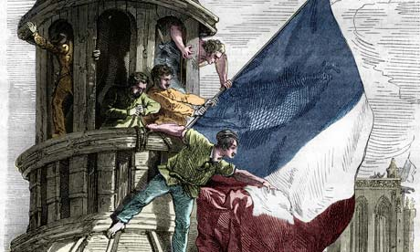
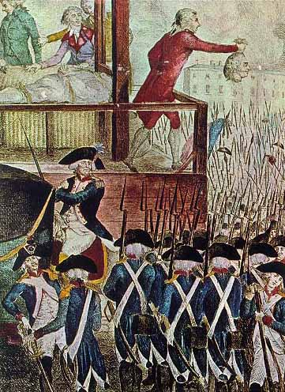
The French Revolution
WHII.6e

Slide 2
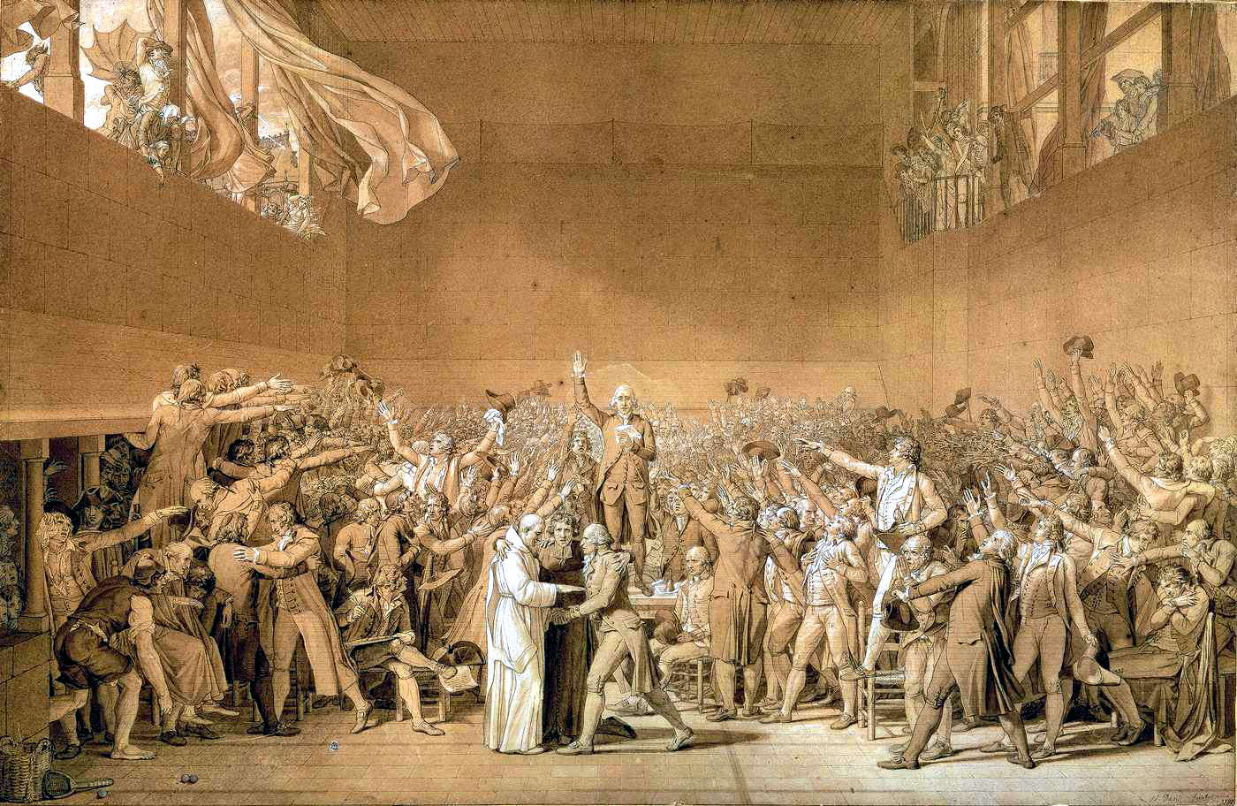
How did the Enlightenment affect the French Revolution
The people had new ideas about government and now felt that they had personal freedom

Slide 3
Pre-Revolution
France appeared to be doing well because…
Large Population
Prosperous Foreign Trade
Center of the Enlightenment

Slide 4
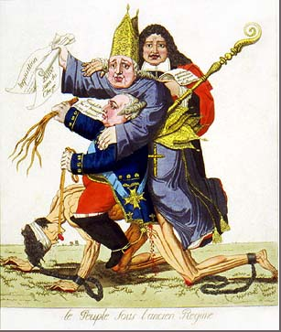
But looks can be deceiving. In reality…
There was great unrest in France.
Bad weather meant bad harvests
High taxes and prices
Questions raised by the ideas of the Enlightenment

Slide 5
Causes of the French Revolution
1. Growing resentment among the lower class
First Estate – clergy of Catholic Church
Second Estate – rich nobles
First and Second Estate paid around 1-2% of their income towards taxes
Third Estate – bourgeoisie, urban lower class, and peasants
Paid 50% of their income towards taxes
Made up 97% of France’s population

Slide 6
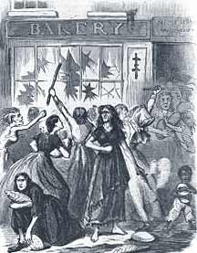
Causes of the French Revolution
2. Enlightenment Ideas and the American Revolution’s success spread to the Third Estate
3. People were poor and hungry! Bad Harvests = Bread Shortages

Slide 7
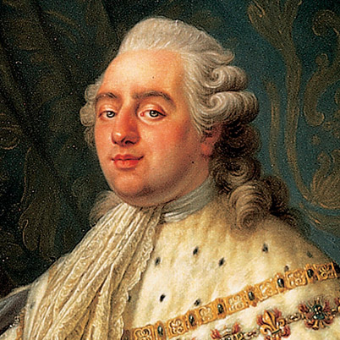
4. Monarchy was in debt (helped fund American Revolution) & king was a weak leader
Creation of the National Assembly
Marked the end of the monarchy and the beginning of a representative government

Slide 8
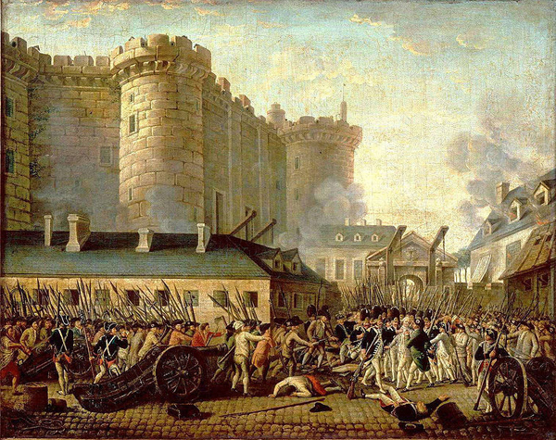
Events of the Revolution: The Bastille
July 14th, 1789
A mob searching for gunpowder and arms storm the Bastille, a prison in Paris.
Overwhelmed the guard and took control of the prison (Start of the FR!)

Slide 9
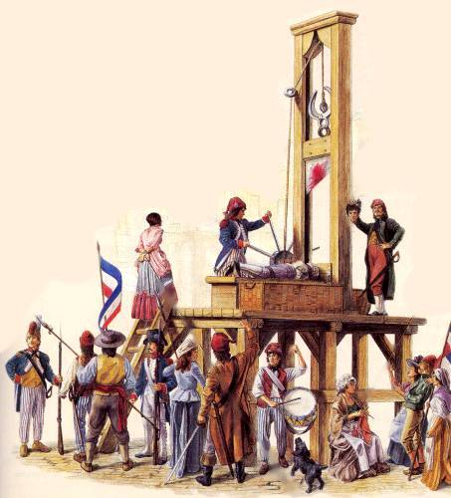
Events of the Revolution: Reign of Terror
New Leader: Maximilien Robespierre
Member of the Jacobins, a radical political organization Ruled as a dictator
“Enemies of the Revolution” were beheaded
Some were sentenced to death because they weren’t radical enough
Estimates of as many as 100,000 people were executed

Slide 10
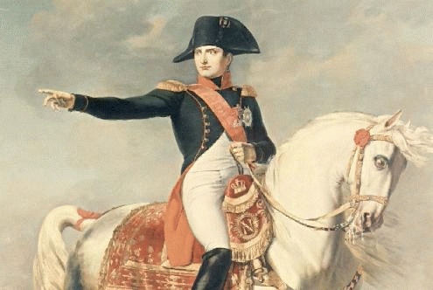
Rise of Napoleon
Members of the National Convention turned on Robespierre
July 1794: Robespierre went to the guillotine
Napolean Bonparte
Suddenly seized power in 1799 as a dictator
Coup d’etat or “Attack to the state”

