Slide 1
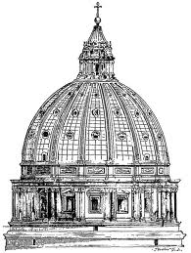
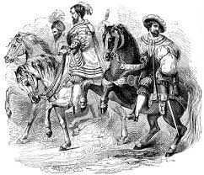
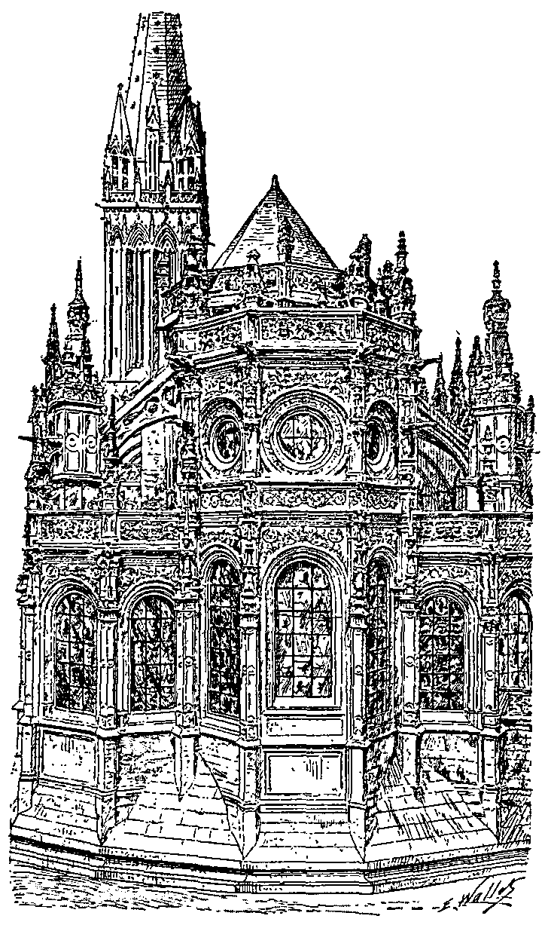
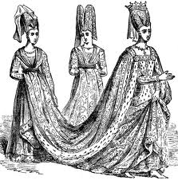
Famous Folks of the Renaissance

Slide 2
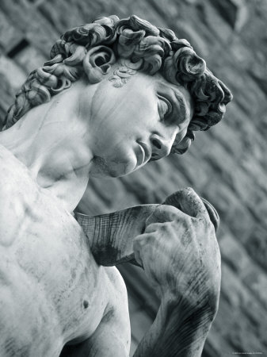
Michelangelo di Lodovico Buonarroti
Sculptor, Poet, Architect, Painter
Used a realistic style when depicting the human body in paintings and sculptures
Figures were forceful & showed heroic grandeur
Statue of David
Influenced by classical statues
1501 to 1504
18 ft tall

Slide 3
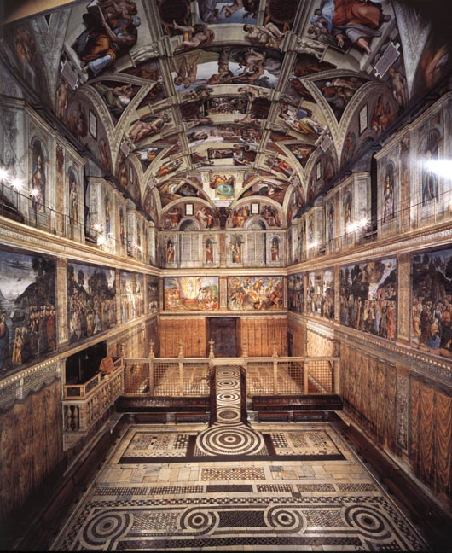
…or just…Michelangelo!
Ceiling of the Sistine Chapel
Painted while lying on his back scaffolding

Slide 4
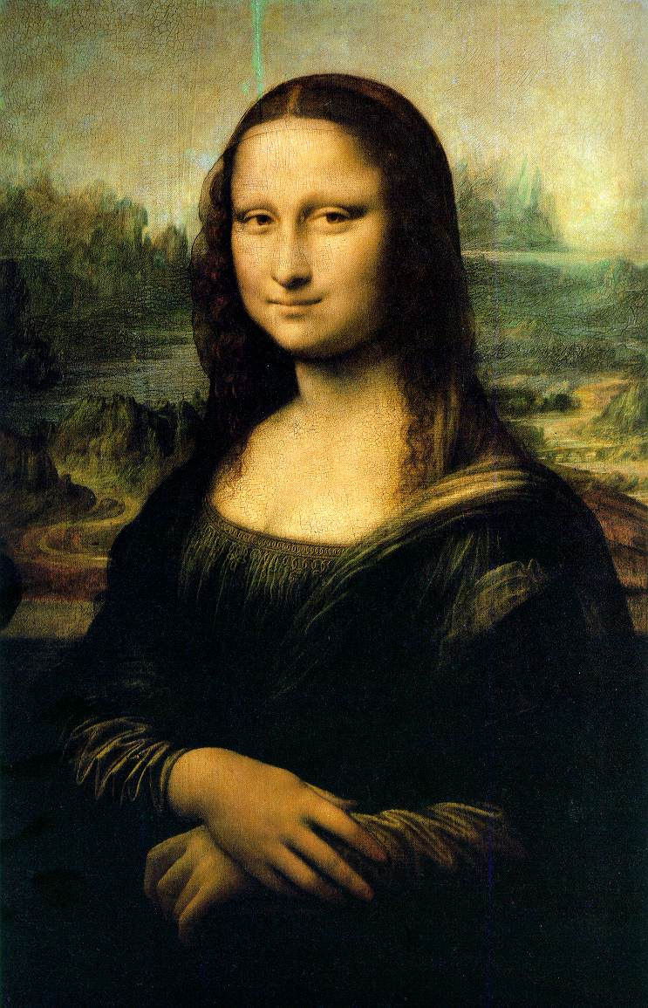
Leonardo da Vinci
Painter, Sculptor, Inventor, Scientist
Filled notebooks with his observations and sketches
Wrote them backwards
The Mona Lisa
1504-1506
One of the best known portraits in the world
“Mona” means “Ma’am” or “My Lady” in Italian. Mona Lisa refers to the subject, a married woman by the name of Lisa Gherardini

Slide 5
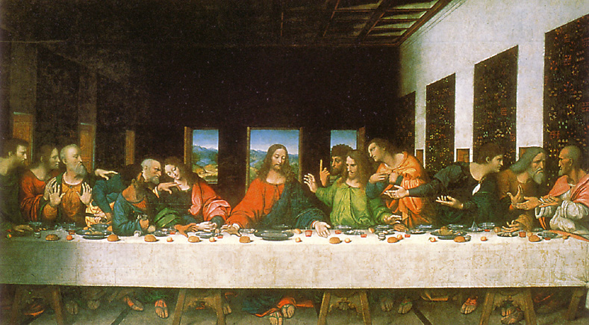
Leonardo da Vinci
The Last Supper
Meant to show the personalities of Jesus’ disciples through facial expressions

Slide 6
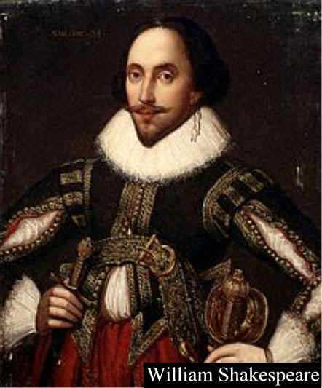
William Shakespeare
Playwright
Born in 1564
Plays had a masterful command of the English language, examined human flaws
MacBeth
Hamlet
Othello
Romeo and Juliet
King Lear

Slide 7
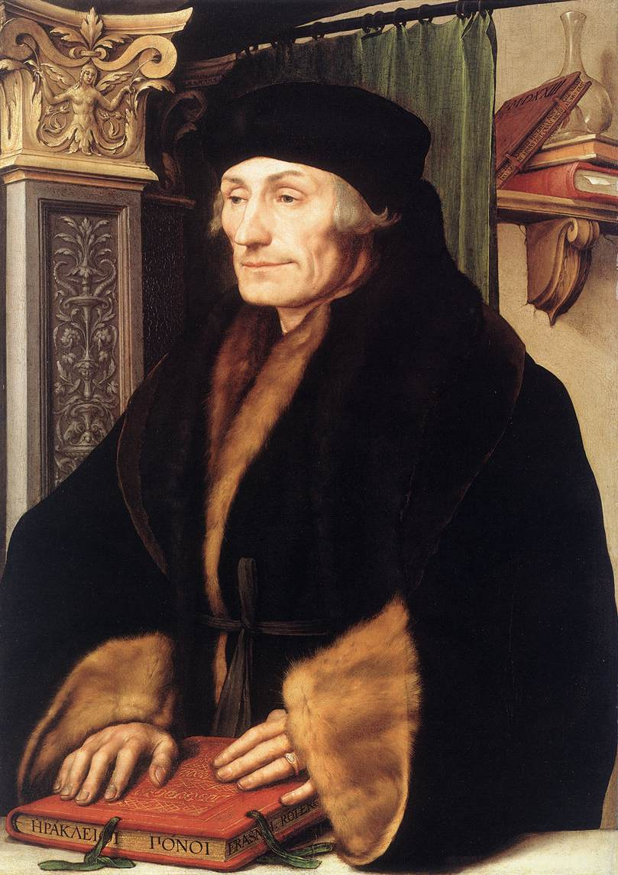
Desiderius Erasmus
Christian Humanist
Believed in Christianity of the heart, not one full of ceremonies and rules
The Praise of Folly
1509
Poked fun at greedy merchants, pompous priests, scholars and lovers

Slide 8
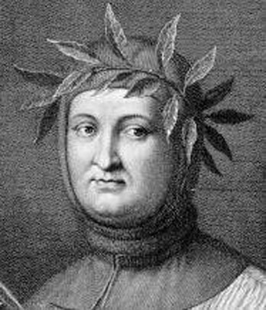
Francesco Petrarch
Poet
One of the earliest and most influential humanists
Wrote in Italian and Latin

Slide 9
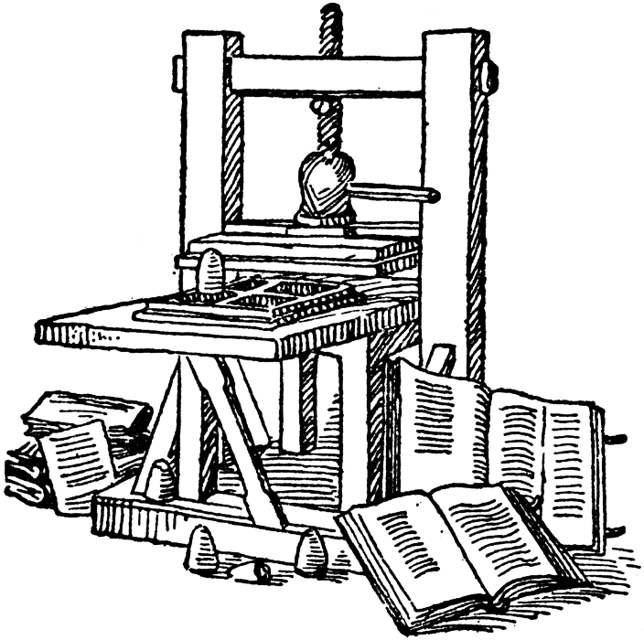
Johann Gutenberg
Craftsman from Germany
1440
Printing press
Made it possible to produce books quickly and cheaply
Increased literacy and spread the ideas of the Renaissance and the Reformation across Europe!
In 1445, he printed the first complete book on the press
Gutenberg Bible (printed in English, French, and German…the vernacular!)

Slide 10
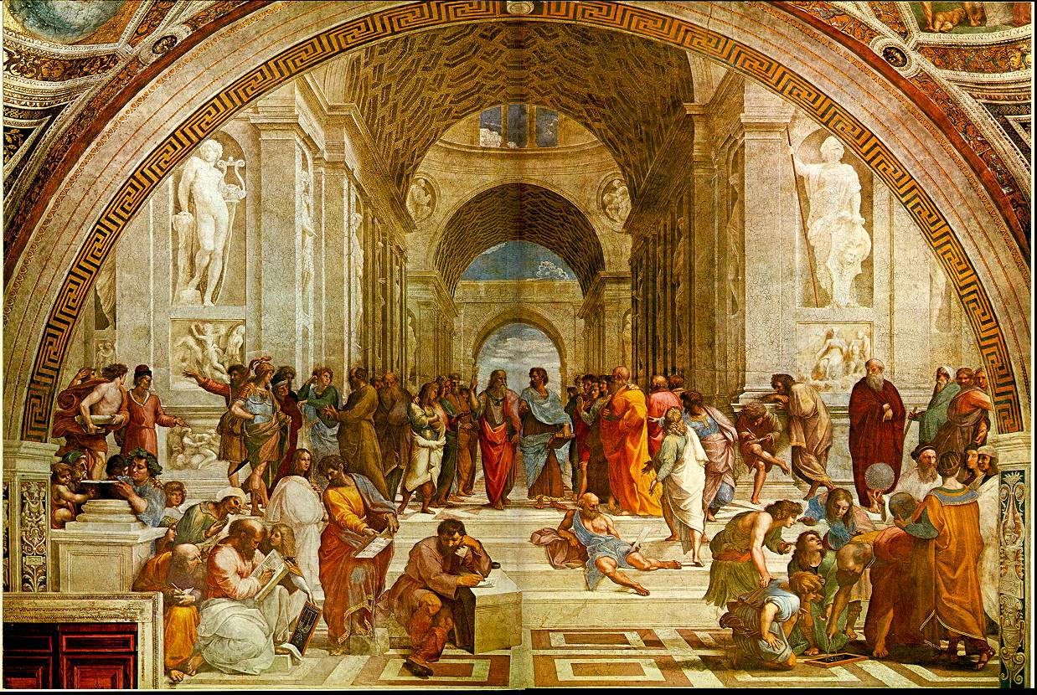
Raphael
Real name was Raffaello Sanzio da Urbino, but commonly referred to as simply Raphael
Younger than Michelangelo and da Vinci – learned from studying their works
School of Athens (revival of Ancient Greece)
Painted on the walls of Pope Julius’ library

Slide 11
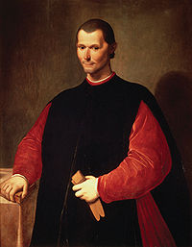
Niccolò di Bernardo dei Machiavelli
Italian historian, author
Book: The Prince
Examines how a ruler can gain power and keep it in spite of his enemies
Not concerned with what was morally right, but what was politically effective

