Slide 1
Exploration and Settlement

Slide 3
Advancements As A Result of Trade
From China: Paper, Compass, Silk & Porcelain
From India & the Middle East: Textiles, numeral system
Scientific Knowledge
Medicine
Astronomy
Mathematics

Slide 4
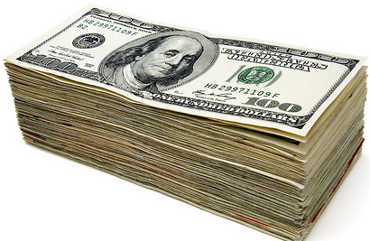
Why were Europeans interested in discovering new lands and markets?
Expanding economies of European states stimulated increased trade with markets in Asia.

Slide 5
One motive for exploration…
Support for the diffusion, or spread, of Christianity
Protestant and Catholic colonists from European countries carried their faith, language and cultures to new lands
Converted indigenous peoples to Christianity

Slide 6
What else…?
Demand for gold, spice and resources in Europe
Political/Economic Competition
Innovations in navigational arts (European & Islamic origins)
Role of Prince Henry the Navigator

Slide 7
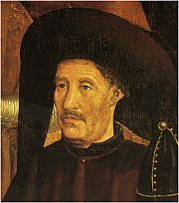
Prince Henry
Prince Henry was the son of Portugal’s king
Dreamed of finding new lands and wished to spread the Christian faith
Established a navigation school in 1419
With his own $$$
Organized 14 voyages along the coast of W. Africa but never went on any of them

Slide 8
What were the effects of European migration and settlement? …In Africa? …In Asia? …In the Americas?

Slide 9
In Africa…
European trading posts were created along the coast
Experience trade in slaves, gold and other resources

Slide 10
In Asia…
Colonization by small groups of merchants from India, the Indies and China
Influence of trading companies (Portuguese, Dutch and British)

Slide 11
In the Americas…
European countries R.A.C.E.D. to conquer the Americas

Slide 12
R… Rigid class system and dictatorship in Latin America
Spanish on TOP
Mestizos
(Part Spanish, Part Native American)
Native Americans, Slaves on bottom

Slide 13
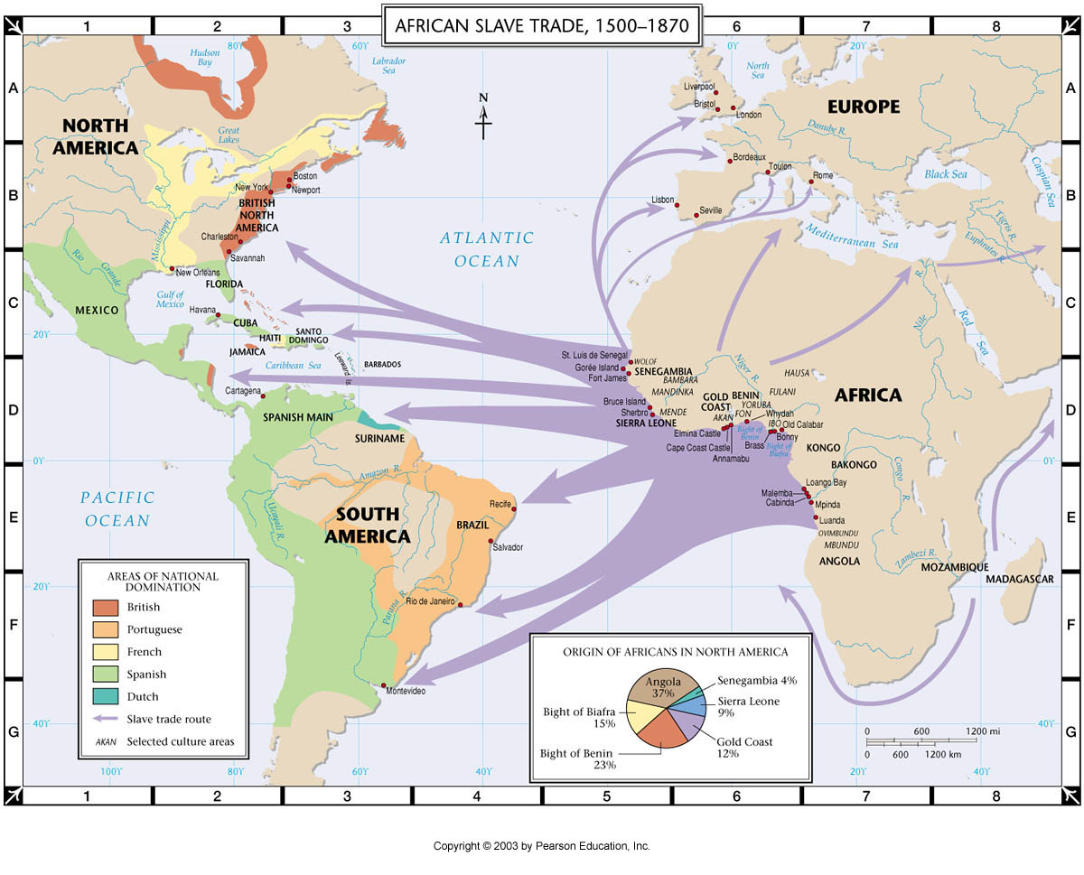
A… Africans brought as slaves

Slide 14
C… Colonies imitate culture of parent country

Slide 15
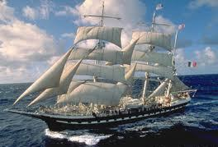
E… Europeans Immigrate

Slide 16
D… Demise of the Aztecs and Incans

Slide 17
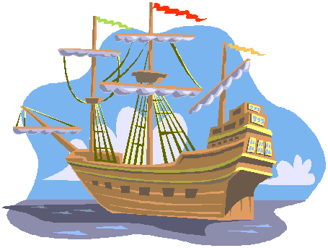
Who were some important explorers?
Portugal
Vasco de Gama
Spain
Christopher Columbus
Hernando Cortez
Francisco Pizzaro
Ferdinand Magellan

Slide 18
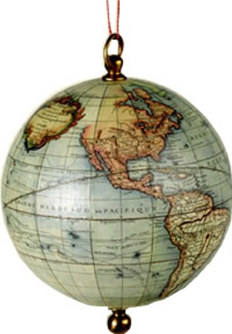
Who were some important explorers?
England
Francis Drake
France
Jacques Cartier

