Slide 1
THE EXECUTIVE BRANCH

Slide 2
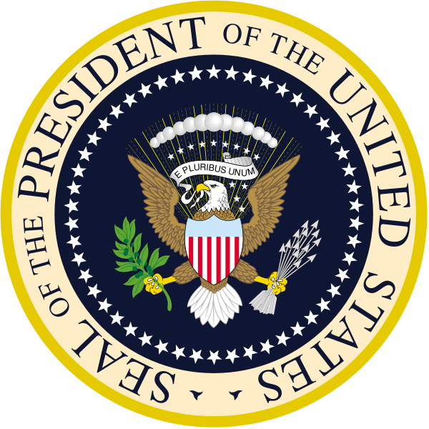
THE EXECUTIVE BRANCH
Established by Article II of the Constitution
The executive branch enforces laws, and the President is the head of the branch
The POTUS (President of the United States of America) carries out many official and unofficial roles in what is perhaps the world’s most high profile political office

Slide 3
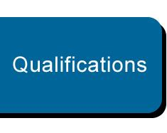
QUALIFICATIONS
To be eligible to run for President, a candidate must:
  Be 35 years old
    Youngest president- Theodore Roosevelt (42- McKinley got assassinated)
    Youngest elected president- John F. Kennedy (43)
    Oldest elected President- Ronald Reagan (73)
  Be a natural born citizen
    On US soil, or have a parent that is a US citizen
  Live in the US for 14 years

Slide 4
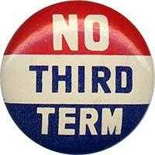
TERMS OF OFFICE
George Washington set the tradition of only serving two terms as President
Franklin Roosevelt broke tradition by being elected to a 3rd and 4th term
The 22nd Amendment officially limits the President to two terms of 4 years each or 10 years in office if a Vice-President becomes President and serves two years or less and then is elected to two terms

Slide 5
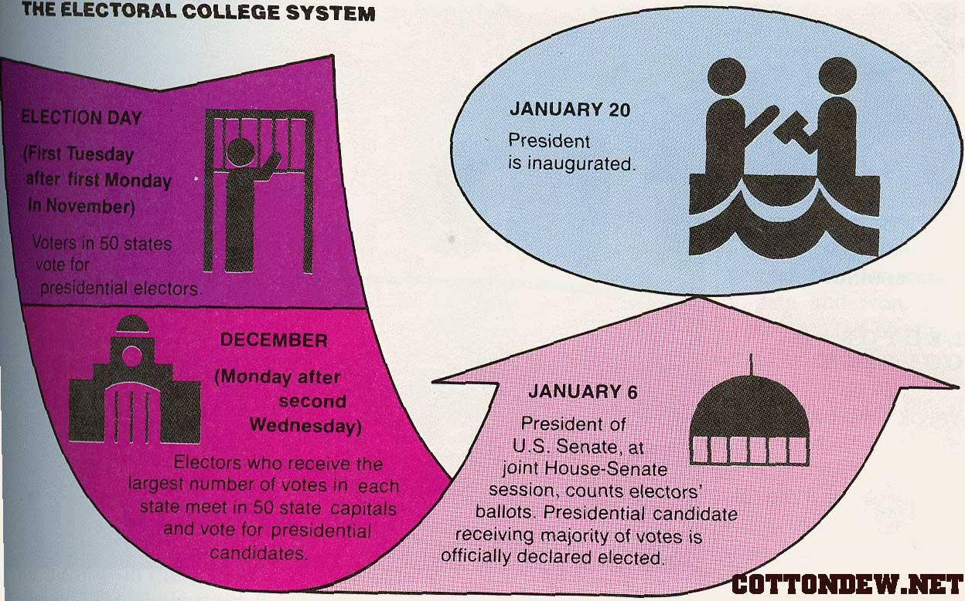
HOW IS THE PRESIDENT ELECTED?
We have elected every President using the Electoral College System
There are a total of 538 electoral votes and it takes a majority, or 270 electoral votes to be elected President. If no candidate gets a majority, the election is decided in the House of Representatives
A candidate must get a majority, and can win the popular vote and lose the election by losing the electoral college
Once elected, the president is inaugurated, or sworn in on January 20th unless that day is a Sunday

Slide 6
LINE OF SUCCESSION
No. | Office | Current officer
1 | Vice President | Joe Biden (D)
2 | Speaker of the House of Representatives | Paul Ryan (R)
3 | President pro tempore of the Senate | Orrin Hatch (R)
4 | Secretary of State | John Kerry (D)
5 | Secretary of the Treasury | Jack Lew (D)
6 | Secretary of Defense | Ash Carter (D)
7 | Attorney General | Loretta Lynch (D)
— | Secretary of the Interior | Sally Jewell (D)^{[a]}
8 | Secretary of Agriculture | Tom Vilsack (D)
9 | Secretary of Commerce | Penny Pritzker (D)
10 | Secretary of Labor | Tom Perez (D)
11 | Secretary of Health and Human Services | Sylvia Mathews Burwell (D)
12 | Secretary of Housing and Urban Development | Julián Castro (D)
13 | Secretary of Transportation | Anthony Foxx (D)
14 | Secretary of Energy | Ernest Moniz (D)
15 | Secretary of Education | John King (D)
16 | Secretary of Veterans Affairs | Bob McDonald (R)
17 | Secretary of Homeland Security | Jeh Johnson (D)
Jump up ^ Not a natural-born citizen (acquired U.S. citizenship by naturalization) and thus ineligible for the Presidency.
The 25th amendment establishes the line of succession to the Presidency
  1. Vice-President
  2. Speaker of the House
  3. President Pro Tempore of the Senate
  4.Cabinet positions in the order that they were created (Secretary of State is first)
The amendment also establishes procedures when the President is disabled.—President informs Congress, or if unable, a majority of the Cabinet and the Vice President inform Congress that the President can not fulfill his or her duties. The Vice-President is then made acting President (happened once- Reagan had surgery in 1985)

Slide 7
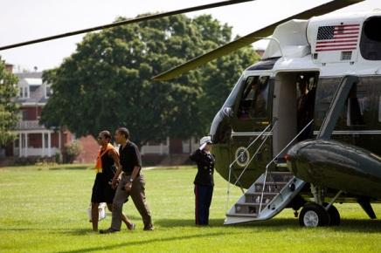
COMPENSATION
In 1789 the President was paid $25,000 a year
Today the President is paid $400,000/year
Vice President $202,000
He or she receives free medical and dental care
Lives in the White House
Access to Camp David (retreat in Maryland)
Access to aircraft- Air Force One (plane) & Marine One (helicopter)
Secret Service protection during and up to 10 years after their term
Retirement benefits

Slide 8
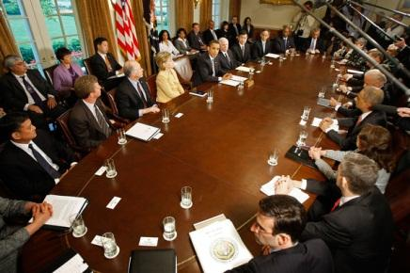
EXECUTIVE POWERS OF THE PRESIDENT
As chief administrator, the President can appoint members to positions in the executive branch, and also has the power to remove them
Executive Orders- formal statements that enable executive officials to carry out actions (it is the law- Thanksgiving, Emancipation Proclamation, desegregating schools & the military)
Executive Privilege- The President does not have to release information to Congress or the courts (courts can deny the right)

Slide 9
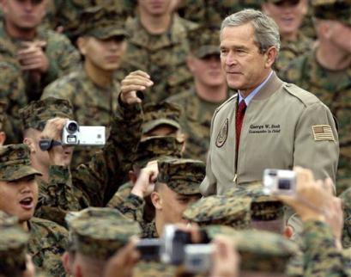
DIPLOMATIC & MILITARY POWERS
As Foreign policy leader, the President:
  Negotiates treaties
  Makes executive agreements w/ other foreign leaders concerning relations (peace w/ Vietnam, NAFTA)
  Grants diplomatic recognition (legitimizing a foreign government- Taiwan)
As commander in chief, the President initiate military action, though Congress has to be consulted first (action in Korea, Vietnam, Iraq, and Afghanistan was initiated by the President)

Slide 10
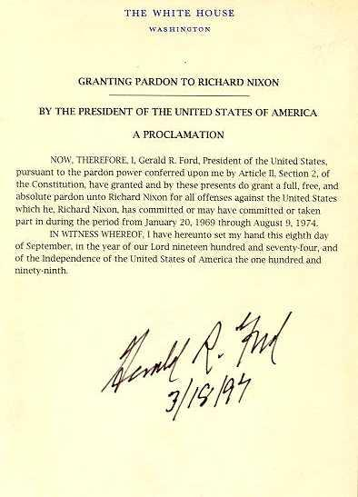
LEGISLATIVE & JUDICIAL POWERS OF THE PRESIDENT
As chief executive, the President can suggest bills and decides rather or not to sign bills into law
The President has four judicial powers
  Grant a reprieve—postponement of a sentence
  Grant a pardon---legal forgiveness of a crime (Gerald Ford pardoned Richard Nixon)
  Commute---reduce a sentence
  Grant amnesty---a blanket pardon to a group of people (1977 Jimmy Carter granted amnesty to Vietnam war draft evaders)

Slide 11
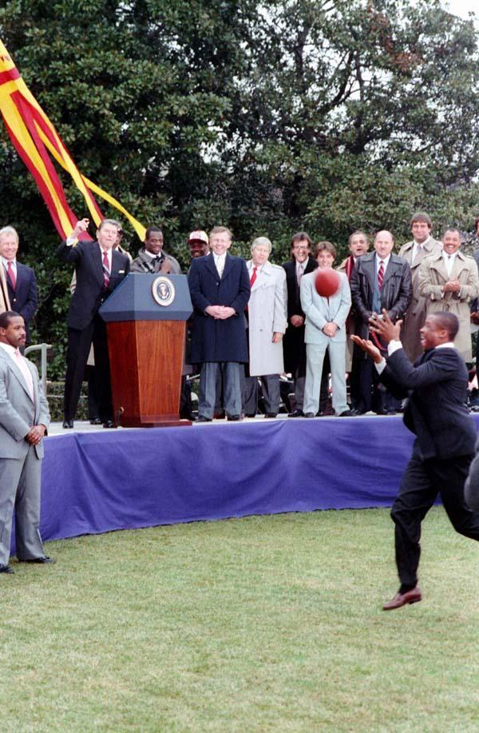
OTHER POWERS & LIMITS
As chief of state, the President is the symbolic figurehead of the US
The President is also the party leader, and has unlimited access to the public through media outlets
The judicial branch can check the president by judicial review, and the legislative branch by blocking nominations, the power of impeachment, and overriding vetoes
The public checks the president by voting

Slide 12
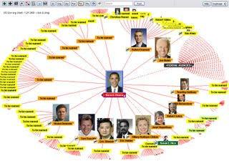
THE FEDERAL BUREAUCRACY
The 2.7 million people that make up the executive branch and handle the everyday business of the federal government
Some things the federal bureaucracy does:
  Deliver mail (USPS)
  Protect the environment (EPA)
  Collect taxes (IRS)
  Manage national parks and forests (USDA)
  Aid in disaster relief (FEMA)

Slide 13
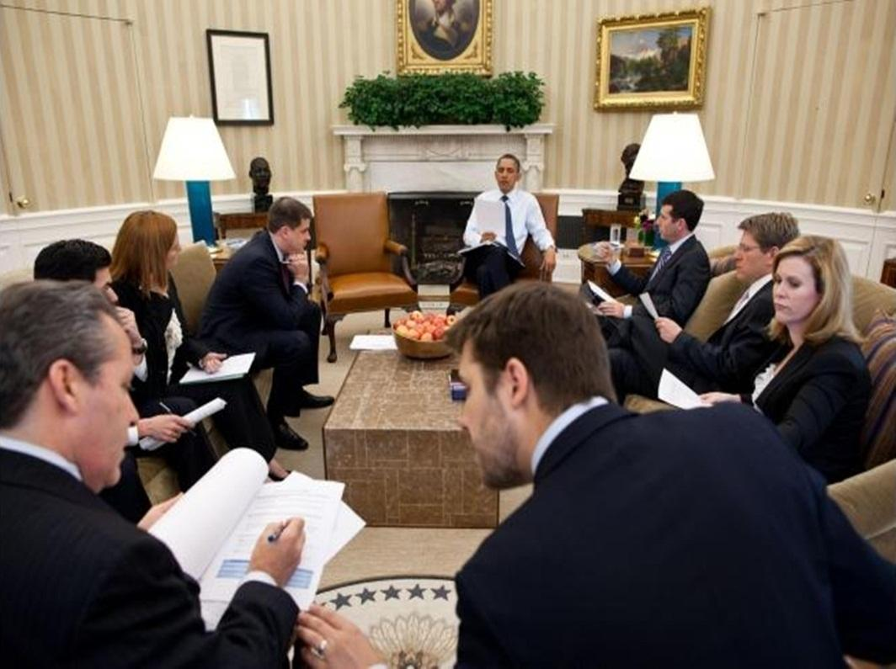
EXECUTIVE OFFICE OF THE PRESIDENT
The Executive Office of the President is the organizational structure under which the president’s advisors and assistants fall
Key offices within the EOP:
  White House Office- responsible for managing the day to day office operations, includes the Chief of Staff & Press Secretary
  National Security Council- coordinate issues of US national security
  Council of Economic Advisors- advises and reports to the president on US economic performance
  Office of Management and Budget- develop and implement the federal budget & regulations

Slide 14
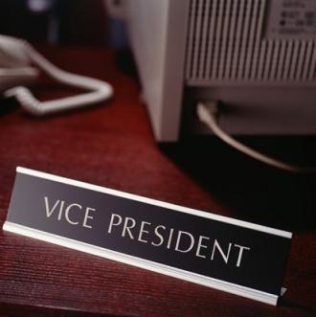
THE VICE PRESIDENT
The Vice President is elected along with the president
The job has three responsibilities
  Preside over the Senate (breaks ties in voting)
  Serve as president if the president is unable
  Counts electoral votes

Slide 15
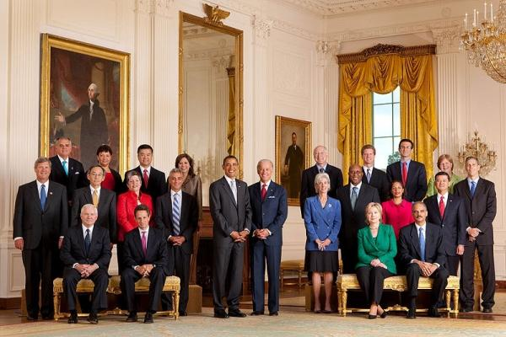
THE CABINET
15 Departments- heads of each comprise the President’s Cabinet
Each Department is headed by a person called a Secretary except Justice department which headed by the Attorney General
Each department head is appointed by President and confirmed by a majority vote in the Senate

Slide 16
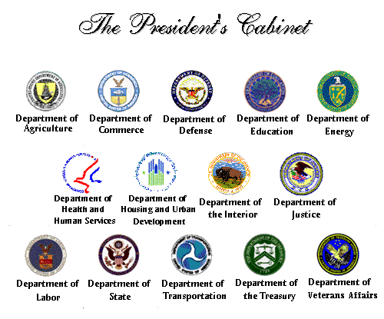
EXECUTIVE DEPARTMENTS
The15 executive departments carry out specific tasks, such as:
  Dept. of Health and Human Services- provides services related to Americans’ health (Social Security, Medicare, Medicaid, FDA, CDC)
  Dept. of Defense- helps defend the country (armed forces, reserves, etc.)
  Dept. of Homeland Security- protect America’s borders and protect from attack (Coast Guard, Secret Service, ICE)

Slide 17

INDEPENDENT EXECUTIVE AGENCIES
Not located in any department, created to serve a specific job
Examples
  National Aeronautics and Space Administration (NASA)
  CIA---Central Intelligence Agency
  EPA- Environmental Protection Agency
  Peace Corps- provides assistance to foreign countries

Slide 18
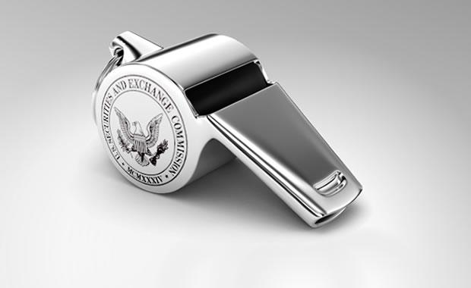
INDEPENDENT REGULATORY COMMISSIONS
Beyond the reach of Presidential direct control---10 agencies created to regulate important aspects of the nations economy
Examples:
  Federal Communications Commission (FCC) oversees public airwaves
  Securities and Exchange Commission (SEC) oversees stock market actions

Slide 19
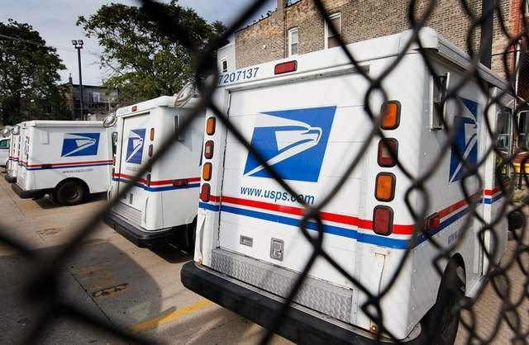
GOVERNMENT CORPORATIONS
Run like businesses but are owned by federal government
Examples
  US Postal Service (delivers mail)
  Federal Deposit Insurance Corporation (FDIC) - protects bank savings up to $250,000
  AMTRAK- passenger railroad service

Slide 20
ASSIGNMENT
Write a paragraph about the presidency. Include in it:
  Which article of the Constitution addresses the Executive Branch
  How old one has to be to run
  Does one have to be born in the US to run?
  How is the president elected and how many votes does it take?
  Does the President have to win the popular vote?
  Term lengths
  Term limits

