Slide 1
The Enlightenment & Its Advancements

Slide 2
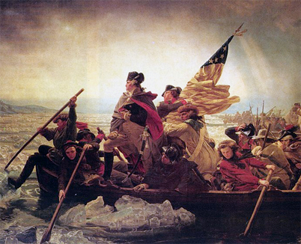
What was it?
Applied reason to the human AND natural world
Stimulated religious tolerance
Fueled democratic revolutions around the world

Slide 3
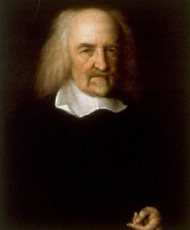
Thomas Hobbes
English philosopher
Wrote Leviathan
Without government, humans exist in a primitive “state of nature”
Life is brutal and short!
Consent to government for self-protection

Slide 4
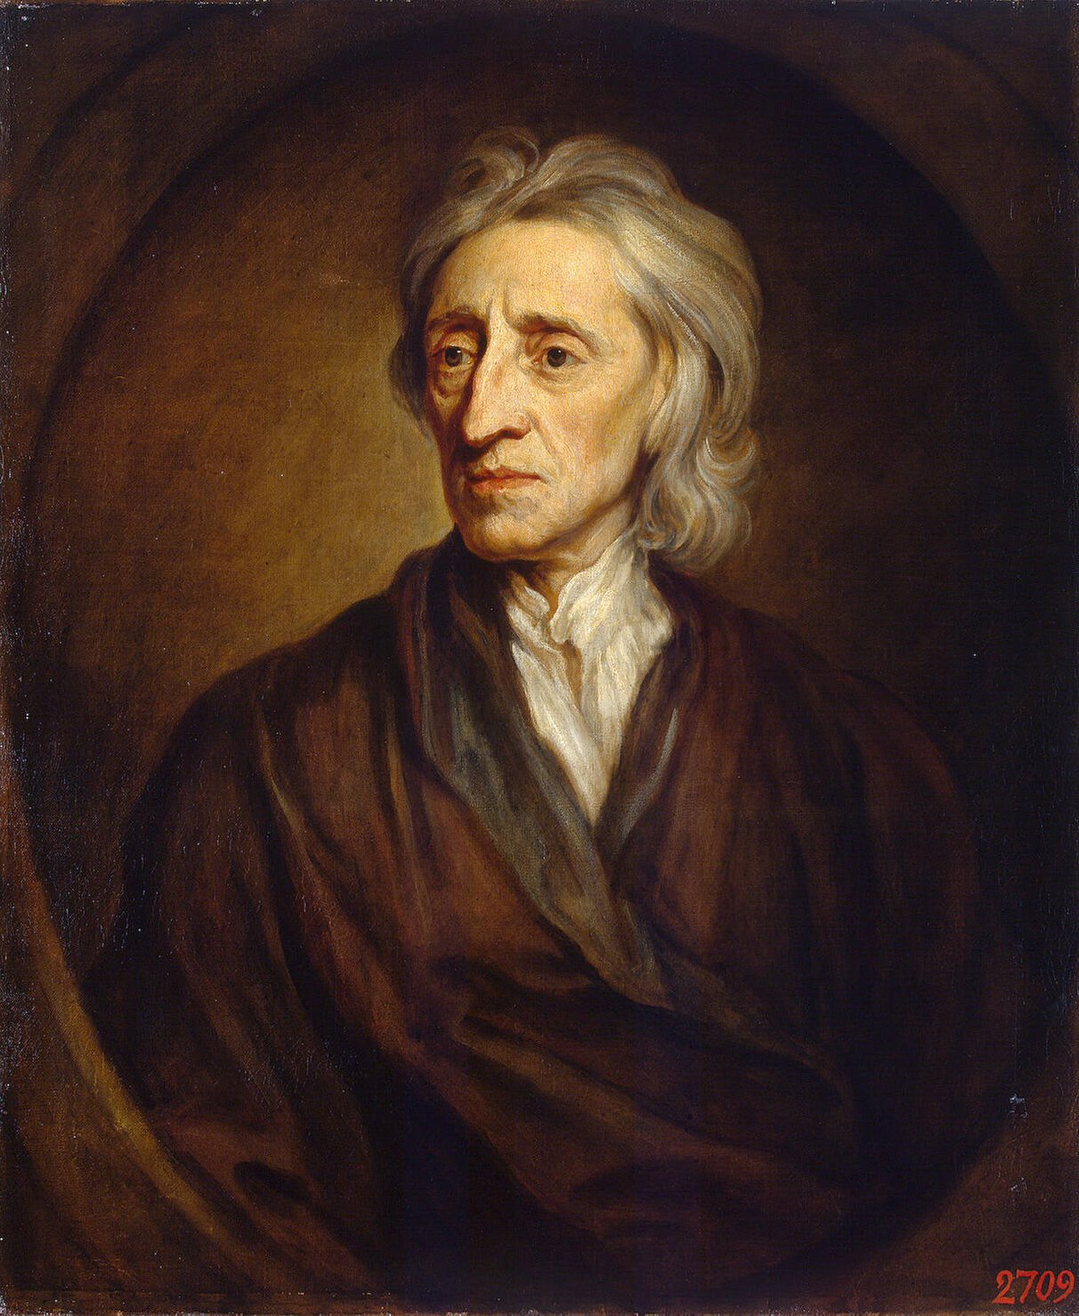
John Locke
English Philosopher
Wrote The Two Treatises on Government
People are sovereign (rule) & CONSENT to government for protection
People have natural rights of life, liberty, & property
Locke is the KEY to the American Revolution! ☺

Slide 5
Montesquieu
French Philosopher
Wrote The Spirit of Laws
Best form of gov’t separates the powers
“Power must Check Power!”

Slide 6
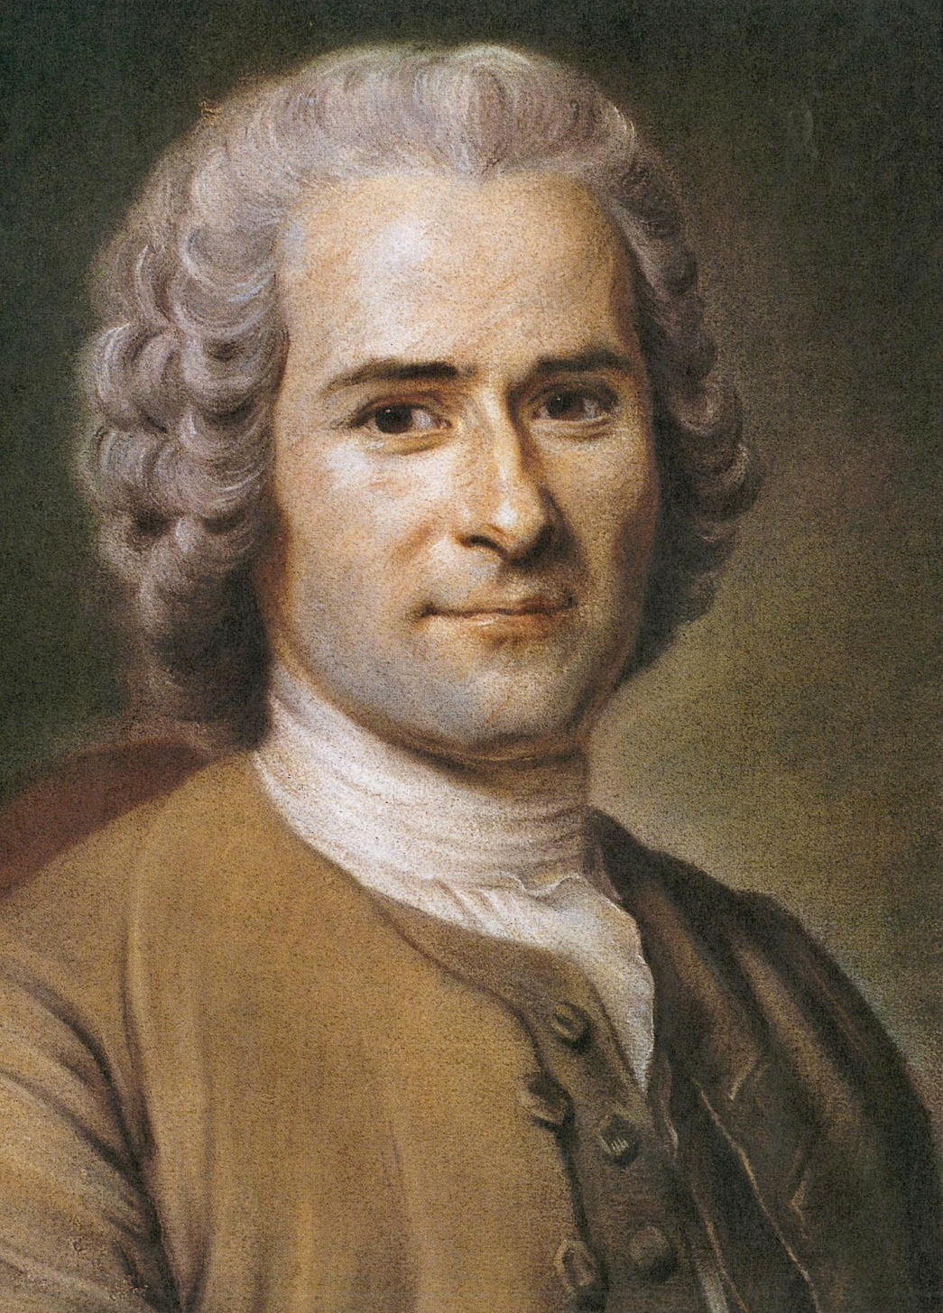
Jean-Jacques Rousseau
French Philosopher
Wrote The Social Contract
Gov’t is a CONTRACT between rulers & the people
People form governments for the welfare of all!
If gov’t breaks contract, people can change gov’t!

Slide 7
Voltaire
French Philosopher
Religious toleration should triumph over religious fanaticism (extremism)
Separation of church and state is best!
“Victorious religious toleration”

Slide 8
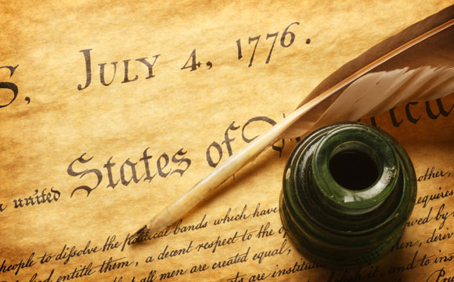
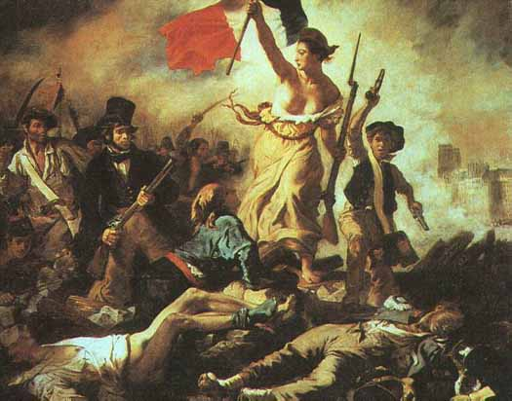
Influence of the Enlightenment
Ideas fueled revolutions in America and France!
Thomas Jefferson’s Declaration of Independence based on Enlightenment philosophies
The Constitution of the US & the Bill of Rights contain Enlightenment beliefs too!

Slide 9
The Age of Reason Famous Folks

Slide 10
Wolfgang Amadeus Mozart
Classical Composer
Child Prodigy (genius, natural musical talent) Wrote his first composition at the age of 5!
Composed light and graceful works that are hallmarks of Classical music
Composed over 600 concertos, operas, and symphonies

Slide 11
Johann Sebastian Bach
German composer of the Baroque period
Organist, violinist, harpsichordist
Music had strong harmonies, elaborate instrumentation
Considered ornate and elaborate like the Age of Absolute Monarchs living lavish lifestyles!

Slide 12
Miguel de Cervantes
Spanish author
Wrote Europe’s first novel (a new form of literature), Don Quixote – a fictional tale of a man who believes he is a knight
Considered the first classical model of romance
“I know who I am and who I may be, if I choose!” from Don Quixote (sound familiar…think of a Renaissance belief!)

Slide 13
Eugène Delacroix
French Romantic Painter
Began the Romantic School (movement) in Art
Works contained exotic and romantic settings
Characters in his paintings showed a great deal of emotion
Styles covered:
classical subjects (Greek/Roman),
public events (French Revolution),
natural scenes, and
living people (portraits).

Slide 14
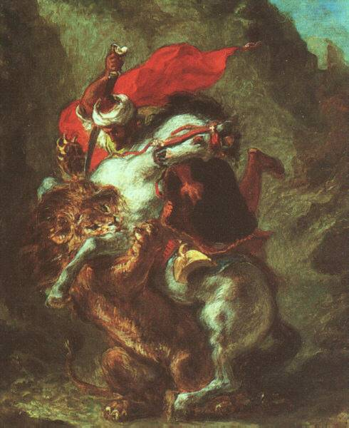
Arab Horseman Attacked by Lion
Liberty Leading the People

Slide 15
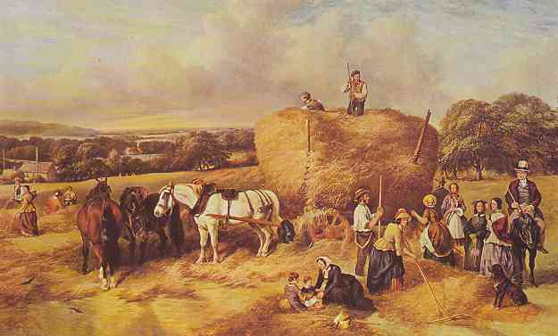
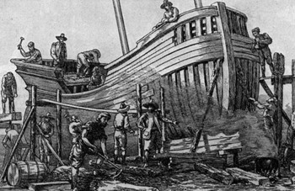
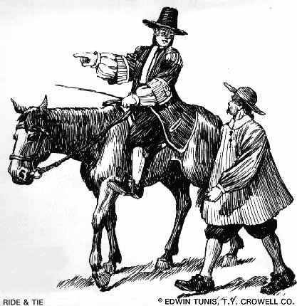
New Technology
All-weather roads improved year-round transport & trade
New designs in farm tools increased productivity (agricultural revolution)
Improvements in ship design lowered the cost of transport

