Slide 1
Elections

Slide 2
Elections
General elections occur on the first Tuesday after the 1st Monday in November
Many states have declared election day a civic holiday (Virginia has not-booooooo!!!)
Ways to vote in Virginia:
At your local precinct on election day
Absentee voting by mail or in person prior to election day

Slide 3
Federal Elections
Occur in even numbered years
The presidency is up for reelection every 4 years
Our representative for the House is up for reelection every 2 years
Our two senator’s seats are up for reelection every 6 years- one of which during the presidential election, and one during the in the mid-way point of the President’s term, or the mid-term

Slide 4
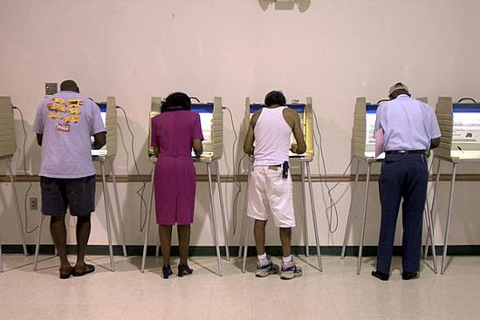
State Elections
Occur in odd numbered years
Our delegate’s seat is up for reelection every two years
The 3 state offices (governor, lieutenant governor, attorney general) are up for reelection every 4 years
Our state senator’s seat is up for reelection every 4 years during the mid-term of the 3 elected state officials
Virginia may also have ballot initiatives, which allows the people to pass legislation

Slide 5
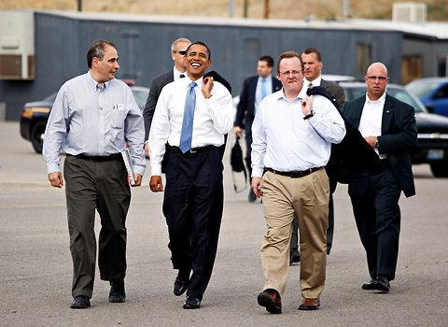
How Campaigns Work
Anybody who is eligible can run for an office
Most candidates are affiliated with one of the two major political parties, the Republicans or the Democrats, who nominate them to run via a state convention, an open primary (anybody can vote) or closed primary (only party members can vote)
The candidate runs a campaign to win, to raise money, and to introduce the public to their platform, or their philosophy and where they stand on key issues

Slide 6
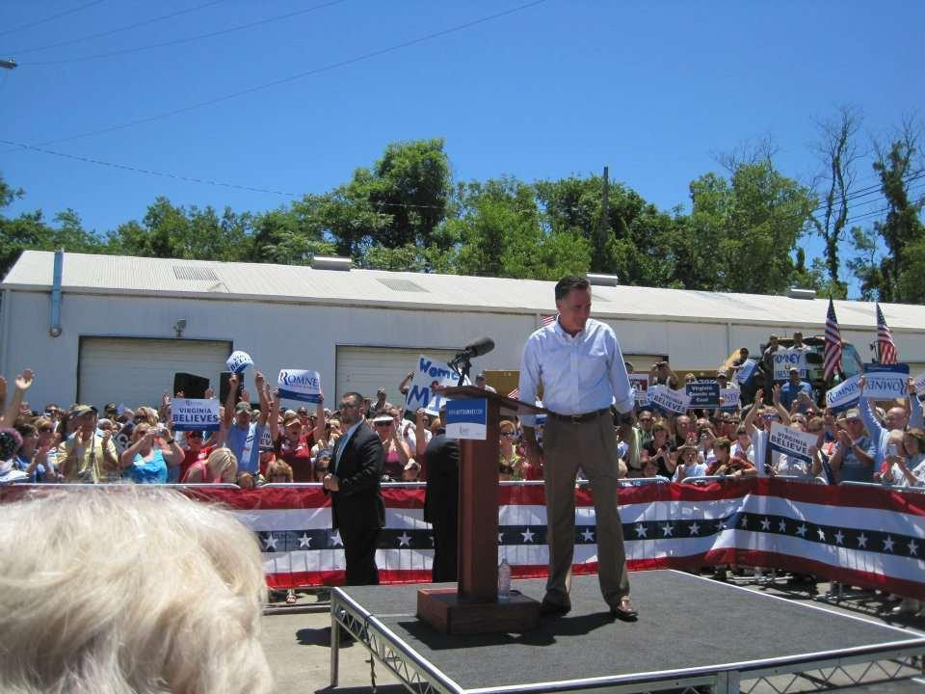
More on Campaigning
The candidate’s staff works on all aspects of a campaign- fundraising, polling, speeches, media relations, issue advocacy, volunteers, image, etc.
Candidates often spend the most time giving speeches and advertising in areas where they are polling strong and areas where they are running equal with their opponent
Why?

Slide 7
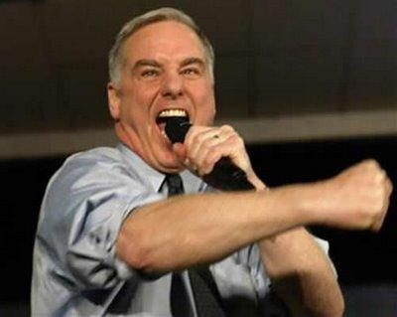
The Message
A candidate’s campaign uses every avenue to get their message out- TV, newspapers, internet, social media, photo ops, interviews, etc.
Candidates’ give speeches that typically cover issues important to the targeted population or what they will do if elected
Campaigns constantly poll the population to see if their message is working
Sound bites from their speeches or and statements get the most airplay from the media, so candidates craft their talking points carefully

Slide 8
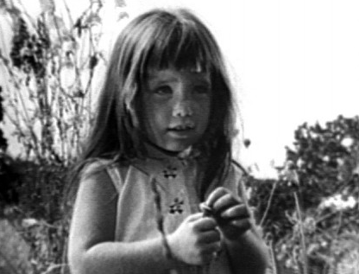
Negative Campaigning
Most candidates today negatively campaign against their opponent by:
Attacking their opponent’s stance on key issues
Attacking their opponent’s record
Associating their opponent with other unpopular or controversial politicians
Predicting doomsday if their opponent were to win
This brings attention to the race and forces the opponent to respond defend themselves

Slide 9
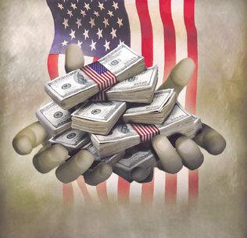
Finances
Money has always played a huge role in campaigning
The Federal Elections Commission (FEC) forces campaigns to report the acquisition and use of its funds and limits the amount they can receive from individuals or their political party
Candidates can spend as much as they want on their own campaign
The money is used to pay for the needs of the campaign staff

Slide 10
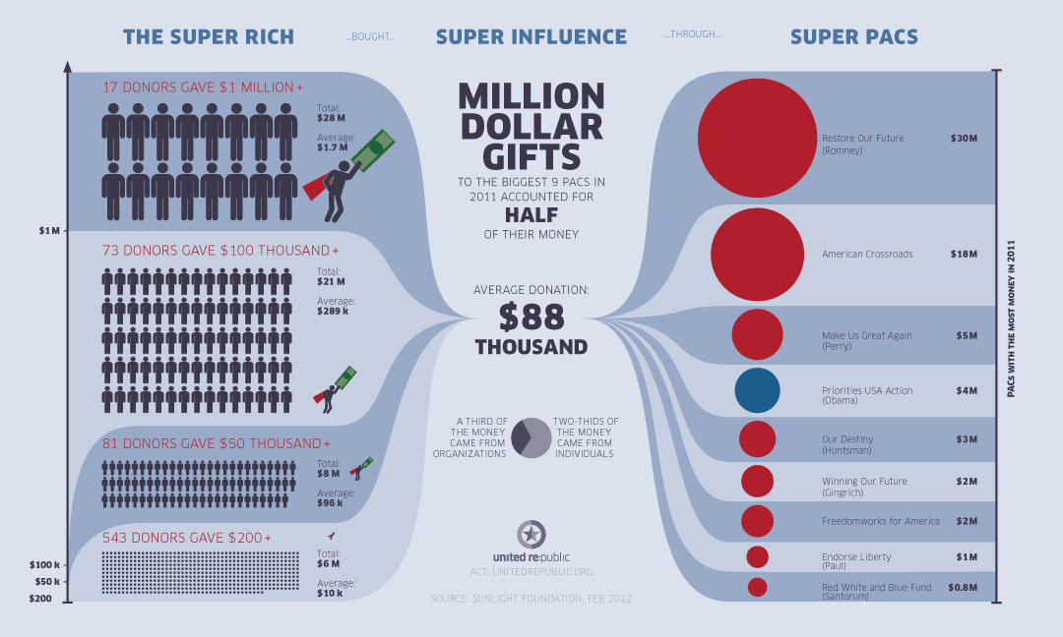
What’s the difference?
While donations directly to a candidate are limited, there are ways around it
Soft Money- money that is given to the political party for “party building”
Political Action Committees can raise unlimited amounts of money and advertise on a candidate’s behalf
527 groups, or issue advocacy groups known as superPACs with no connection to the candidate can do the same, and do not have to file taxes nor reveal their donors

Slide 11
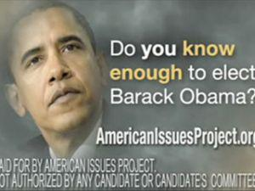
Advertising
All advertisements have to identify who paid for the ad
Those directly from the campaign have to be accompanied by an appearance and message of approval by the candidate
Most negative ads come from 527 groups- they usually go in on the opposing candidate pretty strong

Slide 12
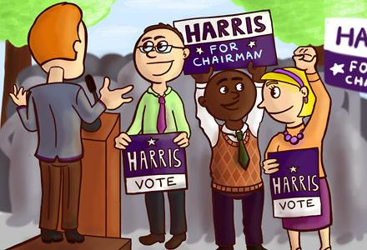
Participation
There are three methods of civic participation in elections
Voting
Volunteering (working the polls, issue or candidate advocacy, helping others vote)
Running for office

Slide 13
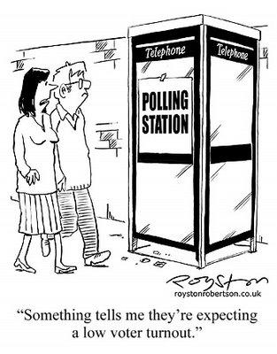
Voter Turnout
Voter turnout is the highest during presidential elections (2/3’s of registered voters participate)
1/2 of registered voters participate in mid-term elections
About 1/3 of registered voters participate in state/local elections
We lag behind other democratic countries in terms of voter turn-out- Why?

Slide 14
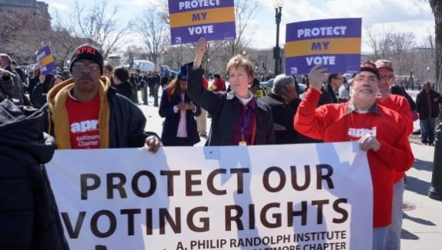
Voting Trends
Older people tend to vote more than younger people (why?)
White people tend to vote more than minorities (why?)
Women tend to vote more than men (why?)
People died for the right to vote, so why don’t we take it more seriously?
Every vote counts- ex. George W. Bush won Florida in 2000 by 537 votes, and over 2 million registered voters didn’t vote

Slide 15
Being A Good Voter
There are three steps to being a good voter
1. Be informed- know the who & what you are voting for, and why you’re voting the way you are
2. Make sure you are registered and know where to vote
3. Go vote

