Slide 1
The Renaissance
What were the artistic, literary, and intellectual ideas of the Renaissance?

Slide 2
WHAT?
Renaissance = “Rebirth” of learning! “Rebirth” of ideas from ancient
Greece and Rome
WHEN?
1350-1600 A.D.
WHERE?
Italian city-states of Florence, Venice & Genoa

Slide 3
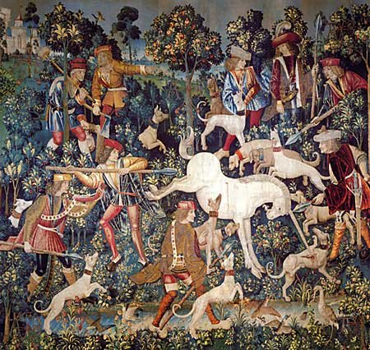
Medieval Art

Slide 4
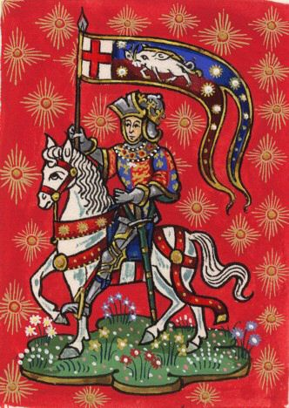
Medieval Art

Slide 5
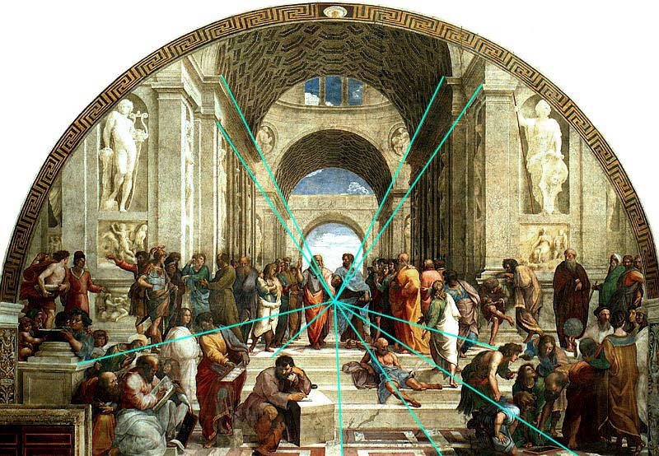
Contributions of the Renaissance
Accomplishments of the visual arts:
  Perspective
  (3 dimensions on a flat surface)
  Realistic painting and sculpture (real people, natural poses and expression)
  Michelangelo, Leonardo da Vinci, Raphael

Slide 6
The School at Athens by Raphael, with lines to show perspective

Slide 7
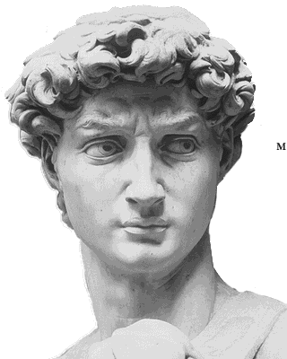
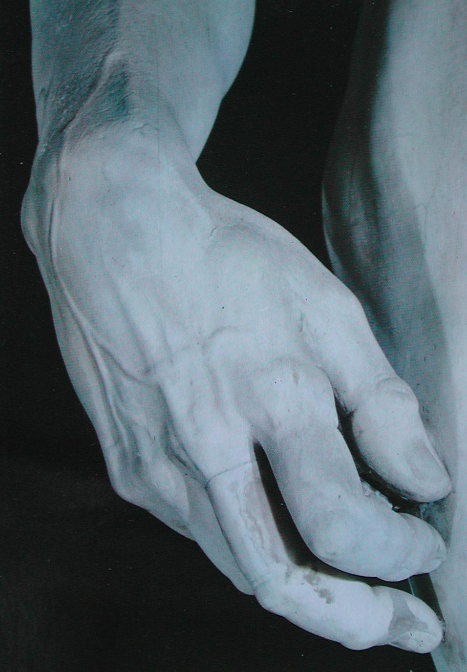
David by Michelangelo

Slide 8
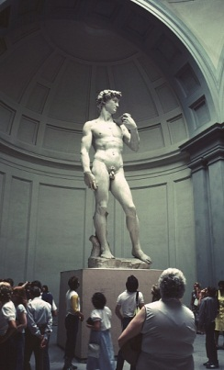
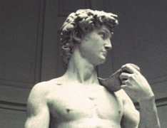
David holds a slingshot over his shoulder – he killed Goliath (a giant) in the Old Testament

Slide 9
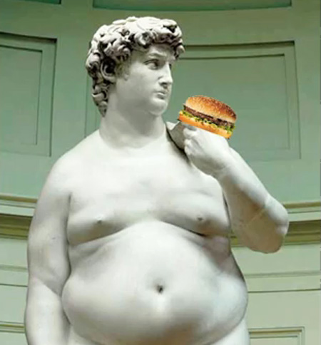
David discovers fast food!

Slide 10
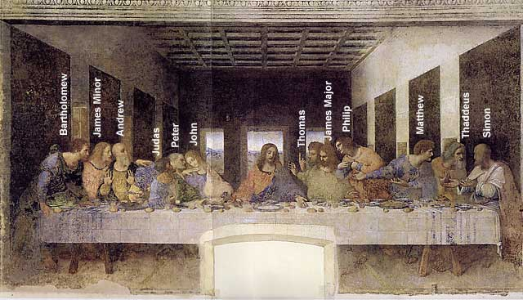
The Last Supper - Leonardo da Vinci

Slide 11
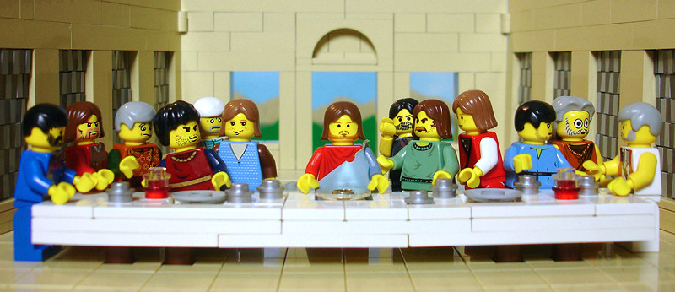
Lego Last Supper???

Slide 12
Contributions of the Renaissance
Accomplishments in literature:
  Wrote in the vernacular
  (their native languages – French, German, English…instead of Latin, the language of the Catholic Church)
  Began an intellectual movement that focused on the worth and potential of human beings…humanism, and emphasized the study of history, literature, and philosophy
    In college, you may see classes referred to as the Humanities (history, literature, etc)…that’s where the word came from…the Renaissance!

Slide 13
Writing for Worldly Pleasure!
Renaissance authors believed in enjoying life now – good music, clothing, food
They emphasized the secular life (worldly) and not the spiritual one that the Church reinforced during the Middle Ages
They believed that you could live an enjoyable life, without offending God. They were devout to their religion while also enjoying art, music, and poetry!
“What a piece of work is a man, how noble in reason, how infinite in faculties…”
-William Shakespeare expresses a very Humanist belief in his play, Hamlet

Slide 14
Medieval vs. Renaissance Art
Medieval Renaissance
~ Appears flat ~ 3 dimensional
~ Emotionless ~ Life-like/detailed
~ Cartoon-like ~ Emotional
~ Focus on religious ~ Use of perspective
themes (saints, etc.) both religious & secular subjects
(non-religious)

Slide 15
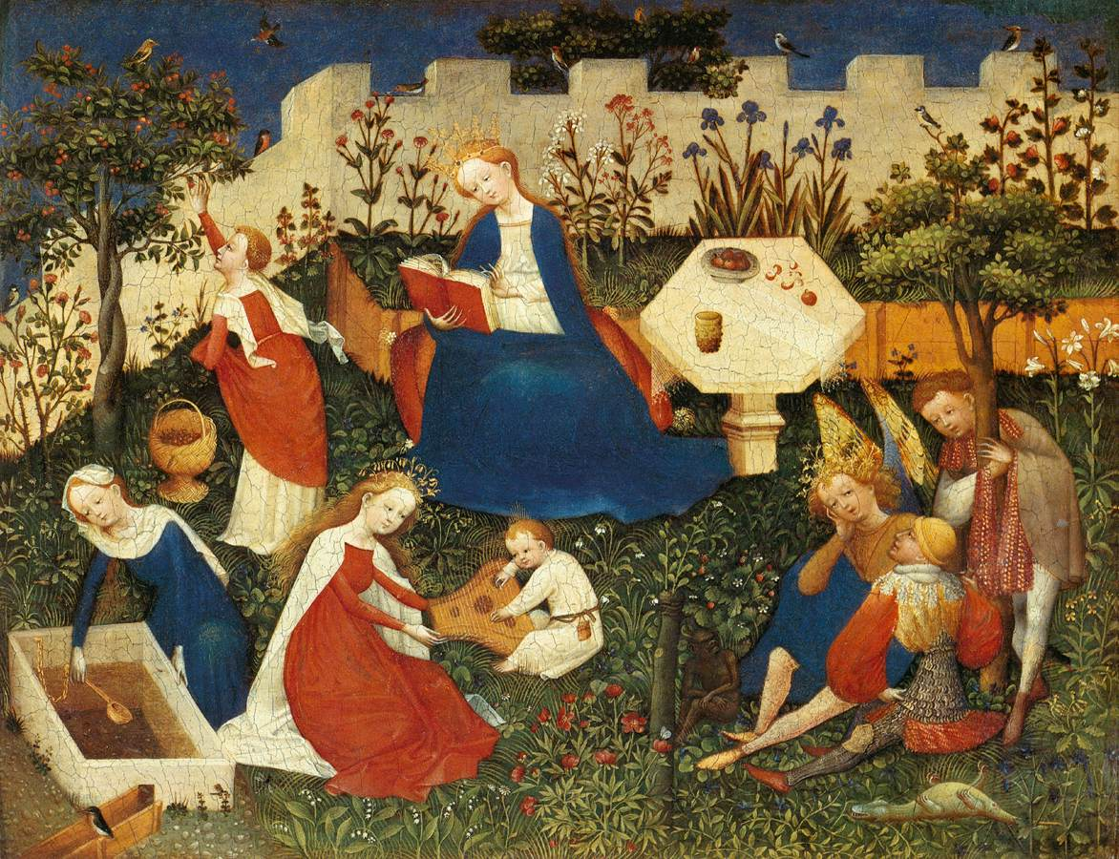
Medieval or Renaissance?

Slide 16
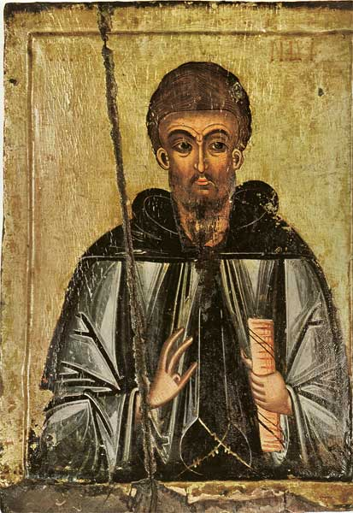
Medieval or Renaissance?

Slide 17
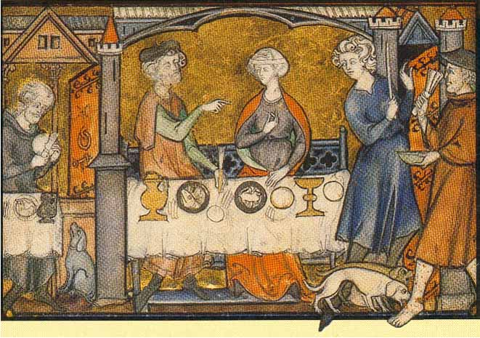
Medieval or Renaissance?

Slide 18
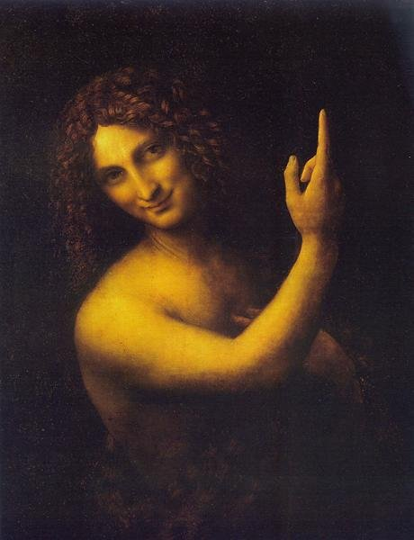
Medieval or Renaissance?

Slide 19
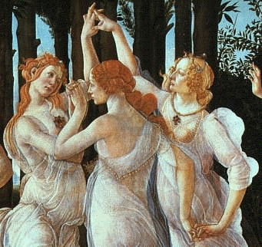
Medieval or Renaissance?

Slide 20
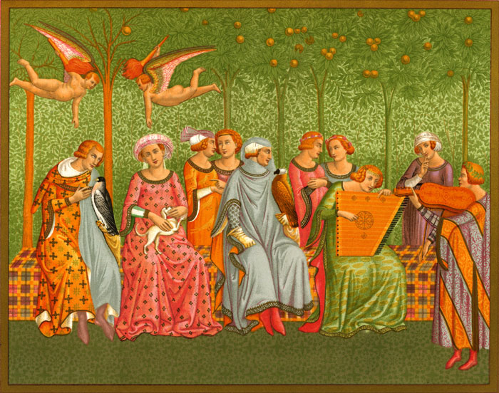
Medieval or Renaissance?

Slide 21
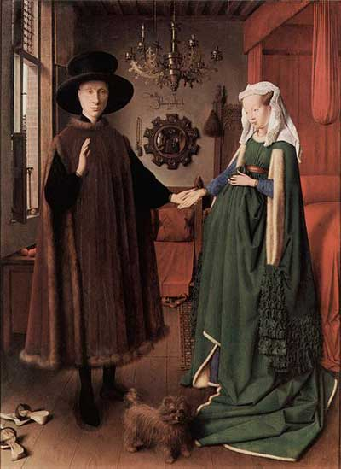
Medieval or Renaissance?

Slide 22
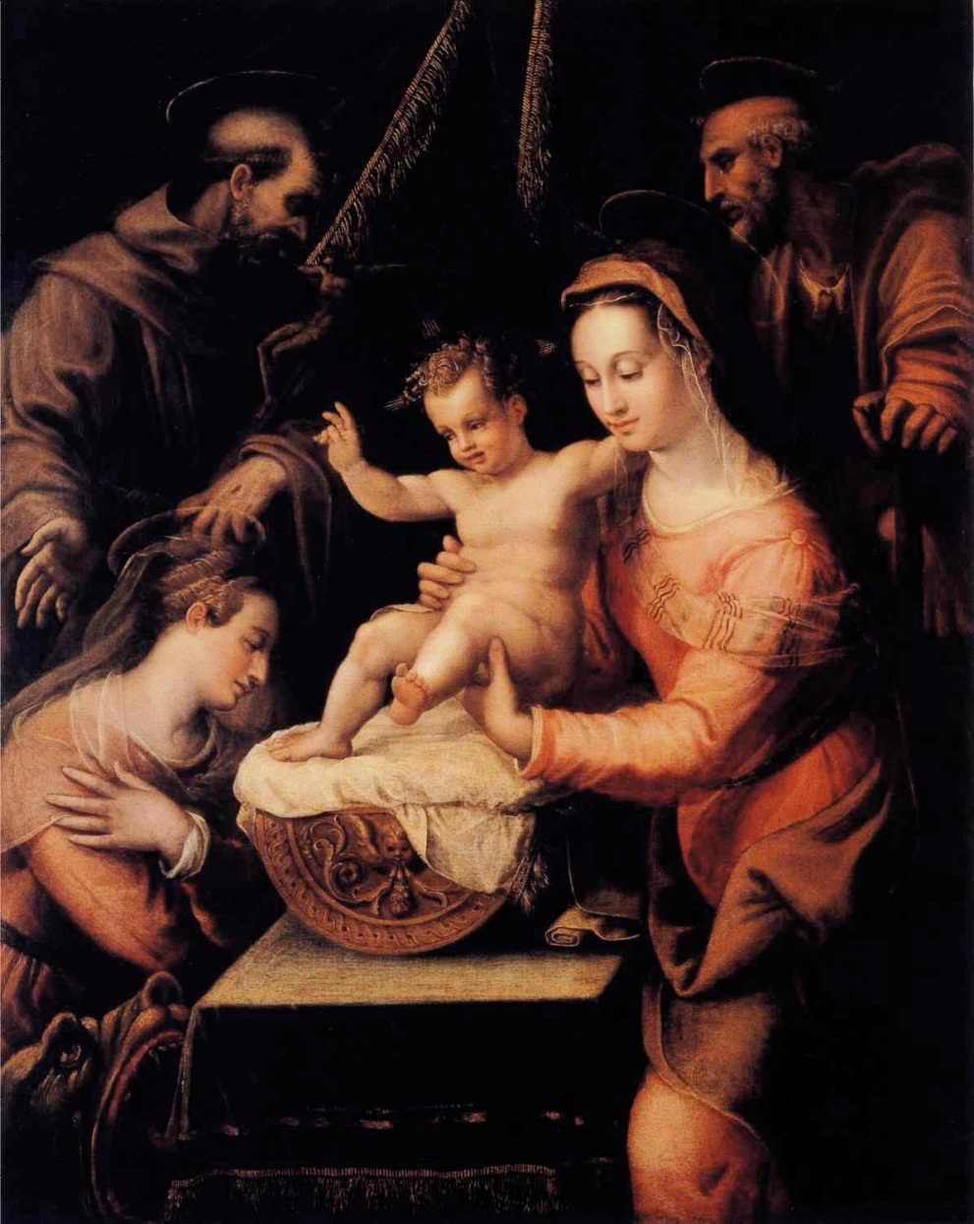
Medieval or Renaissance?

Slide 23
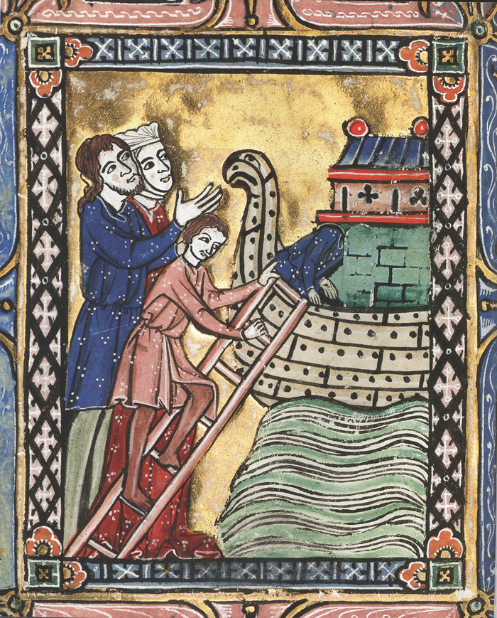
Medieval or Renaissance?

Slide 24
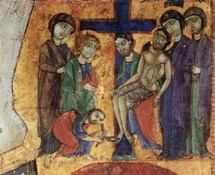
Medieval or Renaissance?

Slide 25
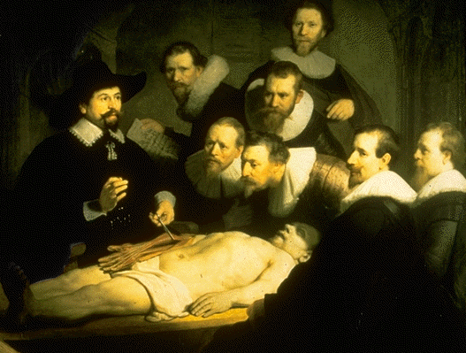
Medieval or Renaissance?

Slide 26
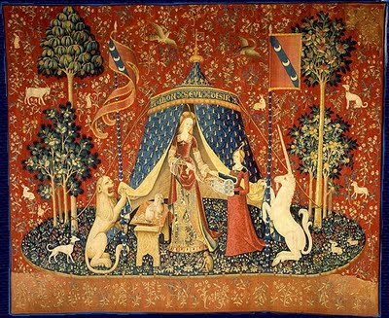
Medieval or Renaissance?

Slide 27
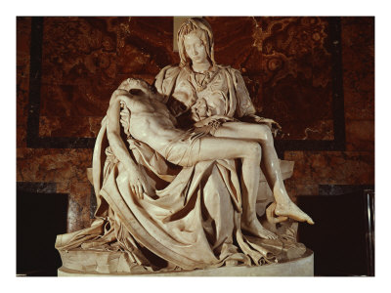
Medieval or Renaissance?

Slide 28
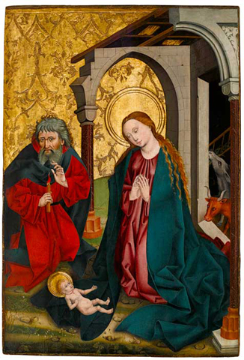
Medieval or Renaissance?

