Slide 1
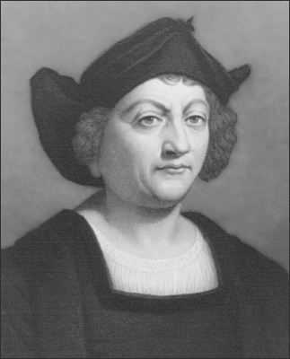
Columbian Exchange WHAT was traded!

Slide 2
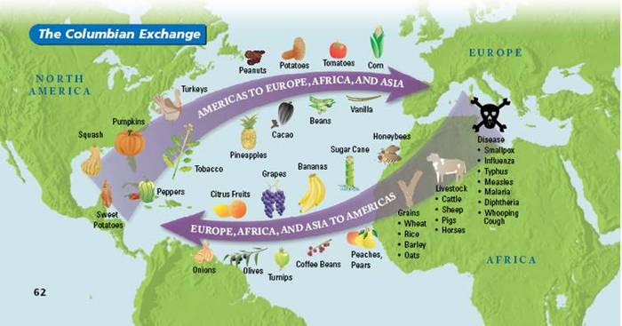
Definition:
The global transfer of foods, plants & animals during the colonization of the Americas

Slide 3
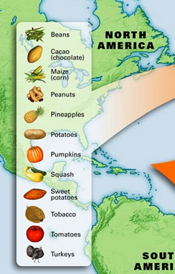
The New World
Plants: tomatoes, squash, pineapples, tobacco, cacao beans (chocolate), corn & potatoes
Animals: turkey

Slide 4
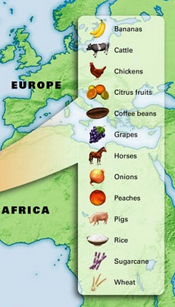
The Old World
Livestock: Horses, cattle, sheep and pigs.
Foods: Bananas, black-eyed peas, yams, wheat, rice, barley and oats.

Slide 5
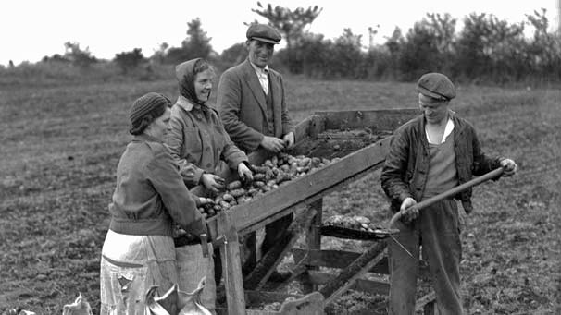
Positives
Agriculture from the Western Hemisphere (corn, potatoes, etc.) changed European lifestyles
Improved diets, longer lives, population expands

Slide 6
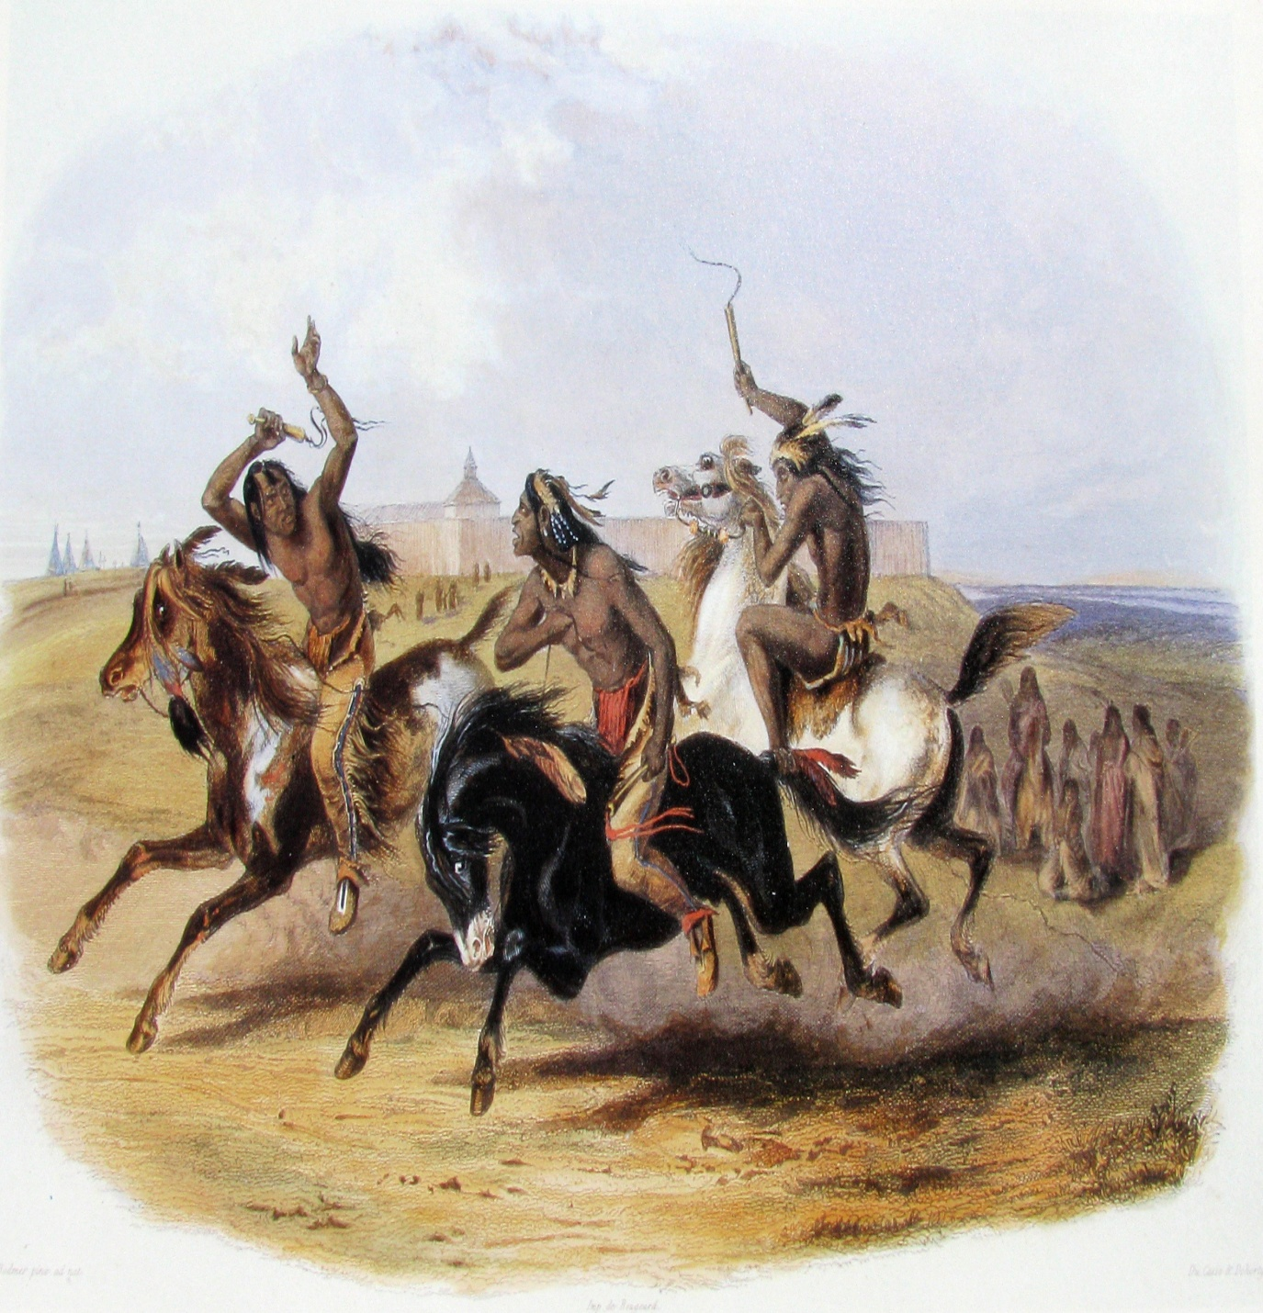
Impacts of Columbian Exchange
Positives
European horses and cattle changed the lifestyle of American Indians

Slide 7
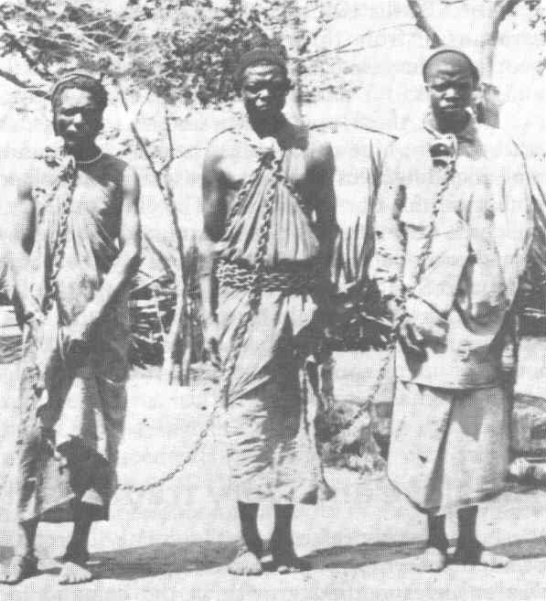
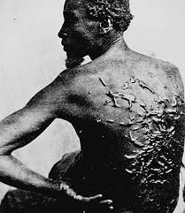
Impact of Columbian Exchange
Negatives
Not enough labor to grow cash crops so Europeans turn to the use of African slaves
Race-based Slavery

Slide 8
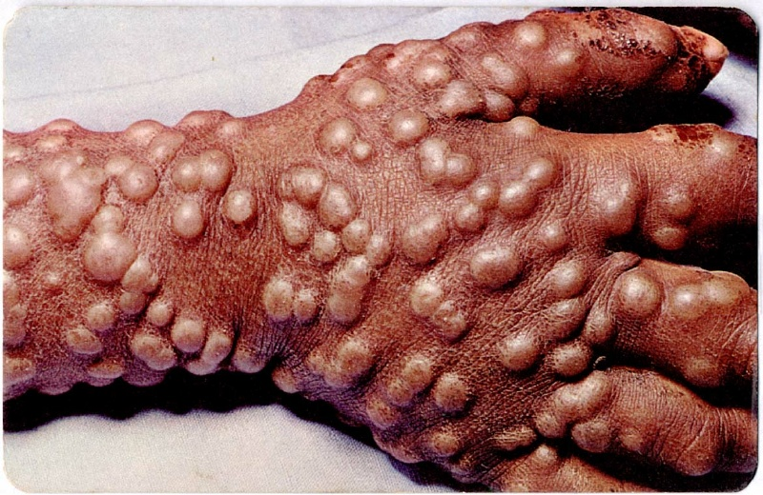
Impact of Columbian Exchange
Negatives
European plantations destroyed indigenous economies & damaged the environment
European diseases (smallpox) killed many American Indians

