Slide 1
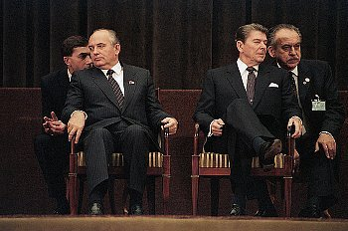
Cold War Leaders

Slide 2
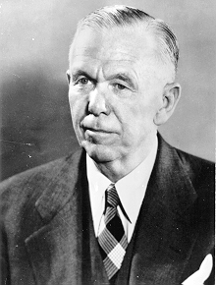
United States
George Marshall: President Truman’s Secretary of State
Designed the Marshall Plan: provide millions of dollars in aid to help Europe recover from World War II
Goal: keep them from turning to Communism by encouraging them to build market economies instead!
Died in October, 1959

Slide 3
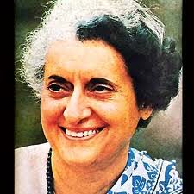
India
Indira Gandhi
Became Prime Minister of India in 1966
Signed a peace treaty with Soviet Union during the Cold War
Develop secret nuclear program
Today, India has nukes!
Assassinated in 1984

Slide 4
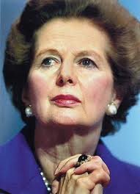
Great Britain
Margaret Thatcher: British Prime Minister 1979-1990
Wanted free trade (trade between countries without restrictions or tariffs) and less government regulation of business
Strengthened relationship with the United States (Ronald Reagan) and US foreign policy
Asserted the United Kingdom’s military power when Argentina tried to invade the Falkland Islands.
Soviets called her “The Iron Lady”
Died April 8, 2013

Slide 5
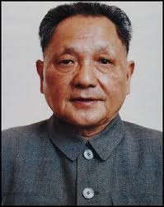
China
Deng Xiaoping: took over after the death of Mao Zedong in 1976.
Reformed Communist China’s economy
Ended farming communes and allowed farmers more freedom
Made it a market economy
Led to rapid economic growth, but a larger gap between the rich and the poor
Continued communist control of the government
Was only 4’ 11” Died in 1997

Slide 6
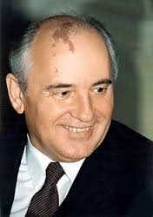
Soviet Union
Mikhail Gorbachev: last president of Soviet Union
Brought reforms to the Soviet Economy (Perestroika) and its government (Glasnost)
His reforms unintentionally contributed to the collapse of Communism in the Soviet Union!
Still Alive! ☺

