Slide 1
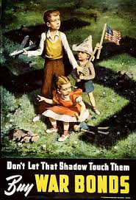
Causes and Leaders of WWII

Slide 2
Economic & Political causes of WWII
Aggression by the totalitarian powers of Germany, Italy and Japan
Japan invades Manchuria & rest of China
Italy invades Ethiopia
Germany invades Rhineland, annexes Austria, Czechoslovakia and Sudetenland
Nationalism: Dictators use pride and loyalty for one’s country in their propaganda and to hold on to power!

Slide 3
Economic & Political causes of WWII
Failures of the Treaty of Versailles
Left Europe in bad economic conditions and left Germany with hyperinflation as they struggled to pay their war reparations!
Appeasement
European countries don’t want to go to war after their experiences in World War I, so they let Hitler take land in the hopes that he would stop and they’d keep the peace.

Slide 4
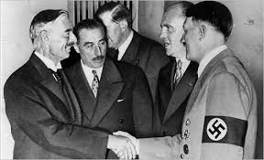
Economic & Political causes of WWII
Tendencies towards isolationism and pacifism (strong anti-war attitudes) in Europe and the United States

Slide 5
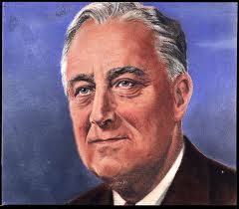
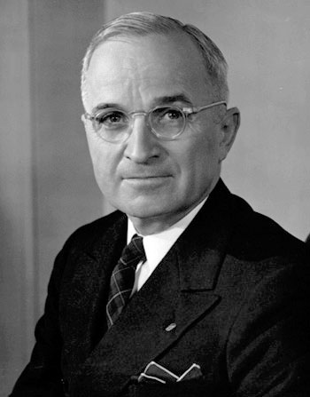
US Presidents during WWII
Franklin D. Roosevelt
Harry S. Truman
US President at the start of war. Declares war after the attack on Pearl Harbor!
President after Roosevelt dies. Makes the decision to drop the atomic bombs on Hiroshima and Nagasaki

Slide 6
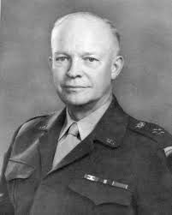
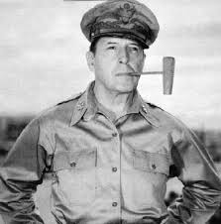
US Commanders during WWII
Dwight D. Eisenhower
Douglas MacArthur
US General and Allied commander in the Pacific that fought the Japanese
Allied commander in Europe and planned the D-Day Invasion to free Europe from Nazi Control!

Slide 7
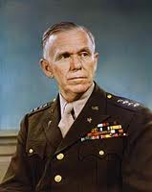
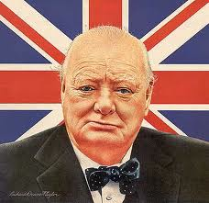
George C. Marshall
Winston Churchill
US General and later becomes known for the Marshall Plan during the Cold War.
British Prime Minister
Symbol of strength. Speeches during the Battle of Britain keep the morale up at home.

Slide 8
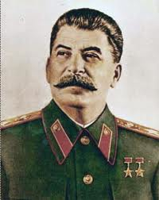
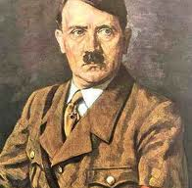
Guess Who?
Guess Who?
Soviet Dictator
Nazi dictator in Germany

Slide 9
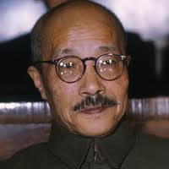
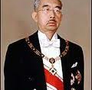
Guess Who?
Guess Who?
Japanese General
Emperor of Japan

