Slide 1
Unit 8 Review PPT
https://www.youtube.com/watch?v=oRH33pTXwKQ

Slide 2
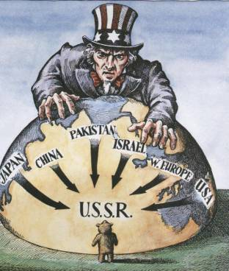
1. US policy during the Cold War to stop the spread of Communism
Containment

Slide 3
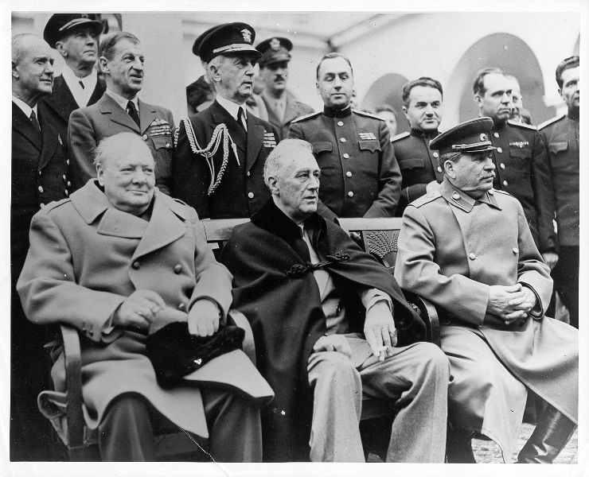
2. Meeting of WWII Allies where Stalin promised free elections in Eastern Europe
Yalta Conference

Slide 4
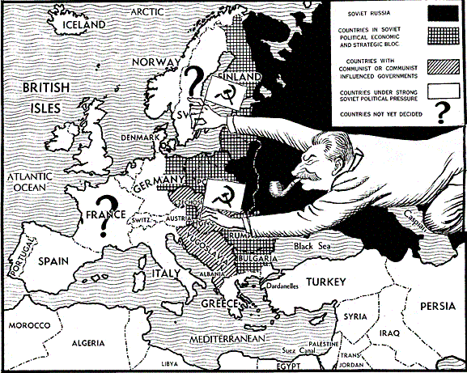
3. Churchill’s reference to the division of Europe into Communist East and Democratic West
Iron Curtain

Slide 5
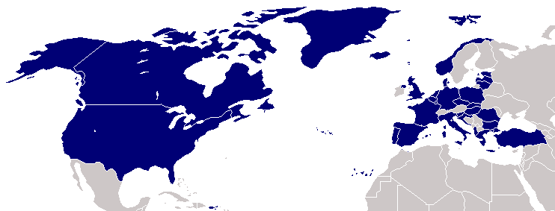
4. Alliance the US enters into with Western Europe to defend against and contain Communism
NATO

Slide 6
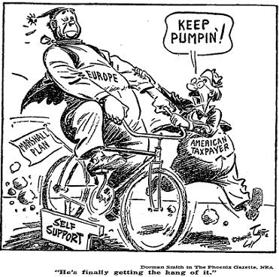
5. US economic plan to rebuild Europe after WWII to avoid the spread of Communism
Marshall Plan

Slide 7
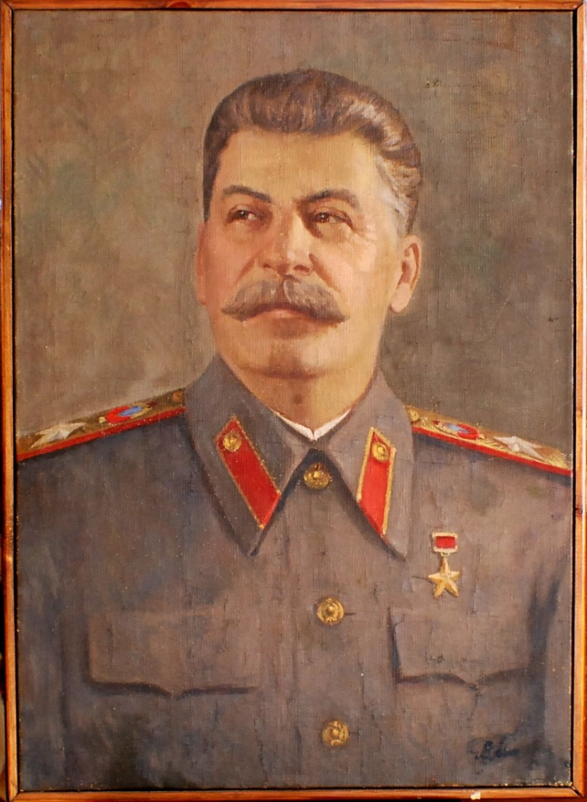
6. Believed that Communism and Capitalism could not coexist
Stalin

Slide 8
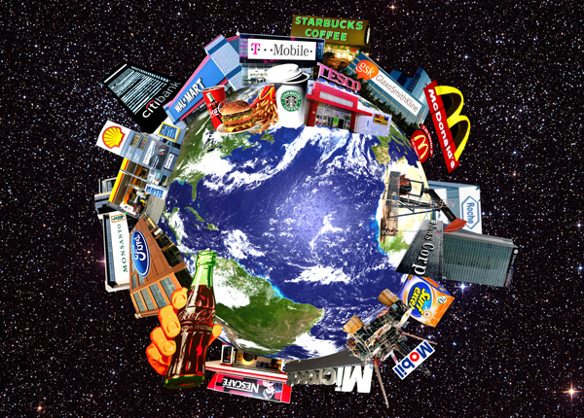
7. Theory that private businesses compete without state control
Free Enterprise

Slide 9
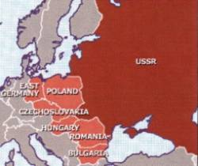
8. Eastern European nations where the Soviet Union installed Communist governments
Satellite Nations

Slide 10
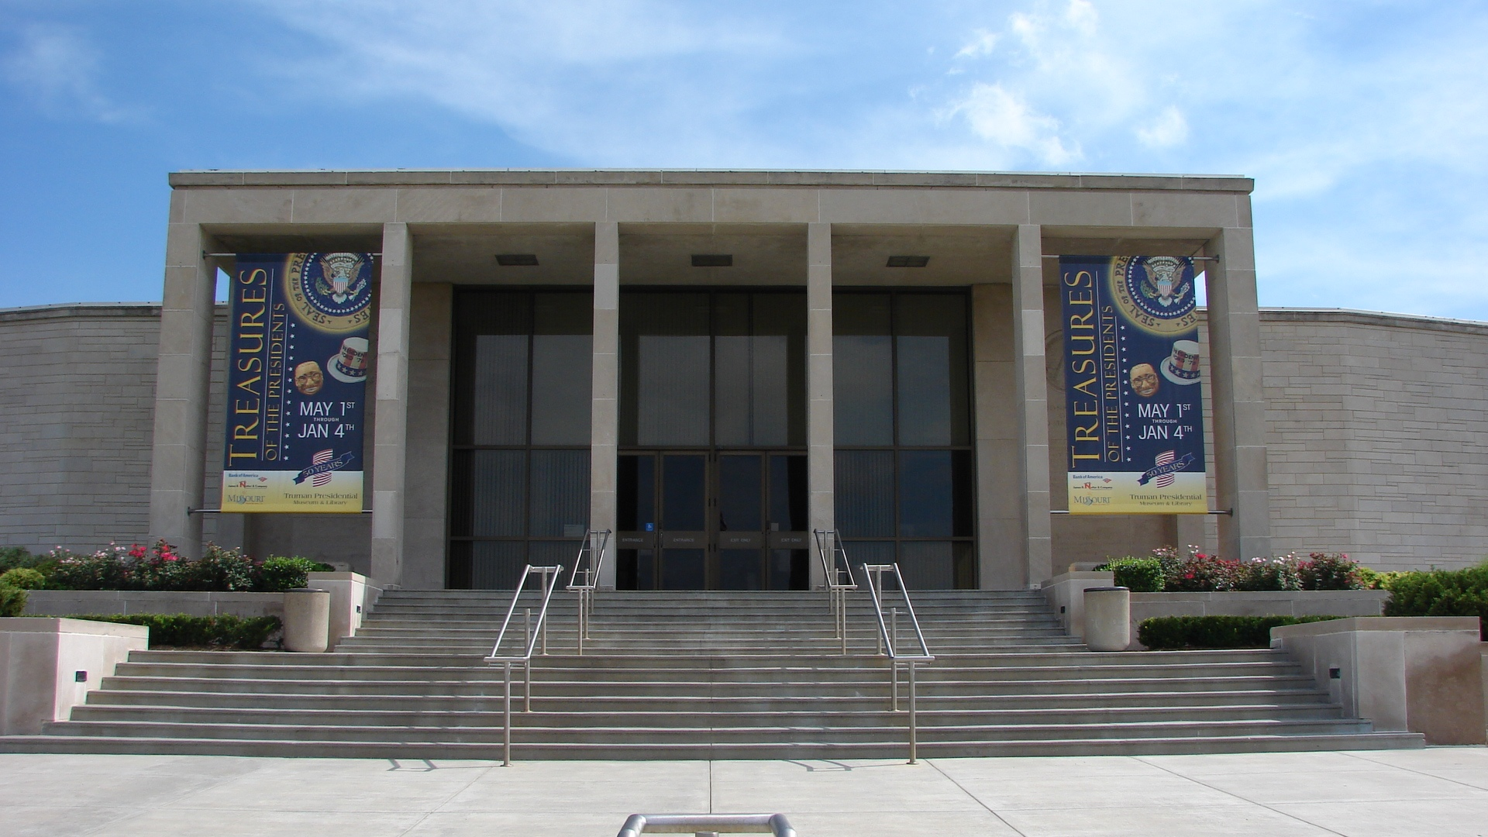
9. US President who first began the Cold War policy of containment
Harry S. Truman

Slide 11
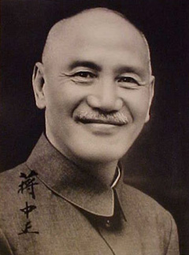
10. Chinese Nationalist leader whose was banished from mainland China
Chiang Kai-Shek

Slide 12
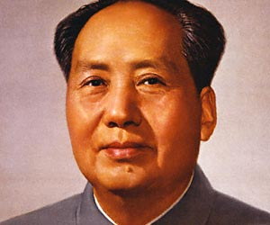
11. Leader of the Communists during the Chinese Civil War and later first Communist leader of China
Mao Zedong

Slide 13
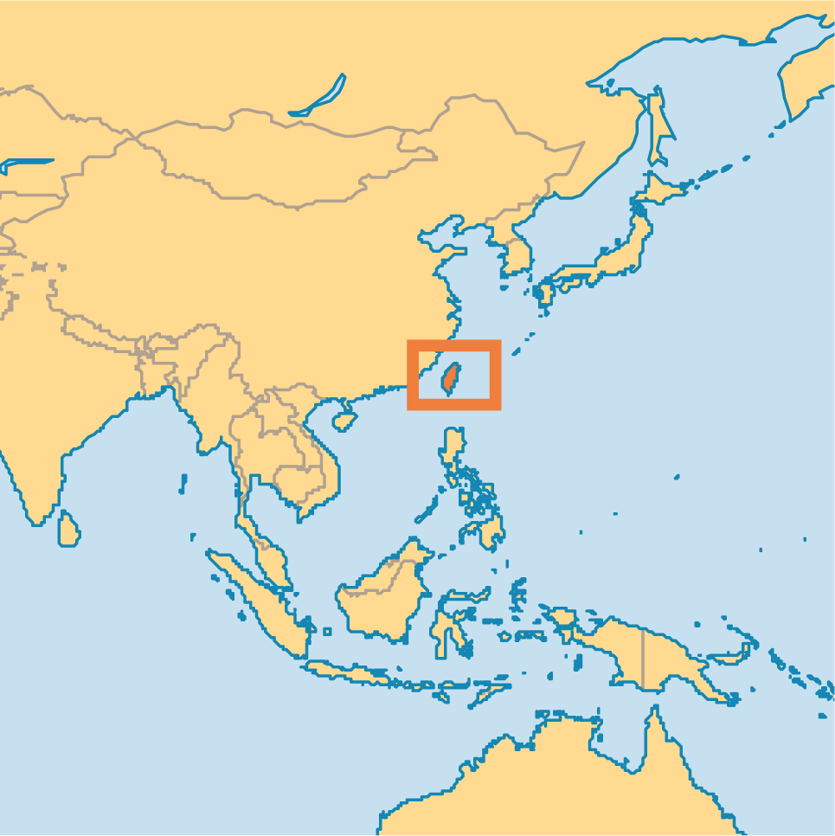
12. US recognized this island as the “true” China and was home to escaped Nationalists
Taiwan

Slide 14
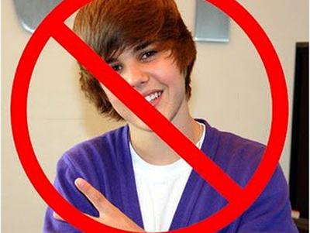
13. The Soviets did this after the US blocked China’s entry into the UN
Boycott

Slide 15
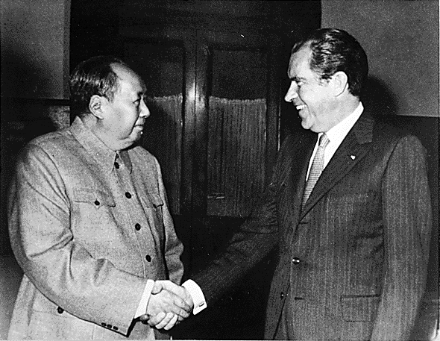
14. First US president to visit Communist China in the 1970s
Richard Nixon

Slide 16
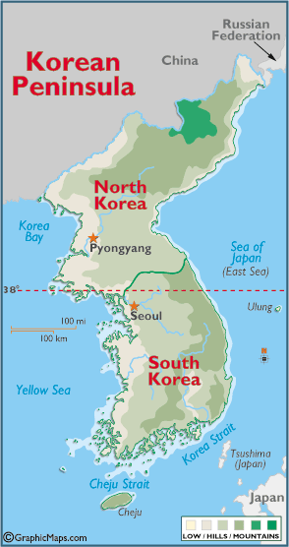
15. The Allies promised this Asian nation independence after WWII
Korea

Slide 17
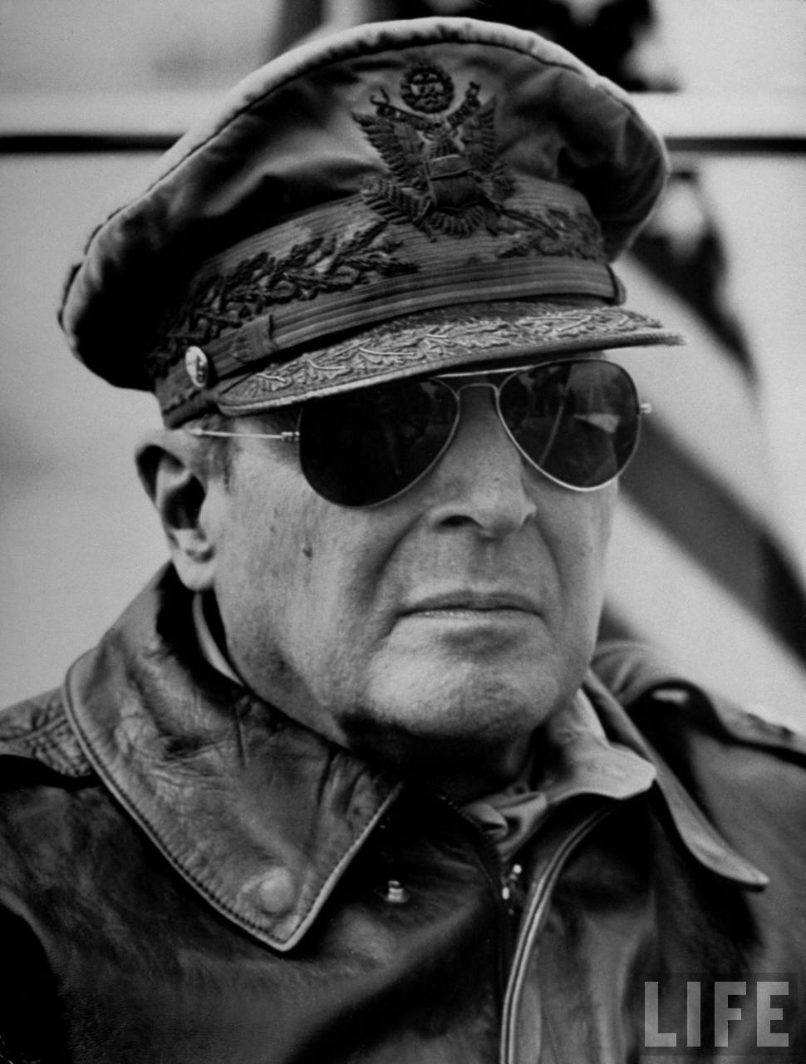
16. He was appointed by Truman to lead the UN forces in the Korean War
Douglas MacArthur

Slide 18
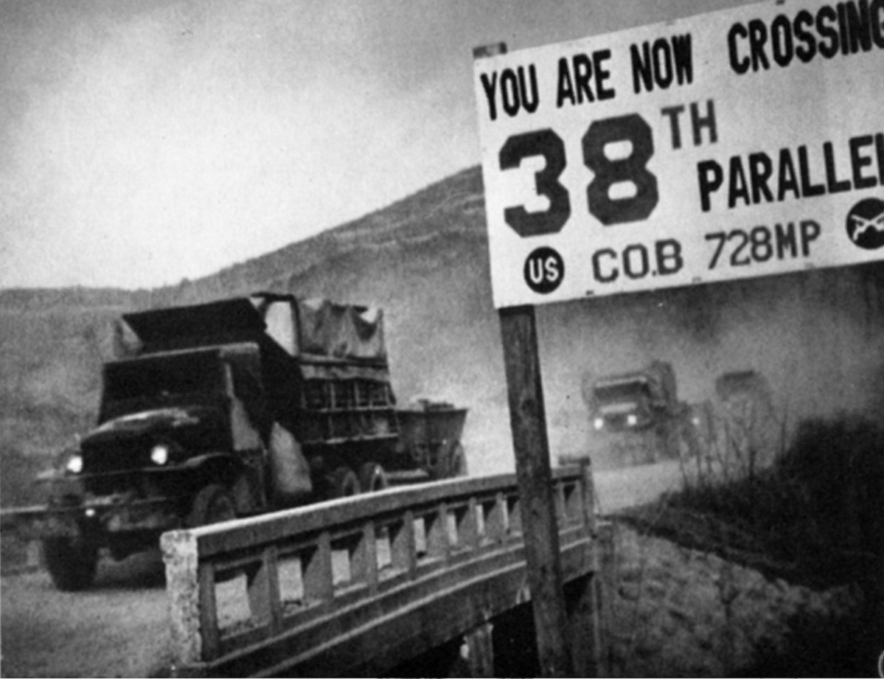
17. Korea was divided into two nations at this location
38th Parallel

Slide 19
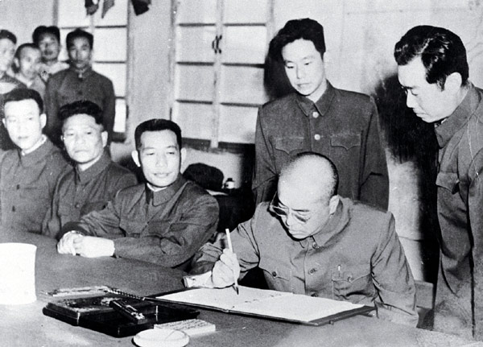
18. A signed agreement to stop fighting until a peace settlement can be reached
Armistice

Slide 20
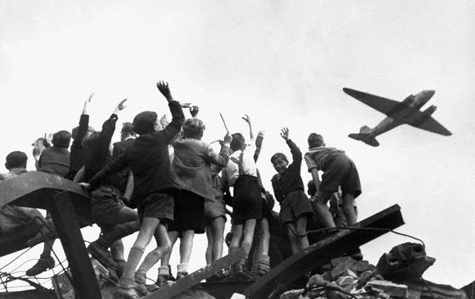
19. US reaction to Stalin cutting off all access to Berlin for 11 months
Berlin Airlift

Slide 21
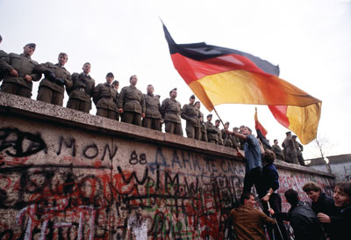
20. Became a symbol of the Cold War until it came down in 1989
Berlin Wall

Slide 22
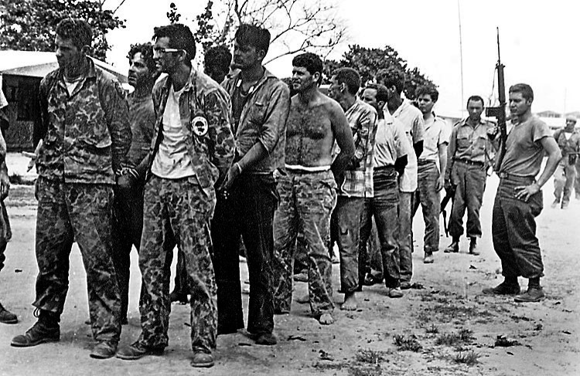
21. US-backed Cuban exiles’ failed attempt to end Castro’s Communist control
Bay of Pigs Invasion

Slide 23
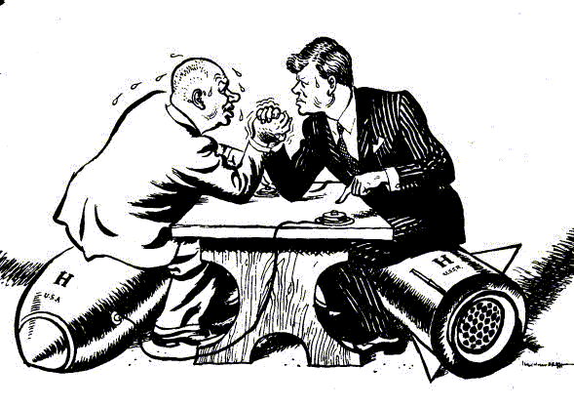
22. The closest the US and Soviet Union ever got to nuclear war
Cuban Missile Crisis

Slide 24
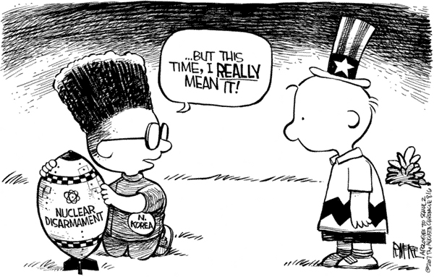
23. Building up ones nuclear missiles and military strength to stop the enemy from attacking
Deterrence

Slide 25
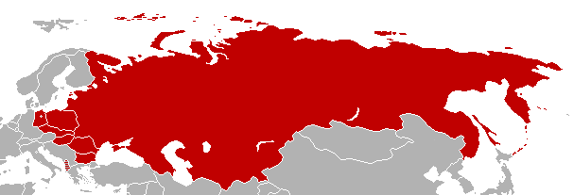
24. The Soviet Union’s response to the formation of NATO
Warsaw Pact

Slide 26
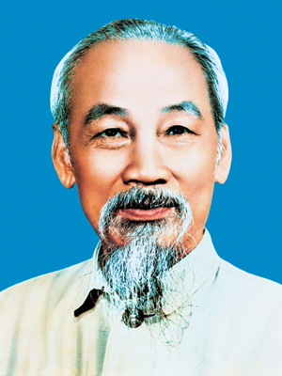
25. Communist nationalist who wanted to free Vietnam from French control
Ho Chi Minh

Slide 27
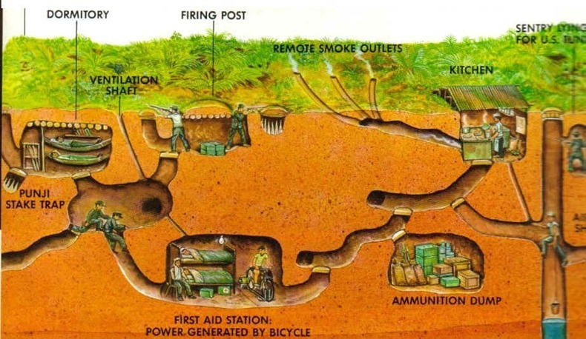
26. Communist guerilla fighters inside South Vietnam attacking the government and US soldiers
Viet Cong

Slide 28
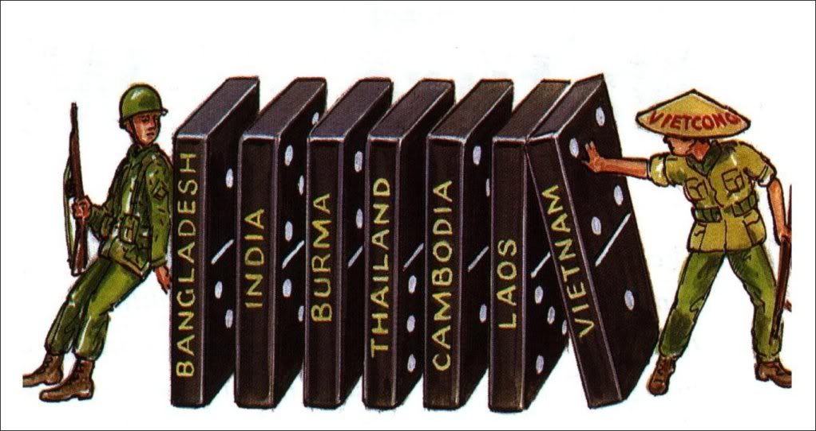
27. US theory that if Vietnam falls to Communism, the rest of SE Asia will
Domino Theory

Slide 29
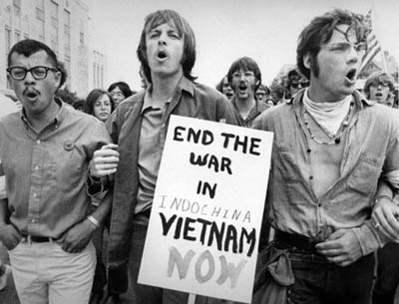
28. Caused anti-war protests in the US and eventually became the first “loss”
Vietnam War

Slide 30
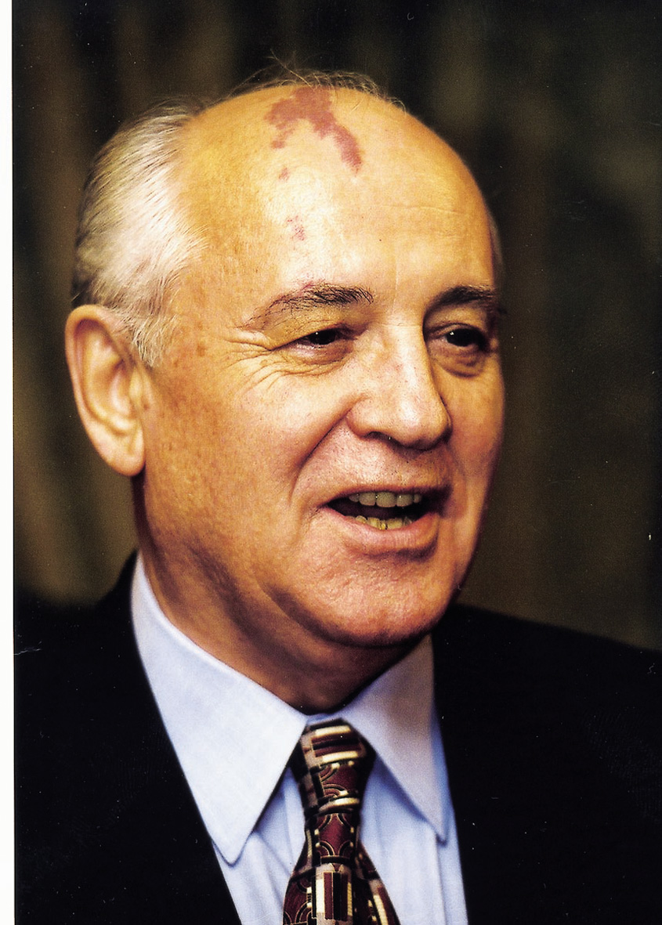
29. He became the Soviet leader in 1985 and came up with a series of reforms
Mikhail Gorbachev

Slide 31
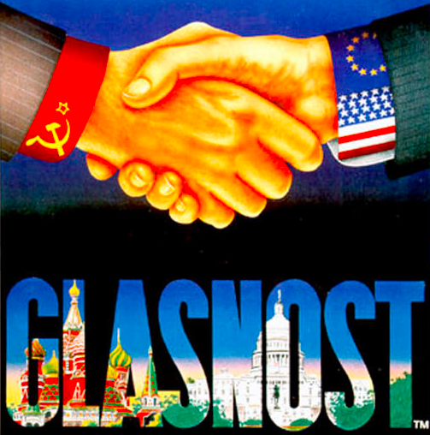
30. Soviet policy of “openness” that granted the people a voice
Glasnost

Slide 32
31. Soviet economic policy granting some privatization of farms and factories
Perestroika

Slide 33
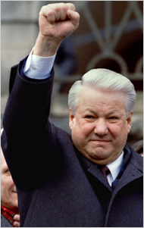
32. First elected president of Russia after the collapse of the Soviet Union
Boris Yeltsin

Slide 34
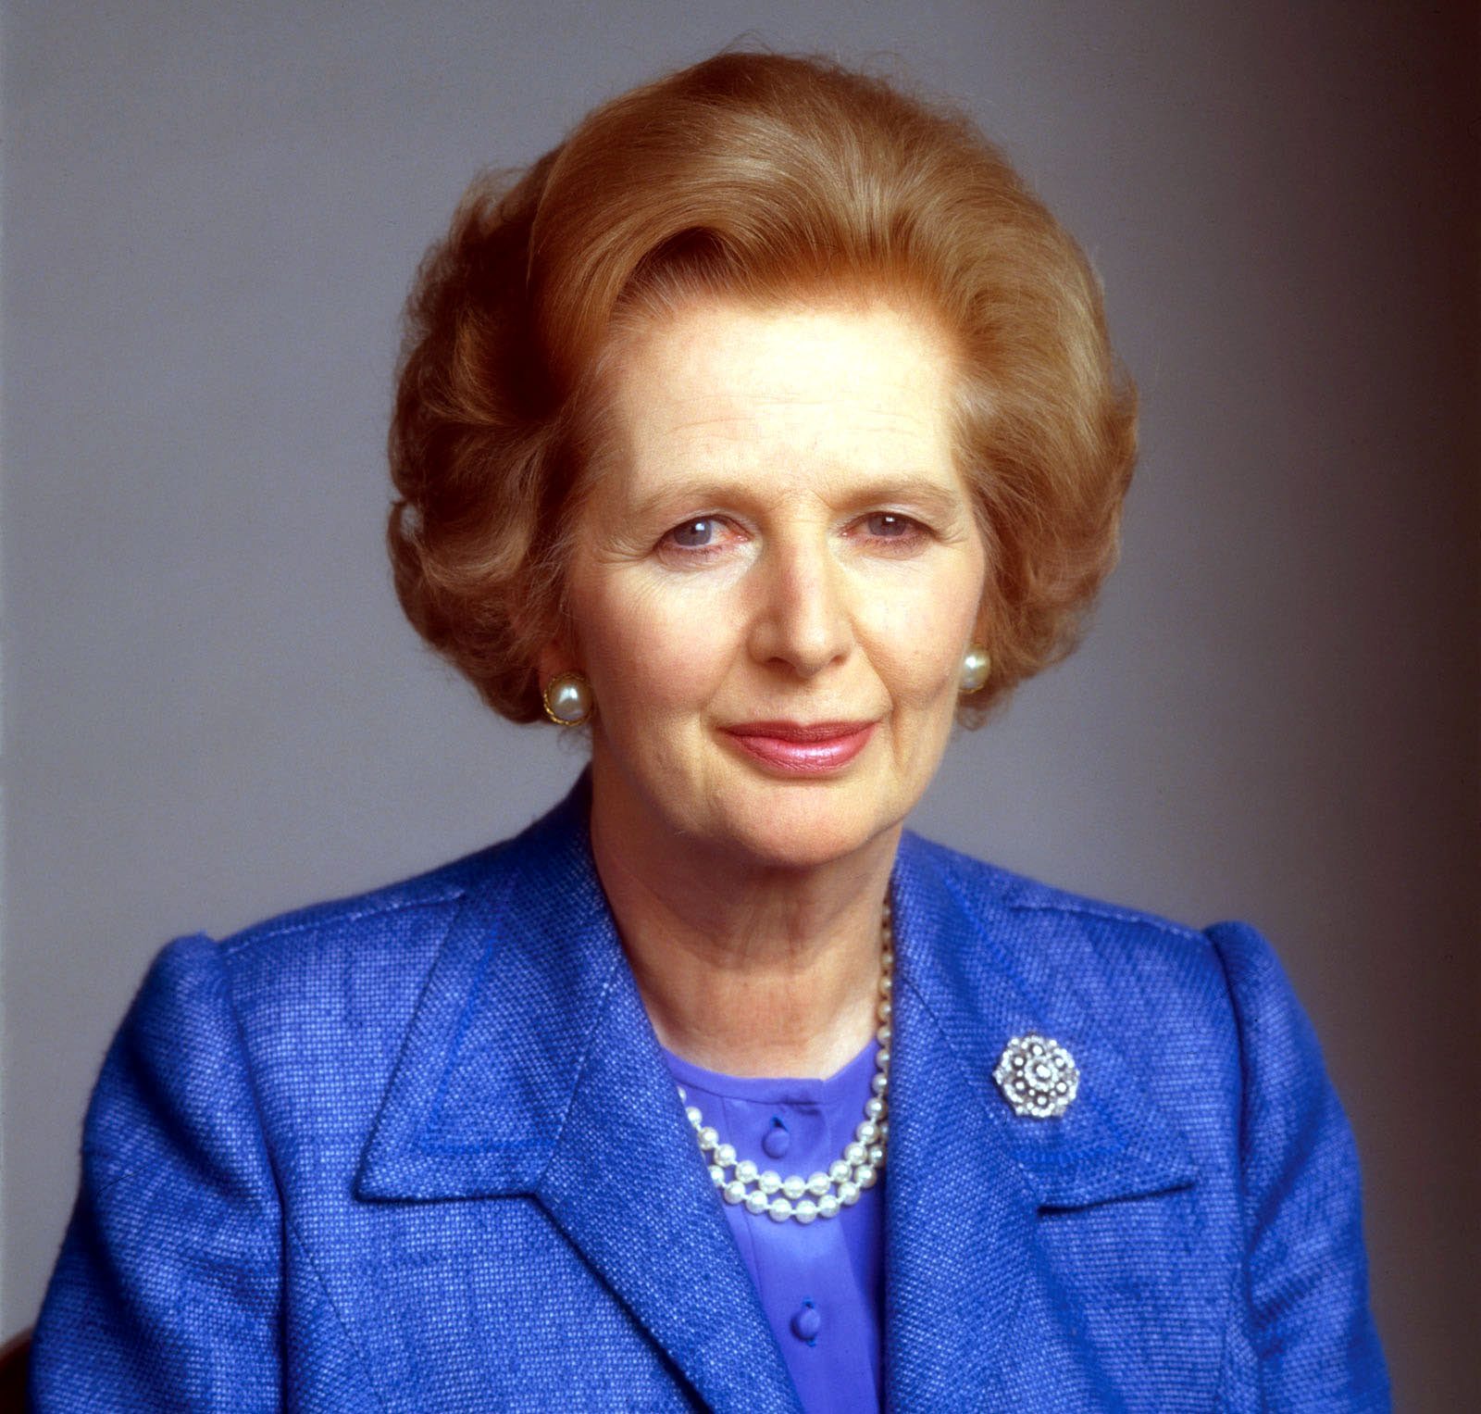
33. British Prime Minister who strengthened relations with US during the Cold War
Margaret Thatcher

Slide 35
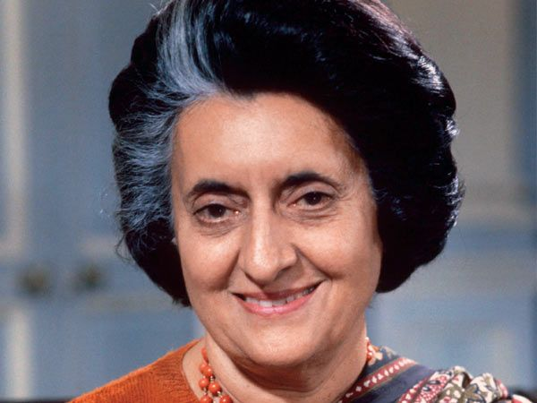
34. Prime Minister of India who secretly developed nuclear weapons
Indira Gandhi

Slide 36
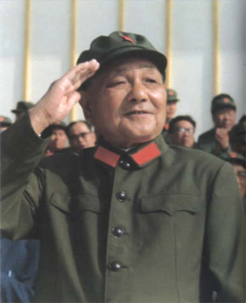
35. Took over in China after Mao’s death and reformed China’s economy
Deng Xiaoping

Slide 37
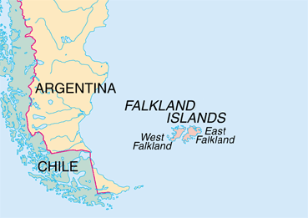
36. Great Britain had to use military force when Argentina tried to invade here
The Falkland Islands

Slide 38
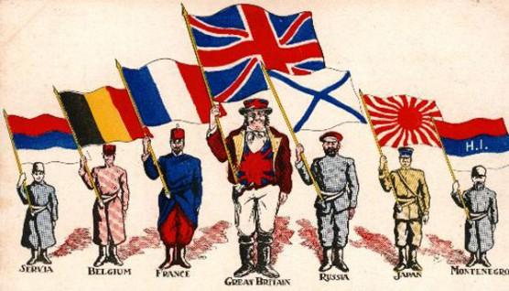
37. The SU faced a threat to their authority in the Soviet republics because of the rise of
Nationalism

Slide 39
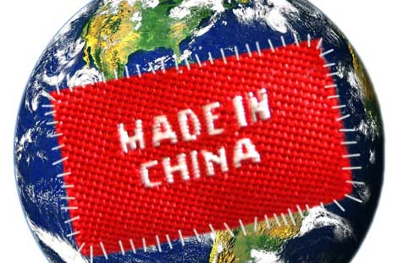
38. Both China and the Soviet Union switched to this system for their failing economies
Market Economy

Slide 40
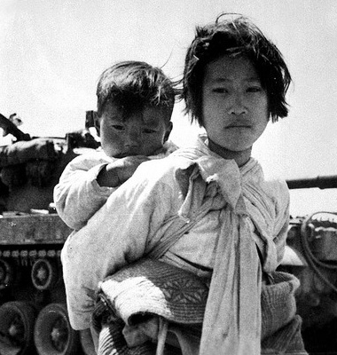
39. This war ended in a stalemate and the peninsula is still divided today
Korean War

Slide 41
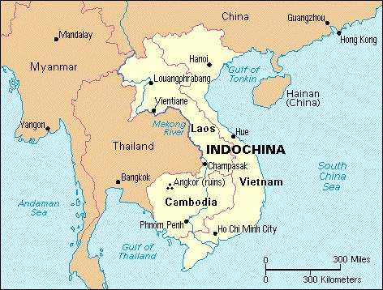
40. This is the name of the colony that eventually became the country of Vietnam
French Indochina

Slide 42
The Writing Part
Describe the 3 hot spots of the Cold War (Korea, Cuban Missile Crisis, & Vietnam) in a three paragraph essay
3 topic sentences (3 points)
3 summary sentences (3 points)
3 facts about each (9 points)

